Slide 1
PERSIDANGAN AKAUNTAN SEKTOR AWAM KALI KE-31
(NATIONAL PUBLIC SECTOR ACCOUNTANTS CONFERENCE)
Integrity . Trustworthy . Sustainability
Peranan & Tanggungjawab Akauntan Sektor Awam dalam Mencapai Matlamat Kemampanan
Sesi 2 – 2:00 pm – 3:30 pm
Navigating Public Accounting for Sustainable Future
Rasmimi Ramli
Executive Director, Sustainability, Digital Economy and Reporting
Malaysian Institute of Accountants (MIA)
MEMACU PERAKAUNAN AWAM UNTUK MASA HADAPAN YANG MAMPAN

Slide 2
Topik
Navigating Public Accounting for Sustainable Future
MEMACU PERAKAUNAN AWAM UNTUK MASA HADAPAN YANG MAMPAN
MIA Sustainability Agenda
Approach: A two-pronged approach on sustainability - the accountancy profession and the Institute.
Aims: To achieve future relevance of the profession, protect public interest and support sustainable nation building.
Target outputs: sustainability blueprint for the profession and sustainability framework and targets for the Institute.
Governance: Sustainability Blueprint Task Force oversees the development of the blueprint whilst the Management Committee on the Institute’s framework and targets.
1

Slide 3
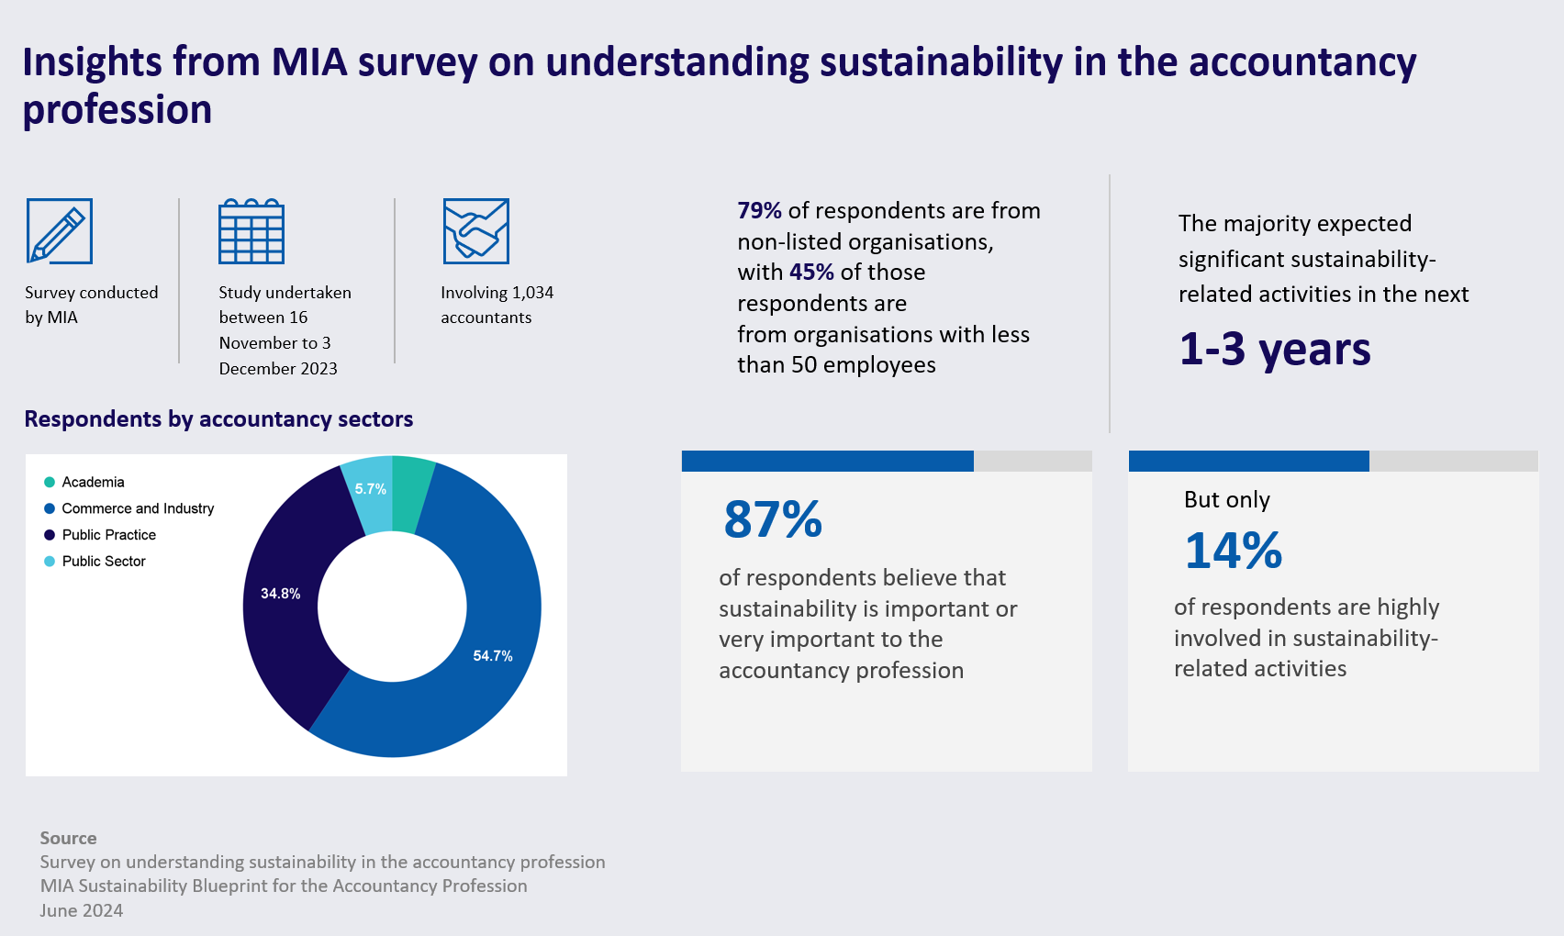
Topik
Navigating Public Accounting for Sustainable Future
MEMACU PERAKAUNAN AWAM UNTUK MASA HADAPAN YANG MAMPAN
2

Slide 4
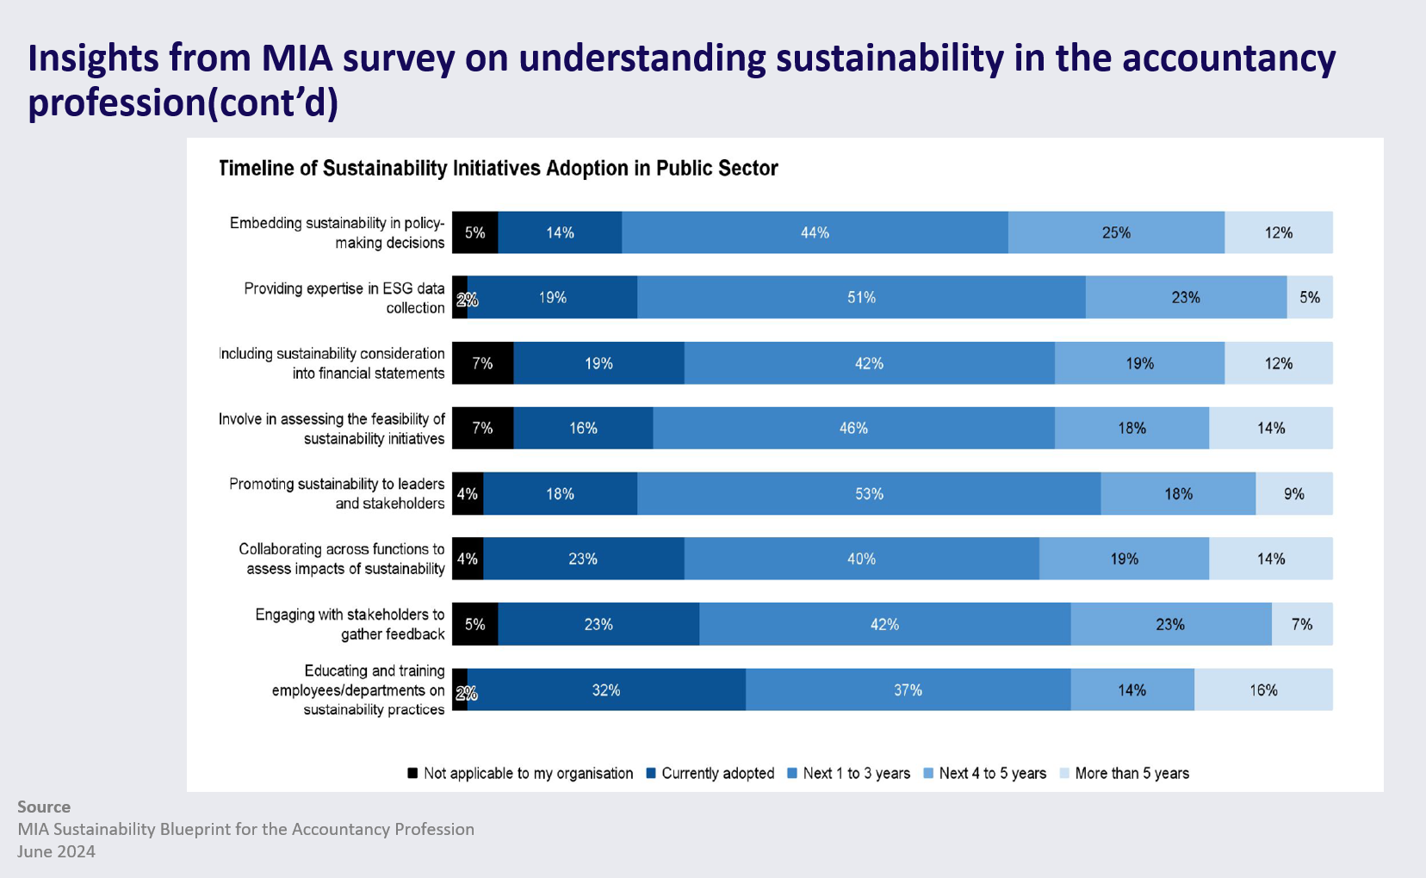
Topik
Navigating Public Accounting for Sustainable Future
MEMACU PERAKAUNAN AWAM UNTUK MASA HADAPAN YANG MAMPAN
3

Slide 5
Topik
Navigating Public Accounting for Sustainable Future
MEMACU PERAKAUNAN AWAM UNTUK MASA HADAPAN YANG MAMPAN
4

Slide 6
TERIMA KASIH

