Slide 2
Public Sector Reform and Management Accounting: What next? Siti Nabiha Abdul Khalid Graduate School of Business, Universiti Sains Malaysia nabiha@usm.my

Slide 3
OUTLINE
NPM and Management Accounting
The impact
The challenge for Public Sector Accountants

Slide 4
New Public Management
Underlying idea of NPM:
The use of managerialist principles in public sector organisation
Superiority of business like practices
Success in meeting targets (financial and others) is measured through public audits of the quality of service delivery.
Benchmarking and Ranking of organisations
Developing and Develop Countries- adopt NPM practices

Slide 5
…. The Changing Role of Public Sector Accountants…
Maintenance Administration/Bureaucratic
Scorekeeper
Book-keeping function
Managerialism Logic
Partners (Professionalism)
Integral to value creating activities

Slide 6
ROLE OF THE PUBLIC SECTOR ACCOUNTANTS
Professionalism
Part of government decision making process
Supplying of accounting/financial data,
Planning, directing and controlling financial activities
Input to decision-making

Slide 7
The central role of management accounting in NPM
Performance measurement and management (PMM), a key component of public sector management.
Focus on managerialist orientation and technical control, underpinned by a new public management philosophy of systematic planning, result-based management and merit-based performance

Slide 8
The central of management accounting
Accounting is used as the technology to push for change in the public sector…….
…………. BUT…
“Accounting - developed within and for the private sector—it is heavily imbued with its values and beliefs” …………
However,
The global crisis and austerity measures intensified the need for effective performance management in the public sector in order to ensure managing more for less.

Slide 9
Management accounting: the promise
GOOD
GOVERNANCE
Accountability &
Transparency
Performance Management System

Slide 10
The promise
Performance Management System
Efficiency
Effectiveness
Equity

Slide 11
Intensification of NPM…
Reforming/Modernization/Reenergizing the Malaysian public service?
Transforming the public service for productivity, efficiency, (11th MP)
Reduce corruption and enhance integrity

Slide 12
Impact
BENEFITS:
Hands off control
Detecting problems, failure, success
Enhance organisational learning
Increased accountability
Faster Service Delivery

Slide 13
Impact of MA practices
negative consequences or risks
such as gaming, hindering creativity and innovation and other negative impacts, specifically for public sector employees
Public organisations may have decoupled the PMS from their organisational practices

Slide 14
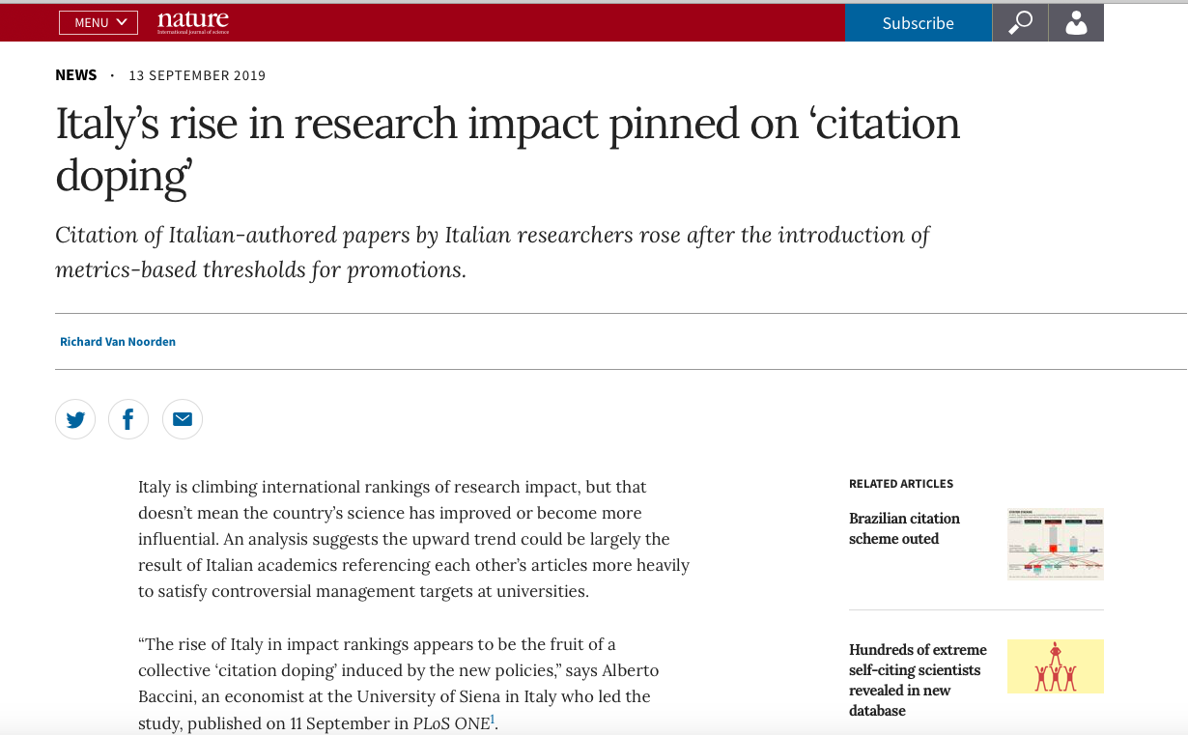

Slide 15
Impact
The implementation of PMM is generally symbolic with
a lack of interconnection of performance objectives across the different governmental levels
operational-level activities disconnected from strategic-level policies
or a lack of alignment between the rules and the institutional environment
The PMS practice is symbolically adopted, i.e. it does not produce tangible changes in the daily activities,
---------------leading to a disconnection between policy and practice……………..

Slide 16
Indonesia
Factors such as limited facilities, insufficient data and a limited number of skilled staff led to difficulties with producing performance reports and that these reports had a limited influence on planning and control
(Djamhuri (2009), Mimba et al., (2013)

Slide 17
Push for compliance
However,
Intensification of the practice, alignment between policy and practice due to external audit and ranking of public organisations
Ex: Indonesia
The changes in the last five years due to ranking and publicity on ranking results
(Djamhuri & Siti–Nabiha, 2019)

Slide 18
Impact: Malaysia
RESEARCH INSIGHTS:
Benchmarking is a Powerful Tool for Change :
What get assessed get implemented
Compliance with the measurement criteria
Service quality and duration has substantially improved.
Existence of systematic processes for planning, monitoring and review
(based on the criteria listed in the assessment instrument)
BUT
This does not necessarily translate to effectual design and use of performance management systems
(Siti-Nabiha et al., 2019, CIMA REPORT)

Slide 19
The impact
.
The design and use of performance management systems are not evaluated in a detailed manner.
Separate strategic and operational planning processes
Strategic thinking may be applied in a manner that does not fully address the needs of stakeholders.
Minimal outcome based indicators
Managerialist Accountability
(Siti-Nabiha et al., 2019, CIMA REPORT)

Slide 20
Type | Institutionalisation of operational performance management, ceremonialisation of strategic performance management
Planning | Objectives: Visions, missions and goals have both operational and strategic elements Plans, Indicators & Targets: Strategic and operational plans are not linked, indicators and targets developed separately
Monitoring & Review | Strategic: Monitoring – yearly, Operational Monitoring – monthly, Review – as needed
Use | Mainly diagnostic, top-down approach

Slide 21
What next?
The challenge in PROVISION OF INFORMATION/INSIGHTS FOR DECISION MAKING
Public sector
Mission centered
Different stakeholders/competing interest and goals?
Provide goods and services that all constituents need regardless of ability to pay for goods and services

Slide 22
The Challenge for Public Sector Accountants
How to measure/manage performance?
(iii) What is the ultimate measure of success
(iii) What information are required :
What information in existence?
What information are needed and are useful?
Will information will be used in making informed decision?
How to integrate all these information
WHAT TYPE OF INTERNAL SYSTEM/TOOLS ARE NEEDEED?
The organization plans to do → intends to accomplish

Slide 23
AI
Customer Feedback
STAR
RATING
Accrual Accounting
Strategic Plan
Cost of service
Outcome Based Budgeting
Dept
KPIs
ISO
Quality Improvement
Client Charter

Slide 24
HOW TO TIED IT ALTOGETHER?

Slide 25
And… achieve
The integration of strategic plan throughout the organizations and its sub-units
The Integration between strategic planning, resource allocation, monitoring and reward and evaluation
Citizen centric governance
Move beyond symbolic implementation
Beyond ”Achieving the targets, but missing the points”

Slide 26
The challenge
ACHIEVE THE ALIGNMENT BETWEEN POLICY, PRACTICE AND OUTCOME
BEYOND MANAGERIALIST ACCOUNTABILITY
TOWARDS NEW PUBLIC GOVERNANCE

