Slide 3
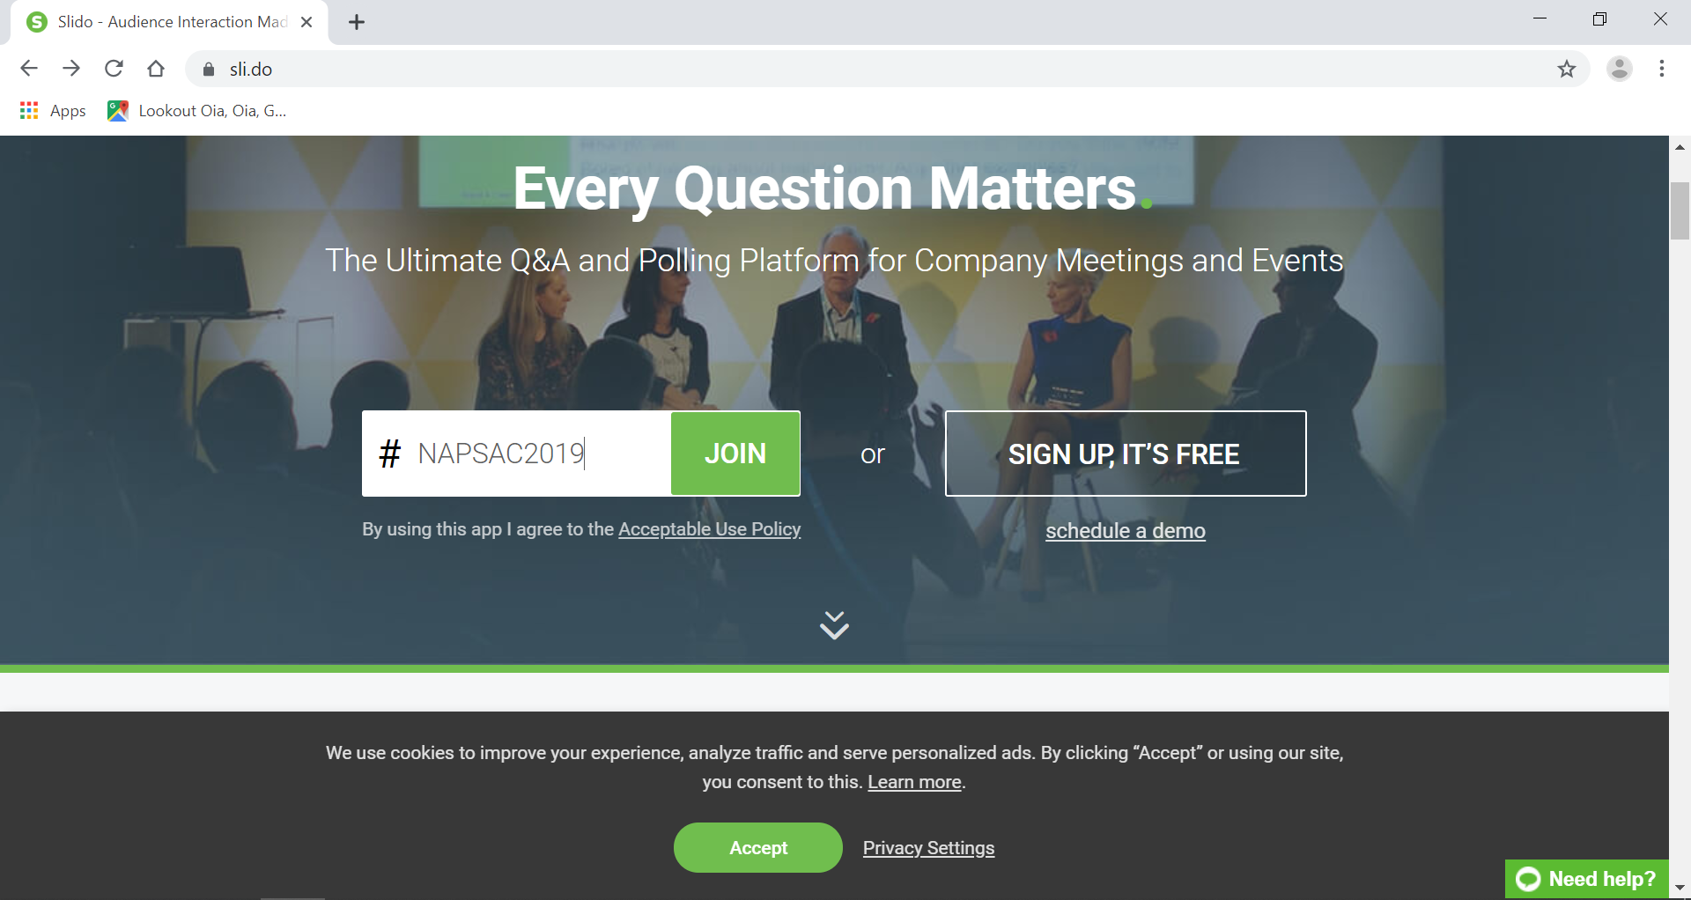
Slido

Slide 5
THE JOURNEY OF TRANSFORMATION IN ACCOUNTING SYSTEM - EXPERIENCES FROM iGFMAS Salmiah Ramli
Session: 2
18 Sept 2019

Slide 6
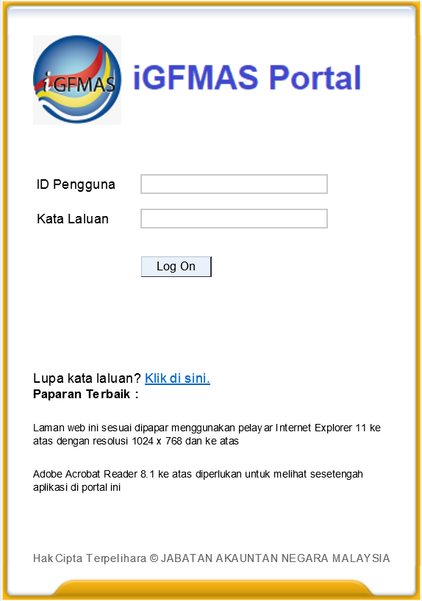
Portal iGFMAS
SINCE
01.01.2018
Today 18-9-2019
1 Year
8 Month
18 Days

Slide 7
What is iGFMAS?
Accrual Accounting System for the Federal Government of Malaysia
iGFMAS
Centralised
Upgraded
Integrated
Harmonised
integrated Government Financial And Management Accounting System

Slide 8
What is iGFMAS?
SCOPE OF iGFMAS:
300
THE PROJECT TO MANAGE
7
LEGACY SYSTEMS
REPLACED
PROJECT TEAM MEMBERS
8919
PROJECT & PROGRAM
ACTIVITIES
14
SAP MODULES
IMPLEMENTED
37
SERVERS
CONSOLIDATED
Into a single system
THE PROJECT HAS TO HANDLE OVER
1000
150+
DATA MAPPING
INTERFACES
DEVELOPED
19623
CASH <> ACCRUAL
RCs
30000
EXCEL TEMPLATES
1.3 mil
138
VALIDATED ASSETS
EXTERNAL AGENCIES
/SYSTEMS
1.4 mil
PAYROLL RECORDS
TRAINING TO HANDLE
1.25 b
1000
RECORDS TO MIGRATE
TRAINERS
FOR TTT
73000
1500
RICEFW FOR CUSTOMIZE
INTELLIGENT PORTAL
iGFMAS USERS
* RICEFW – Reports, Interfaces, Conversions, Extensions, Forms, Workflows
4

Slide 9
Why iGFMAS?
iGFMAS came about as a result of the decision to adopt Accrual Accounting for prudent fiscal management
New
Economic
Model
Four Key Measures of the Financial & Reporting Reform is to implement the following initiatives:
1
Adopt accrual accounting for prudent fiscal
management
Bureaucratic
Reforms
Fiscal
Discipline
&
Reforms
2
Strengthen expenditure control
NEM
3
Improve fiscal policy institutions & processes
Improving quality
of Human Resources
in Civil Service
4
Implement efficient broad-based tax for revenue & fiscal stability
Strengthening
National Policy
Formulation
Policy Measures For Public Sector Transformation

Slide 10
Adoption of Accrual Accounting
Empowering Ministries and Agencies to be financially accountable for their respective revenues and expenditures
Better financial management through complete view of government assets and liabilities
Adds depth to the accountability and transparency of the management of public sector resources
iGFMAS
Accrual Basis
03
01
02
GFMAS
Modified Cash Basis

Slide 11
Implementation Strategy
Setting of Accounting Policies
IPSAS Gap Analysis
Setting of Accounting Standards
(MPSAS)
Amendment of legislation and rules
Liaise with AG Chambers’ for advice
Standards &
Policies
Law &
Regulation
Change Management
Buy-in from all relevant parties
Involvement of all personnel
in the Public Sector accounting
service.
Human Capital Development
Develop accounting system
System Gap Analysis.
Fully integrated with OBB and
other relevant systems.
Human
Resources
Process &
Technology
Notes:
There were more than 1,500 RICEFW * where 557 programs were developed for 23 sub-modules consisting of 355 processes and 978 reports

Slide 12
The Journey
EOT Application
Requirement Gathering
System Development
Strategized Go Live Approach (R1 & R2)
Deferred Go Live to 2018
Expansion of scope
Go Live (R2)
Optimization
Continuous Improvement
Gap Fit Analysis
VM Lab
Procurement Process
Deferred Go Live to 2016
Requirement Gathering
System Development
2012
2014
2016-2017
2019
2010 - 2011
2013
2015
2018
Increase Project Ceiling
Appoint SI
Project Kick Off
Requirement Gathering
System Development
Project Evaluation by MAMPU
PwC as PMO Project
Deferred Go Live to 2017
Changed of PD & PMO
Expansion & additional scope of work
NEM Report
SRI Lab
iGFMAS Go Live (R1)
EOT Approved
Fine Tuning
Notes:
2015 evaluation by MAMPU –scope to reasons for delayed ( 2 projects igfmas & u customs)
The Findings:
1. Complexities of the projects – a big transformation
Original plan development 18 months (development of the system concurrent with the policy /dasar))
NZ took 5 years, Australia 6 years
UK 10 years
2. Scope under estimate by vendor - think accounting in Government differ fr private sector
initial project team 100 , SME or SAP related consultant difficult to get due to myGST implementation at the same time
SME in October but the contract starts in April 2013
Solution Architect in Dec 2014
3. Differ the Akta Perakaunan Akruan – the impact
Due to the short time line, JANM & Vendor agreed to emphasise the development to accrual but when differ to 1.1.2016 Dual Ledger need to be build
2016 – discussion to consider the application EOT by iA or to terminate the SI
3 times deferred the go live date
Ist --- 30 Nov 2014 (fr 1.1.15 to 1.1.16) impact Cash Based FS has to be tabled to the Parliament – dual ledger
Tangguh pembentangan undang berkaitan di Parliament – impact go live to 2016
Maintenance of espkb & gfmas to continue – Teliti under receivableship. Can’t continue. Lantik iA
2nd --- KSP letter 2015 ( fr 1.1.2016 – 1.1.2017) fo ensure the readiness & completeness as well as the stability (mantap) of the system

Slide 13
iGFMAS Challenges
NEW SYSTEM REQUIREMENT
Centralised Server & Database
Dual Transaction & Reporting
Adaptation Of Accrual Accounting
1
SYSTEM
IMPLEMENTATION
7
System slow performance
Change management
User familiarisation
SYSTEM DEVELOPMENT
Tight timeframe
Concurrent policy & system development
Massive and evolving new requirements
2
HUMAN RESOURCES
6
Scarce resources
Maintaining talent
PROJECT GOVERNANCE
3
Long procurement process
Multiple layer of governance
5
DOCUMENTATION
Massive system and operational documentation
NEW REGULATIONS
4
Amendment of Act, Rules
and Regulations

Slide 14
Lessons Learnt
1
Firm And Complete Business Requirements Before System Development Start
5
Feasibility Study & Findings From Operational, Policy Maker View
2
6
Establish Comprehensive SOP before system Go Live
Realistic Timeline
3
7
Identify And Maintain The Right Talent To Carry Out System Development
Minimum Customization
4
Rigorous Sharing Of Knowledge Between The Project Team
8
Enhance Coordination & Teamwork
9
Improve Communication
Notes:
Involvement of SME too late – MPSAS & Government Accounting

Slide 15
Way Forward
1
Transfer Of Technology
2
Continuous Improvements
3
Enhancing Knowledge
4
Complete Documentation
5
Leveraging System Function
6
Data Migration Transition Period
7
Implementation of BSP/ISP 2019-2023

Slide 17
Slido

