Slide 1


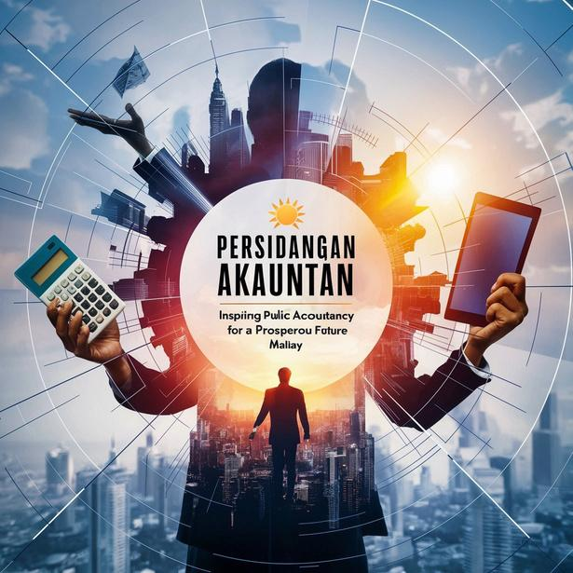
PERSIDANGAN AKAUNTAN SEKTOR AWAM KALI KE-31
(NATIONAL PUBLIC SECTOR ACCOUNTANTS CONFERENCE)
Integrity . Trustworthy . Sustainability
Sustainable Development Agenda, Governance, Implementation status and Reporting in Malaysia and Internationally
Session 1 – 9.00am - 10.00am
Navigating Public Accounting for Sustainable Future
Manon Bernier
United Nations Development Programme (UNDP)
MEMACU PERAKAUNAN AWAM UNTUK MASA HADAPAN YANG MAMPAN

Slide 2


Content
Introducing UNDP
Introduction to Sustainable Development Goals (SDG) and SDG Progress Globally/Regionally
Governance of SDGs (key goals, budgeting, and reporting)
The role of Accountants in supporting SDGs
Question & Answer session
© 2024 United Nations Development Programme | 2

Slide 3


















Introducing UNDP
© 2024 United Nations Development Programme | 16

Slide 4
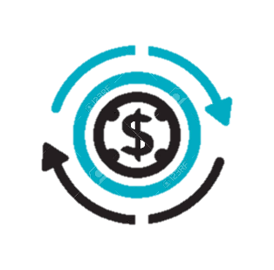
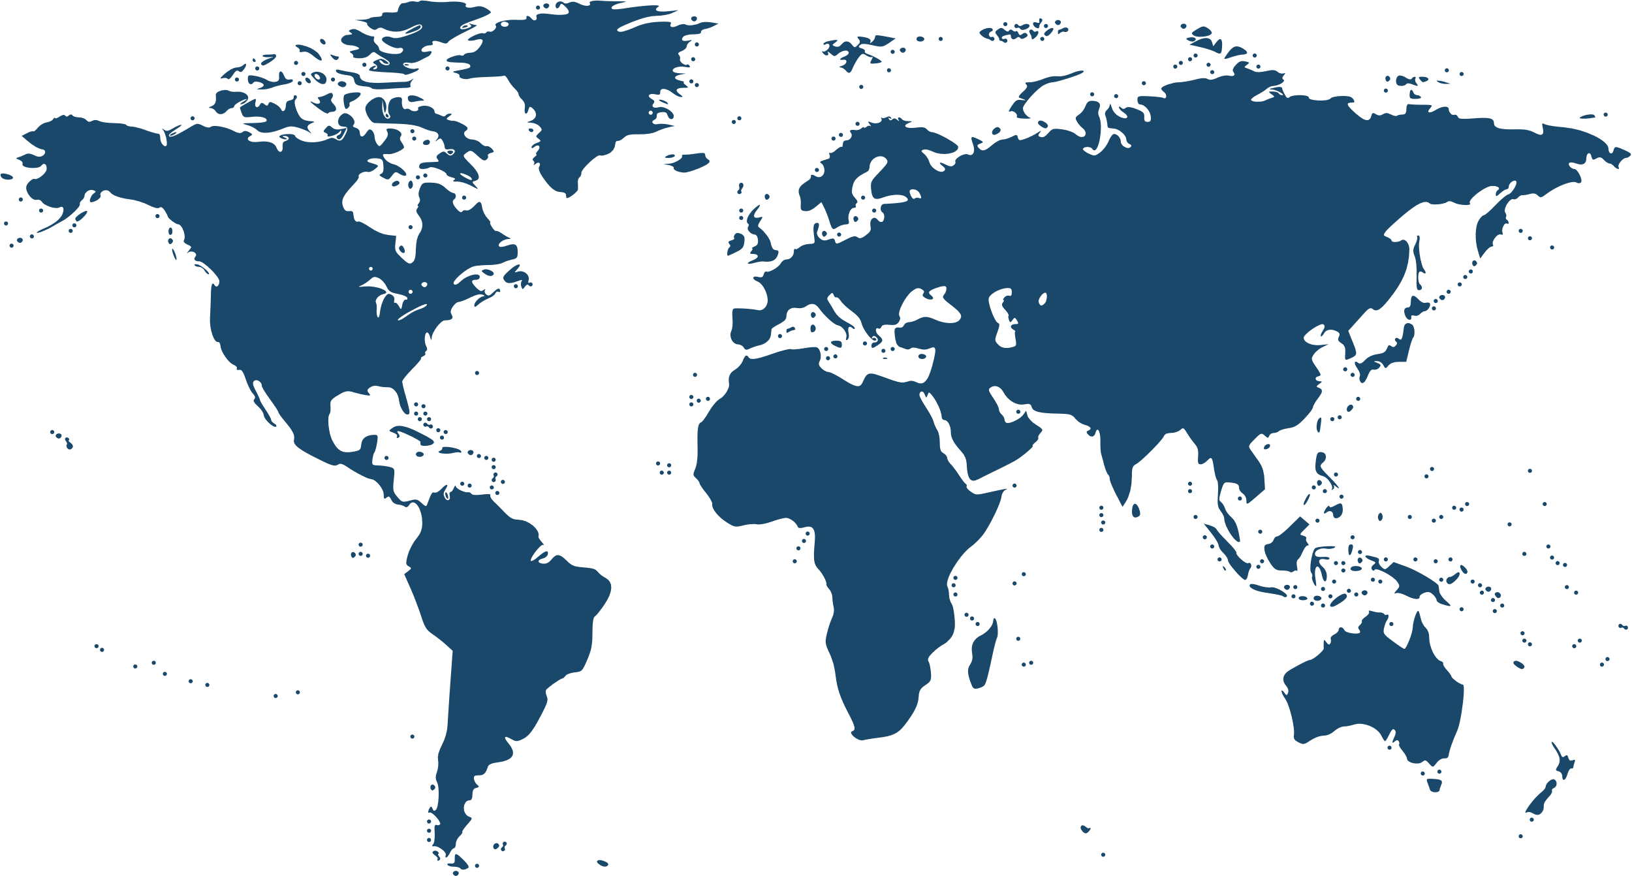

Introducing UNDP
UNDP is the United Nation's development arm that advocates for change and connects countries to knowledge, experience and resources to help people build a better life. UNDP emanated from the merging of the United Nations Expanded Programme of Technical Assistance (1949) and the United Nations Special Fund (1958). UNDP, as we know it now, was established in 1966 by the General Assembly of the United Nations.
Investing more than
$6B in development progress
> 20,000 people
On 4,685 projects
In nearly 170 countries
© 2024 United Nations Development Programme | 3

Slide 5

Our Role: UNDP as a development partner
Policy Analysis & Formulation
Technical and Advisory Services
Assessments and Evaluations
Develop/ strengthen data statistical indicators
Platforms to engage civil societies, NGOs & private sector
Institutional strengthening/ capacity building
SDG
Integrator​
© 2024 United Nations Development Programme | 14

Slide 6





UNDP Global Targets
The UNDP Strategic Plan 2022-2025 sets out the direction for a new UNDP, optimized to help countries achieve the 2030 Agenda for Sustainable Development.
UNDP Global Targets:
Helping
100 million people to escape
multidimensional poverty
Supporting
500 million people
to gain access to clean energy
Supporting
800 million people
to participate in elections, many for the first time
Promoting
over US$1 trillion
of public expenditure and private capital investment in the SDGs
© 2024 United Nations Development Programme | 4

Slide 7

UNDP in Malaysia
UNDP’s presence in Malaysia – UNDP Country Office (Putrajaya) and UNDP Global Shared Services Centre (Cyberjaya)
Thematically, the following areas have been worked on during our presence in Malaysia:
66
Environmental management & resilience to climate change
Renewable energy & energy efficiency
Biodiversity & ecosystems for livelihoods
Science & technology for development
National response to HIV/AIDS
South-South Cooperation
Inclusive growth & economic development
Poverty eradication
Gender empowerment
Good governance & anti-corruption
Public sector reform
Empowering persons with disabilities
Years of
development partnership
© 2024 United Nations Development Programme | 11

Slide 8


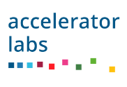
Action Areas in Malaysia
In Malaysia, we are addressing development challenges and inequalities through:
Four Action Areas:
Development Financing
Advancing Social Protection and Inclusive Growth
Addressing structural gaps on social protection; efficient poverty reduction strategies, last-mile challenges
01
Enhance Climate-Resilient and Nature Positive Systems
Green growth path on market and jobs, climate change mitigation and adaptation actions, nature conservation and local economy & livelihood
02
Digitalization
Strengthening Governance and Peace
Strengthening institutions, promoting just transitions, and supporting peacebuilding and community resilience activities
03
Accelerator Labs: Strategic Innovation
04
Catalysing SDG Impact and Financing
Building sustainable finance frameworks and mechanisms
© 2024 United Nations Development Programme | 12

Slide 9
Introduction to Sustainable Development Goals (SDG) and SDG Progress Globally/Regionally and in Malaysia

Slide 10
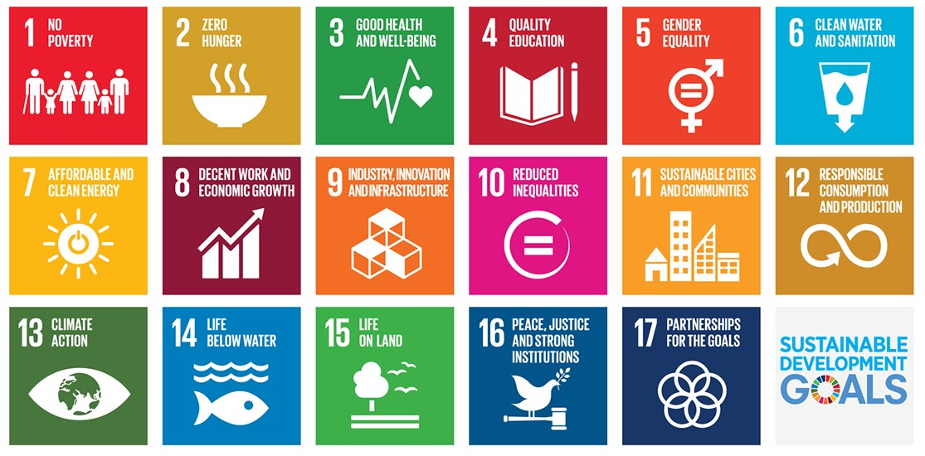
2030 Agenda & the SDGs
SDGs are a universal set of goals, targets, and indicators that UN member states are expected to use to frame their agenda and political policies over 15 years (2016 – 2030).
17 Goals, 169 Targets and more than 200 Indicators
5 dimensions - People, Planet, Prosperity, Peace and Partnership
Target deadline: 2030!
© 2024 United Nations Development Programme | 12

Slide 11
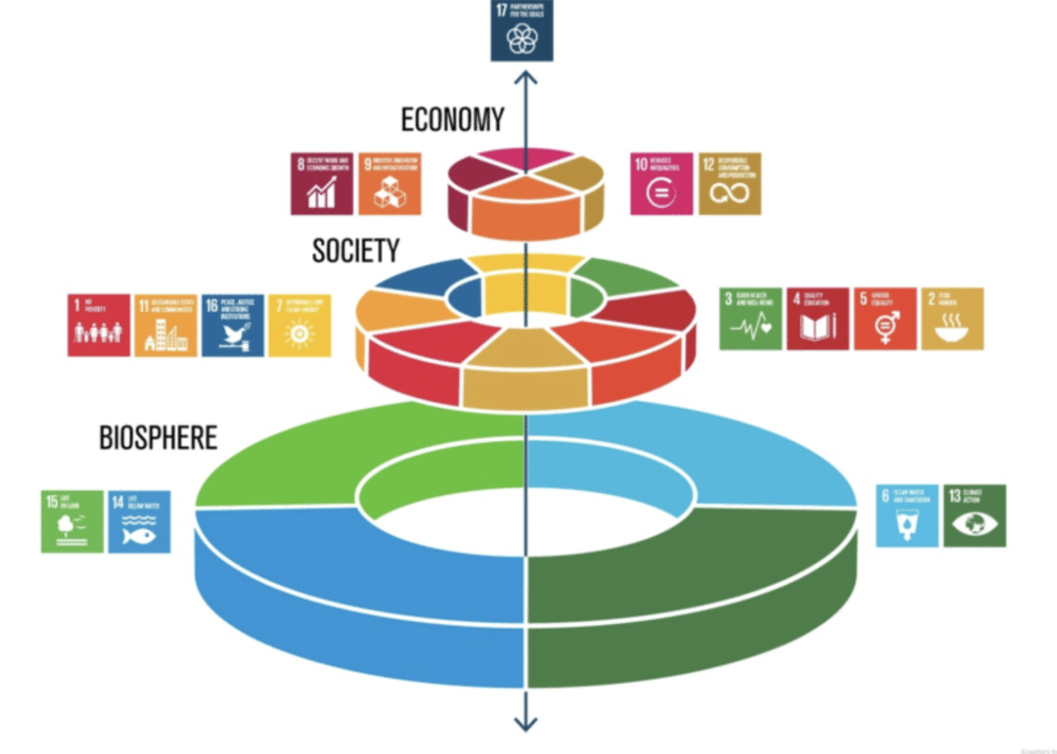
Whole of Society Approach
Achieving the 2030 agenda is a commitment requires global cooperation and a multistakeholder approach
Multi-stakeholder partnerships and platforms involving actors from government, civil society, youth, academia and the private sector are critical mechanisms for the achievement of SDGs
© 2024 United Nations Development Programme | 12

Slide 12

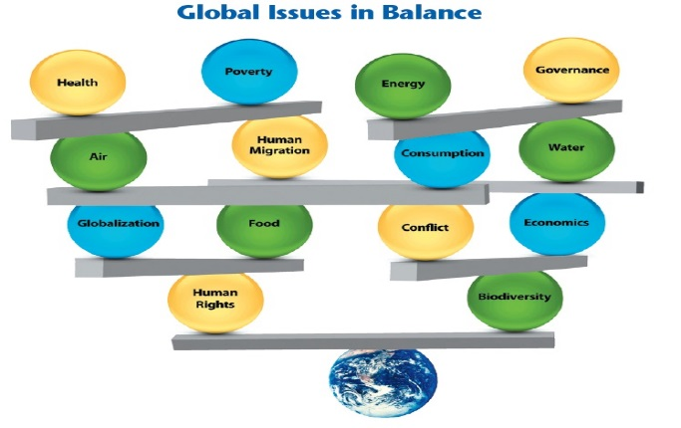


Key principles
UNIVERSALITY
INTEGRATION
‘NO ONE LEFT BEHIND’
Goals & targets are relevant to all governments & actors
Universality does not mean uniformity, need differentiation to national conditions
Balance social aims, economic growth & environmental protection
Manage trade-offs & maximize synergies
Equity centre stage SDGs should benefit all, eradicating poverty & reducing inequalities
Strong human rights basis
© 2024 United Nations Development Programme | 12

Slide 13
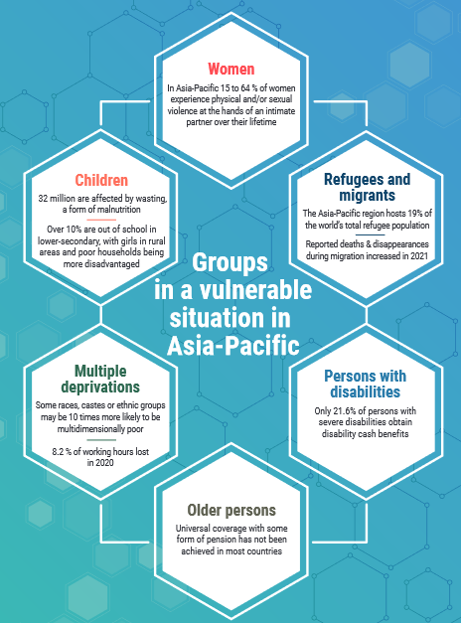
No One Left Behind
In areas of progress, inequality in key opportunities and in the experience of barriers are found in groups with distinct socioeconomic characteristics.
Those furthest behind, including women, rural populations and poorer households, generally face more exclusion and vulnerability.
Living in a household in the bottom 40 per cent of the
wealth distribution (B40) is strongly associated with multiple forms of vulnerabilities (poverty intersects with other factors i.e. rural area, climate, gender, age, disability etc.)
(Source: Asia and the Pacific SDG Progress reports 2022, UNESCAP)
© 2024 United Nations Development Programme | 12

Slide 14
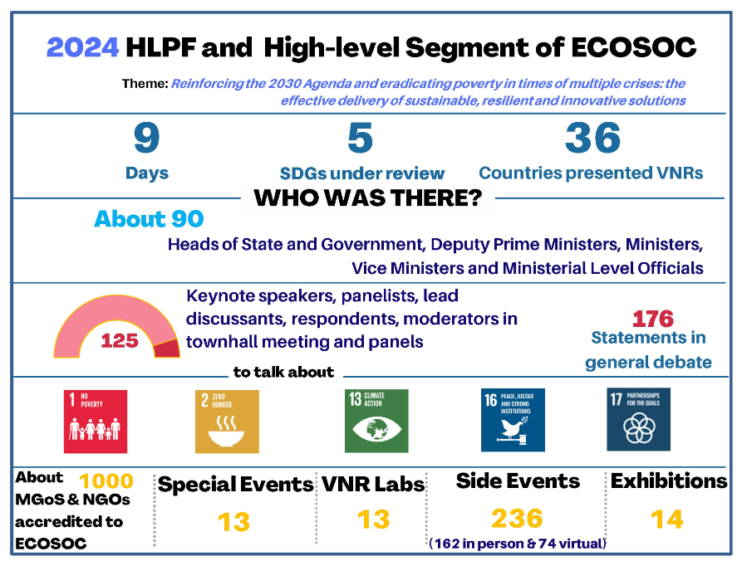
International: High-Level Political Forum
The HLPF is the central United Nations platform for the follow-up and review of the 2030 Agenda for Sustainable Development and the Sustainable Development Goals (SDGs) at the global level. It is the apex of the architecture for follow-up and review of the 2030 Agenda established by 2030 Agenda and General Assembly resolution 70/299.
The United Nations Conference on Sustainable Development (Rio+20), through its outcome on "The Future We Want", established the United Nations High-level Political Forum on Sustainable Development (HLPF) in 2012.
© 2024 United Nations Development Programme | 14

Slide 15
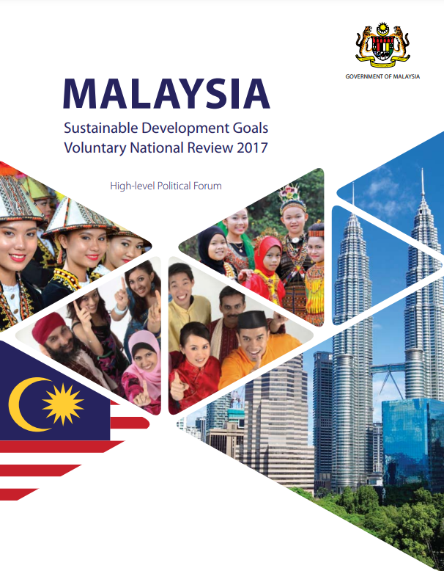
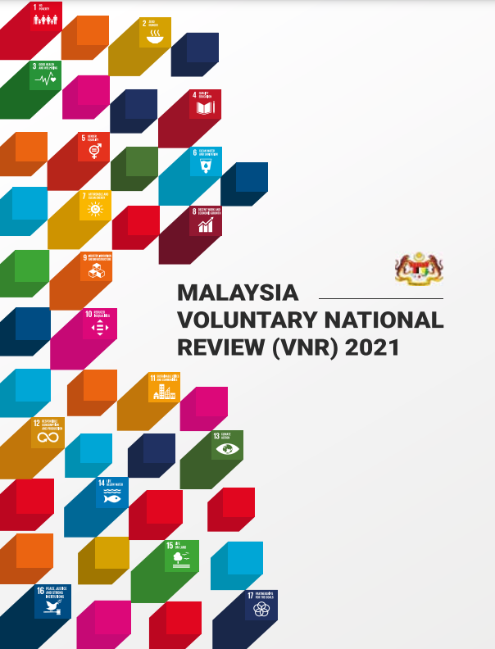
National: Voluntary National Reviews & Local Reviews
Malaysia is committed to presenting a Voluntary National Review (VNR) report every four years, with the next edition scheduled for release in 2025. (VNRs submitted to HLPF in 2017 & 2021)
The Ministry of Economy is responsible for collating inputs from various stakeholders in preparing the report. While DOSM coordinates the collection and compilation of data and utilises the SDG Dashboard
In addition, the National SDG Council has mandated that at least one district or city in each state must produce a Voluntary Local Reviews (VLR) report. - Bandar Pulau Pinang (Penang Island), Kuala Lumpur, Subang Jaya, Shah Alam, Sepang, Alor Gajah and Bandar Melaka.
Selangor is the first state to prepare the Voluntary Subnational Reviews (VSR).
© 2024 United Nations Development Programme | 14

Slide 16
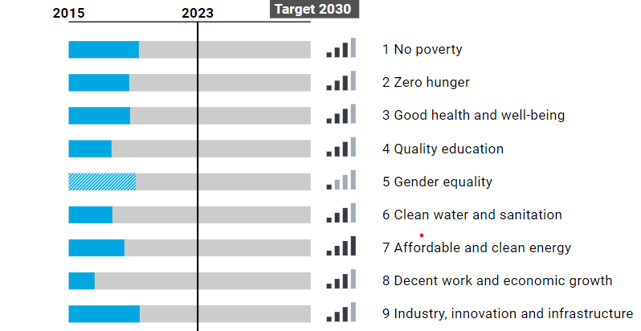
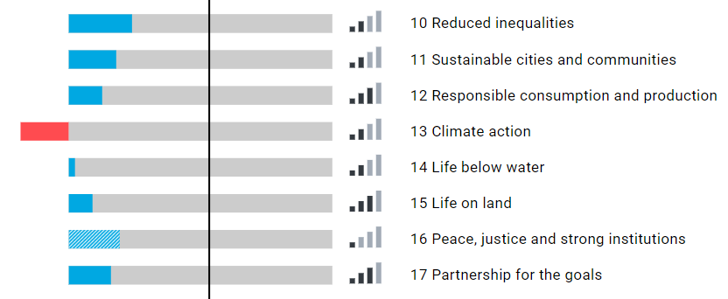
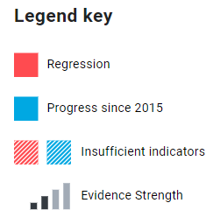
Snapshot of SDG Progress in the Asia Pacific region (2024)
Source: UN ESCAP (2024)
© 2024 United Nations Development Programme | 14

Slide 17
Progress insights and the need for action
Questions: How did we get here? How do we get back on track?
Pandemic was a major driver, but also imbalanced recovery, geopolitics (Ukraine, Middle East), & global inflation spike
But SDGs already off-track pre-Covid. Progress not universal & not sufficient, launch of the “Decade of Action”
Climate change ever more existential, Paris Agreement's +1.5 Cº target in doubt
Secretary General: 2023, Need to rescue the goals; 2024, SDGs hanging by a thread
Bold action needed, youth & future generations are major considerations
© 2024 United Nations Development Programme | 14

Slide 18
Six transitions to turbocharge the SDGs (2023)
Leveraging smart technologies in food systems & promoting circular agriculture
Clean energy technology investment & transfer, unlocking energy efficiency, access & affordability
Deliver inclusion via digital connectivity, as an opportunity for economic leapfrogging
Ensuring education for all & enhancing digital education and skills
Jobs & social protection: eradicate poverty, break the cycle of informal employment & low pay
Decarbonize industry & promote sustainable consumption & production to mitigate the triple crisis of climate change, biodiversity loss, & pollution
© 2024 United Nations Development Programme | 14

Slide 19
Governance of SDGs (key goals, budgeting, and reporting)

Slide 20

Implementing the SDGs at the national level
Enabling Policy and Institutional Environment
Data Ecosystems
Stakeholder Engagement
Financing
Innovation
SDGs
© 2024 United Nations Development Programme | 14

Slide 21


Malaysia’s Commitment to SDG
Malaysia is committed to SDG by promoting sustainable development and enhancing international collaboration while addressing national challenges. SDG are implemented in three phases, with each phase lasting five years between 2016 and 2030. Phases I and II coincide with the Eleventh Malaysia Plan (11MP) and the Twelfth Malaysia Plan (12MP), respectively, while Phase III will correspond with the Thirteenth Malaysia Plan (13MP; 2026-2030). This phased approach provides flexibility to adapt and refocus strategies to achieve the desired outcomes for a sustainable future.
MADANI and SDG
SDG are in harmony with the MADANI policy framework on building a Sustainable and Prosperous Malaysia based on Care, Compassion, Respect, Innovation and Trust, where inclusiveness and equality are embraced by the whole nation.
While SDG integrate the social, economic and environmental dimensions of development, MADANI pursues the complementary human-centric values which are needed to promote individual and collective action in addressing the challenges of sustainable development. Ultimately, a balanced inner development of the self and external development of Malaysia provides a stronger framework for SDG achievements
© 2024 United Nations Development Programme | 14

Slide 22
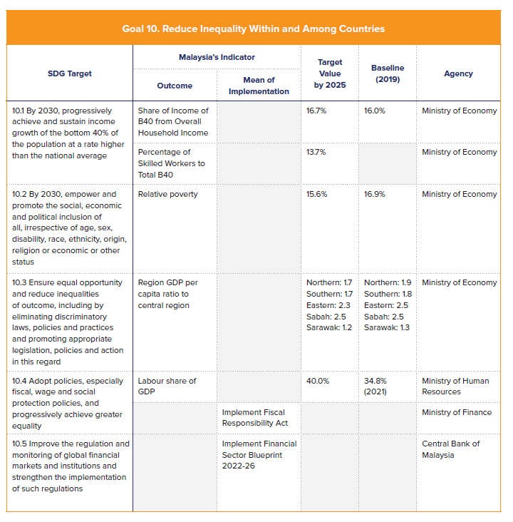
Implementing SDGs in Malaysia
  Formulation of SDG Roadmap
  The SDG Roadmaps follow 5-year Malaysia Plan: 11MP (SDG Roadmap Phase I), 12MP (SDG Roadmap Phase II), 13MP (SDG Roadmap Phase III)
  Purpose of the Roadmaps:
    Localising SDGs at sub-national levels by replicating the national multi-stakeholder governance structure at state levels
    Mobilising resources and funding through partnerships with stakeholders including, crowdsourcing, social entrepreneurship and Corporate Social Responsibility programmes besides public sector funding under 11MP; and
    Strengthening data readiness and filling data gaps to develop a comprehensive dataset for SDG implementation
© 2024 United Nations Development Programme | 14

Slide 23
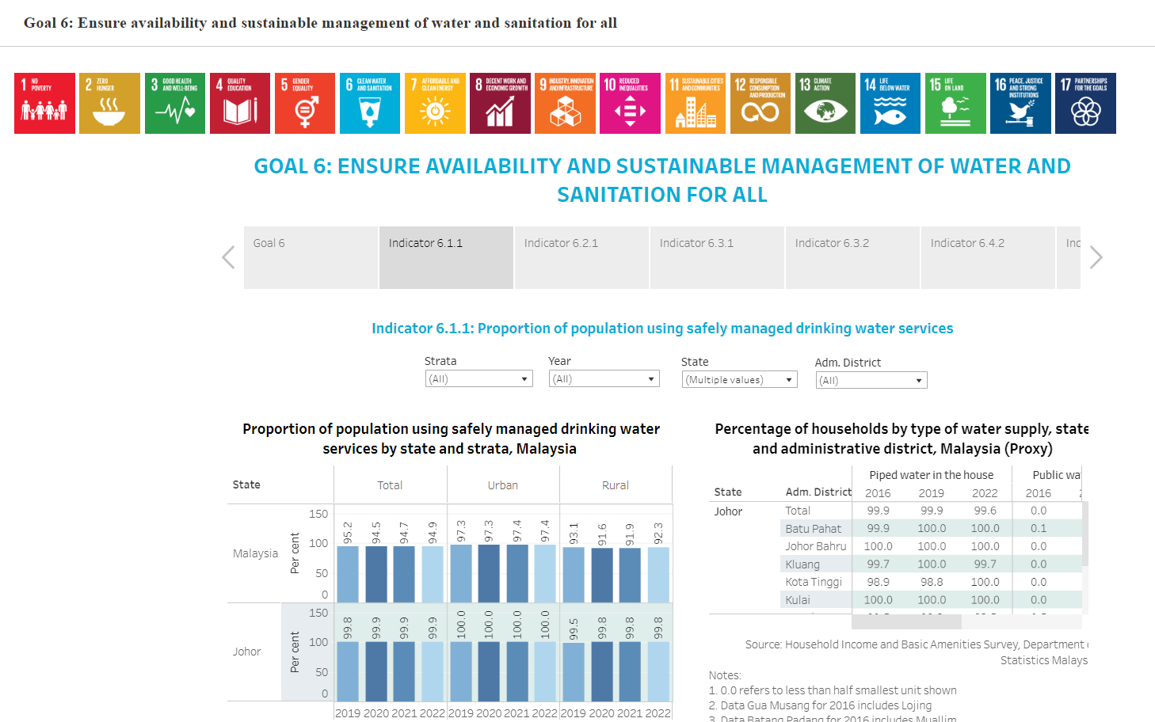
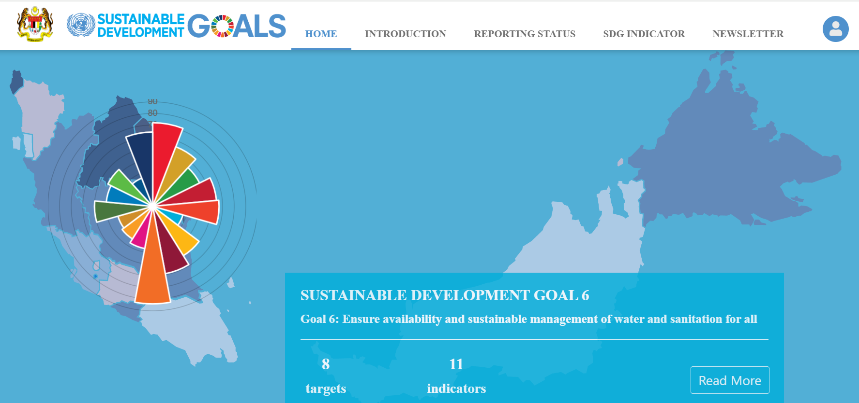
Implementing SDGs in Malaysia
  National SDG Progress Monitoring System (SDG Dashboard)
© 2024 United Nations Development Programme | 14

Slide 24
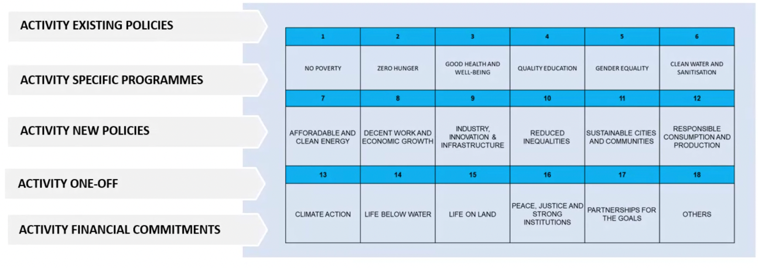
Implementing SDGs in Malaysia
  SDG Budgeting
In the Outcome Based Budgeting (OBB) process, the MyResults platform is a key budgeting management information system, directly linked to the Integrated Government Financial Management Accounting System (iGFMAS) under the Accountant General’s Department and the Project Monitoring System II (SPP II) under the Implementation Coordination Unit of the Prime Minister’s Department.
Under the current set-up, in the MyResults, each activity or project can be mapped to a minimum of 1 and a maximum of 3 SDGs. As a result, it is possible for all activities and projects to be mapped and reported against the SDGs
All Activities are Mapped to the SDGs
Total SDG Spending (2021)
Source: Ministry of Finance Treasury Department
© 2024 United Nations Development Programme | 14

Slide 25
The role of Accountants in supporting SDGs

Slide 26
The value that accountants can deliver in achieving the SDGs
Agenda setting
Policy formulation
Decision making
Implemen-tation
Evaluation/audit/ reporting
Raising awareness of sustainability matters, especially within the profession
Review achievements for transparency and accountability
Develop methodology to understand opportunities and risks
Support in the change of implementation models
Create framework for reporting, financial accounting techniques
Everyone can play a role in achieving the SDGs
© 2024 United Nations Development Programme | 14

Slide 27
Question & Answer session

Slide 28

Thank you
For enquiries, contact:
Manon Bernier, Deputy Resident Representative, UNDP Malaysia, Singapore & Brunei Darussalam (manon.bernier@undp.org)
Adam Phillion, Chief, Financial Performance Management and Reporting, UNDP Global Shared Services Centre (adam.phillion@undp.org)

