Slide 1
PERSIDANGAN AKAUNTAN SEKTOR AWAM KALI KE-31
(NATIONAL PUBLIC SECTOR ACCOUNTANTS CONFERENCE)
Integrity . Trustworthy . Sustainability
Peranan & Tanggungjawab Akauntan Sektor Awam dalam Mencapai Matlamat Kemampanan
Sesi 2 - 2.00pm - 3.30pm
Navigating Public Accounting for Sustainable Future
DR. AHMAD SHUKRI BIN ABDUL GANI
INSTITUT PERAKAUNAN NEGARA
JABATAN AKAUNTAN NEGARA MALAYSIA
MEMACU PERAKAUNAN AWAM UNTUK MASA HADAPAN YANG MAMPAN

Slide 2
PERANAN & TANGGUNGJAWAB AKAUNTAN SEKTOR AWAM
INTRODUCTION
Navigating Public Accounting for Sustainable Future
MEMACU PERAKAUNAN AWAM UNTUK MASA HADAPAN YANG MAMPAN
THE PUBLIC SECTOR NEEDS TO BE OUT IN FRONT IN THE JOURNEY TOWARD SUSTAINABILITY REPORTING
WHY THE PUBLIC SECTOR MUST TAKE THE LEAD IN SUSTAINABILITY REPORTING?
5
VAST ASSETS & RESOURCES CONTROLLED BY GOVERNMENTS
POLICY & REGULATORY SOLUTION
YEARS
TO GO
PHYSICAL
INFRASTRUCTURE
WATER
NON-RENEWABLE RESOURCES
AGENDA
2030
NATURAL
ASSETS
RARE EARTH ELEMENTS
2

Slide 3
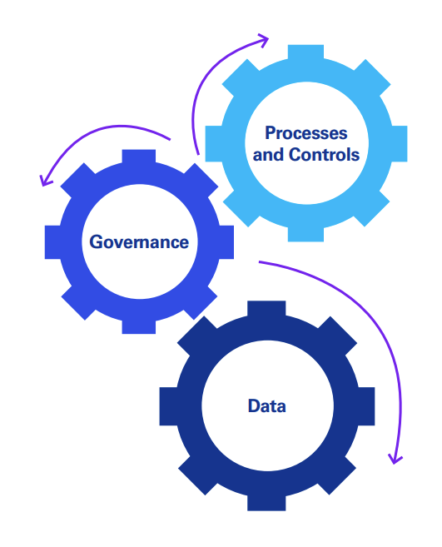
PERANAN & TANGGUNGJAWAB AKAUNTAN SEKTOR AWAM
INTRODUCTION
Navigating Public Accounting for Sustainable Future
MEMACU PERAKAUNAN AWAM UNTUK MASA HADAPAN YANG MAMPAN
CRITICAL SUCCESS FACTORS
ISSUES AND CHALLENGES
DEVELOP NEW PROCESSES AND CONTROLS THAT INTERFACE IN EXISTING SYSTEMS & DATA SOURCES
LACK OF ON THE IMPACT OF AND NEED FOR THE ADOPTION OF ESG PRACTICES.
DIFFICULTY IN UNDERSTANDING, QUANTIFYING, AND MANAGING ESG RISKS.
ADOPTING ESG PRACTICES CAN BE COSTLY.
ESG PRACTICES CAN BE COMPLEX AND TIME-CONSUMING TO IMPLEMENT.
LACK OF EXPERTISE AND RESOURCES TO ADOPT ESG PRACTICES.
RESISTANCE FROM STAKEHOLDERS.
LIMITED DEMAND FOR ESG PRODUCTS AND SERVICES IN MALAYSIA.
COMPETING REPORTING STANDARDS AND FRAMEWORKS.
QUICK CHANGING INTERNATIONAL STANDARDS.
THE RELIABILITY & AVAILABILITY OF COMPREHENSIVE DATA
EFFECTIVE GOVERNANCE MODELS
3

Slide 4
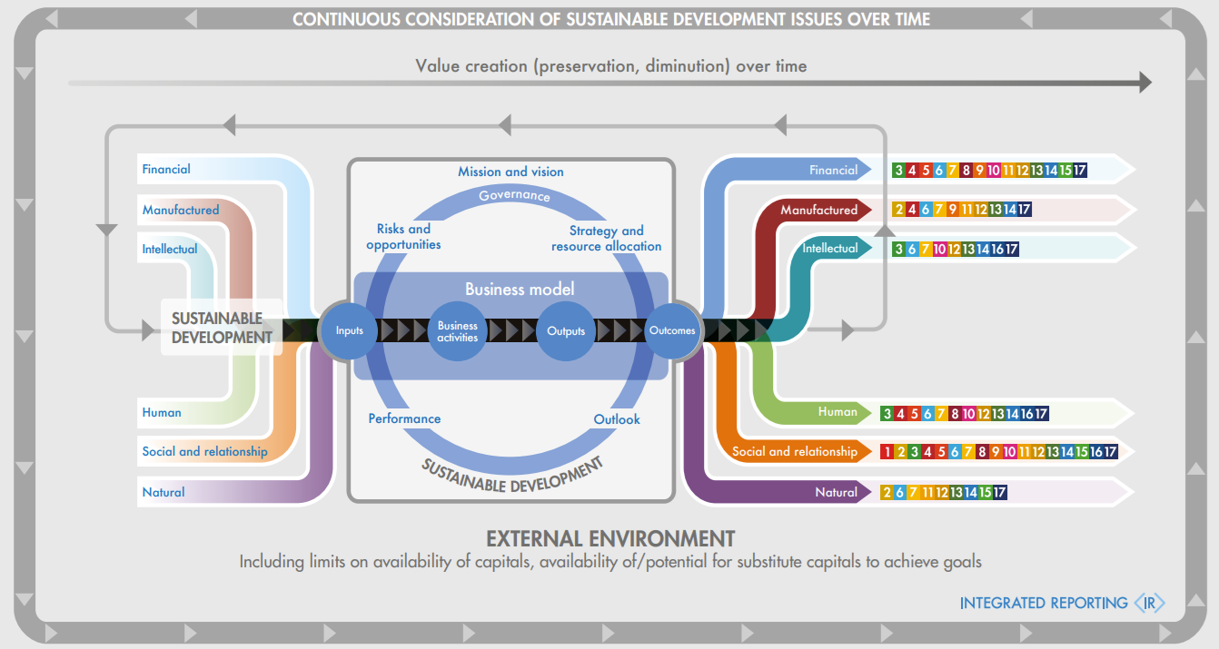
PERANAN & TANGGUNGJAWAB AKAUNTAN SEKTOR AWAM
INTRODUCTION
Navigating Public Accounting for Sustainable Future
MEMACU PERAKAUNAN AWAM UNTUK MASA HADAPAN YANG MAMPAN
MANAGEMENT ACCOUNTING
ALIGNING THE SDGS WITH THE VALUE CREATION PROCESS
CREATION OF VALUE THROUGH EFFECTIVE RESOURCES USE
4

Slide 5
TERIMA KASIH

