Slide 1
Leveraging on Digital Economy in Government Services Rozaini Mohd Sani, Council Member, MICPA
Session: 3

Slide 2
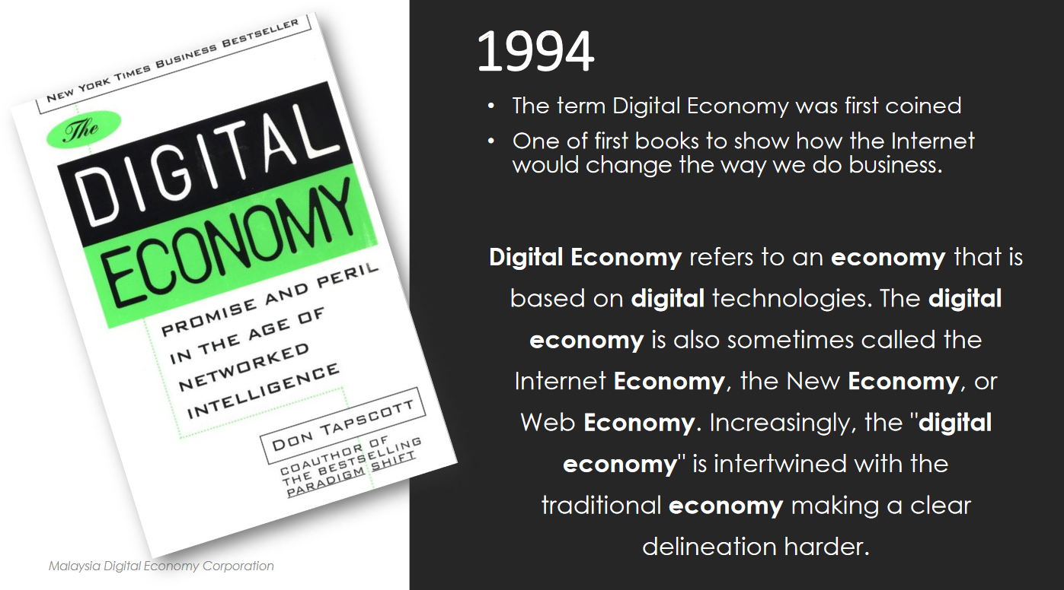
What is Digital Economy?
Defines it as..
Action by both public and private sector
Adopt and utilise digital technologies
Communicate with people
Deliver goods and services
Raise productivity, revenue and income

Slide 3
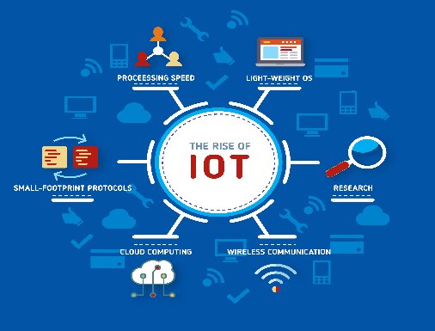
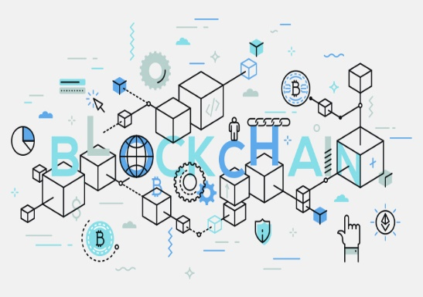
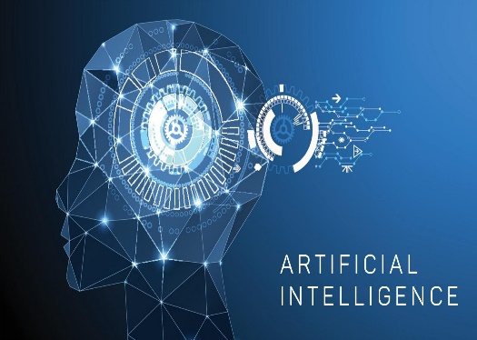
Adopt and utilise digital technologies…
Technology - IOT, Blockchain, AI & Cloud Computing are “tools” to serve a purpose
Adoption - Requires culture change
Utilisation – Requires clear understanding of purpose

Slide 4
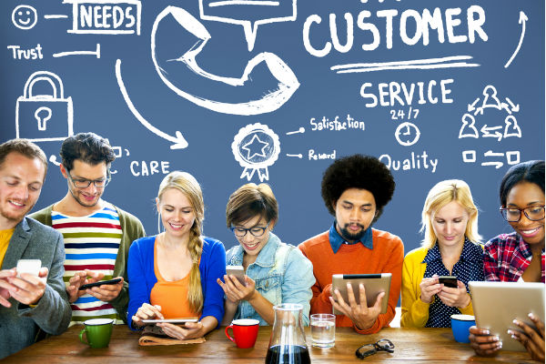
…to serve customers

Slide 5
Use of mobile phones is a lifestyle

Slide 6
On average, Malaysians use mobile phones and social media more than others in the world

Slide 7
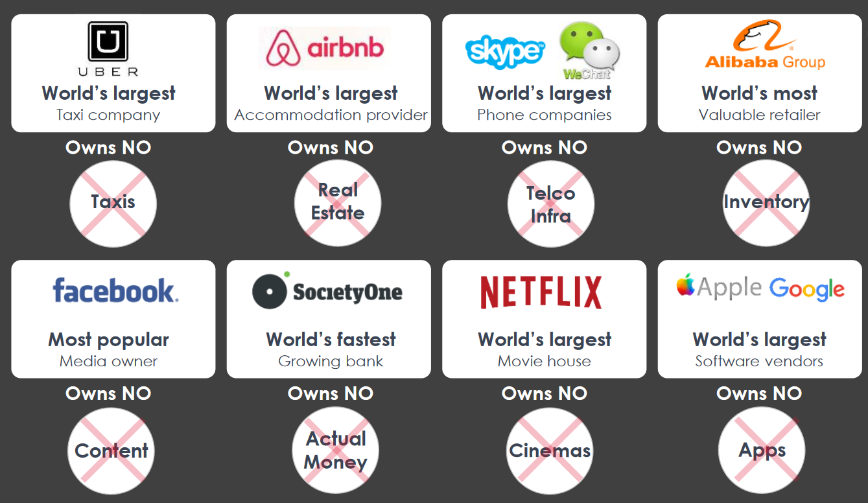
Largest solutions own no physical assets - Their biggest assets are their CUSTOMERS

Slide 8
Consumer preferences are rapidly shaping the digital economy

Slide 9
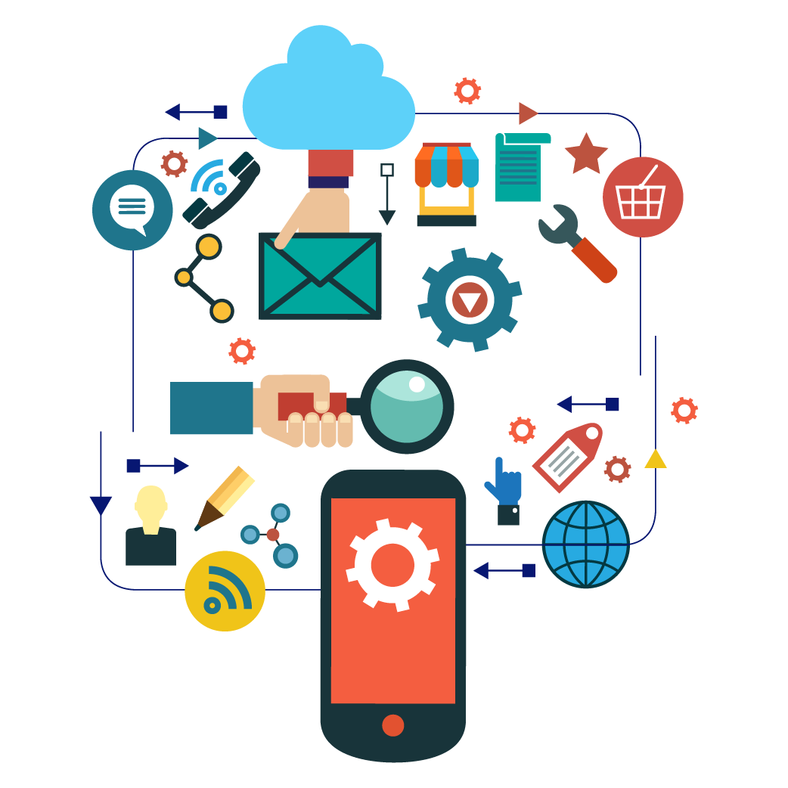
Customer centricity is key in digitalisation
Customers are indifferent of the technologies used
Personalised services
Fast and on-the-move solutions
Quick access to information
Secured and trustworthy solutions
Customer centric mindset and process must be put in place in digitalising government services

Slide 10
Endless possibilities exist from leveraging on the digital economy
IOT
Traffic Management
Blockchain
National Identification
Crisis & Disaster Management
Licensing, Certificates, Registration
National Border Security
Cashless transactions
Big Data
Citizen Feedback and Satisfaction
Artificial Intelligence
Economic and Financial Review
Real time Demographics
Research and Development
Automated Auditing and Enforcement
Policy Making
Happiness Index
Savings in Government Expenditure
Stronger Governance
Ease of Doing Business
Effective Policy Making

Slide 11
Endless possibilities exist from leveraging on the digital economy

Slide 12
Endless possibilities exist from leveraging on the digital economy

Slide 13
Endless possibilities exist from leveraging on the digital economy

Slide 14
Endless possibilities exist from leveraging on the digital economy

Slide 15
However, digitalisation should never be SILO. Make it an ecosystem

Slide 16
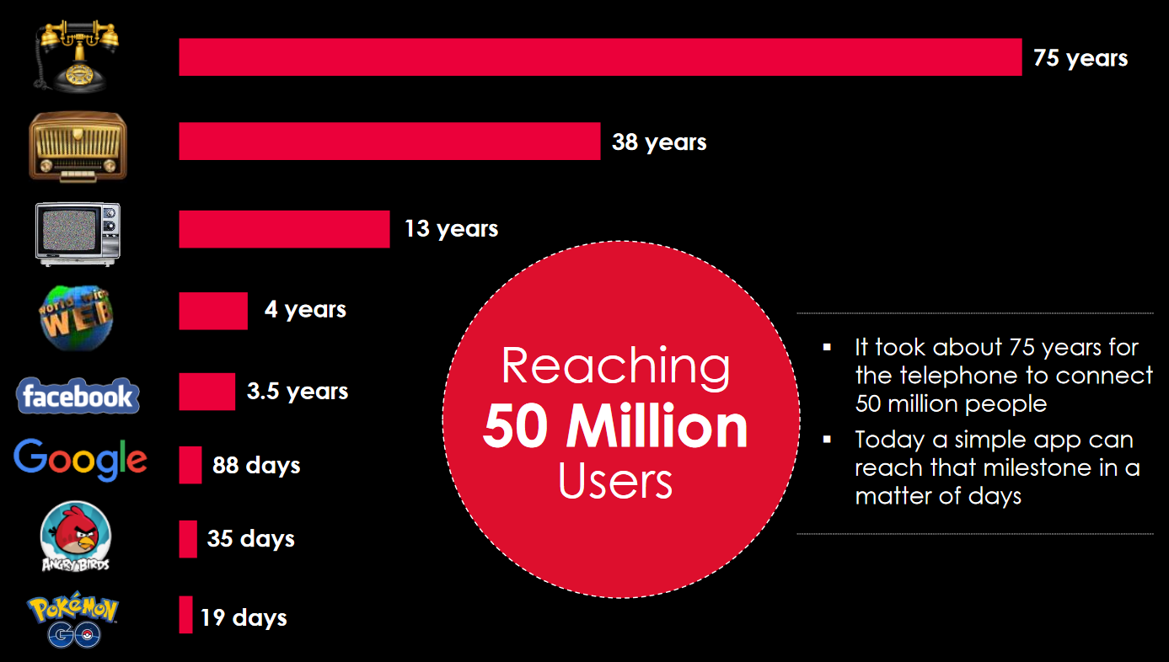
Developing mobile applications is NOT the solution
Danger of developing mobile applications based on SILO “departmental” views
Confused customers faced with “application overload”
Positive / negative experience brings quick widespread impact on satisfaction & perception

Slide 17
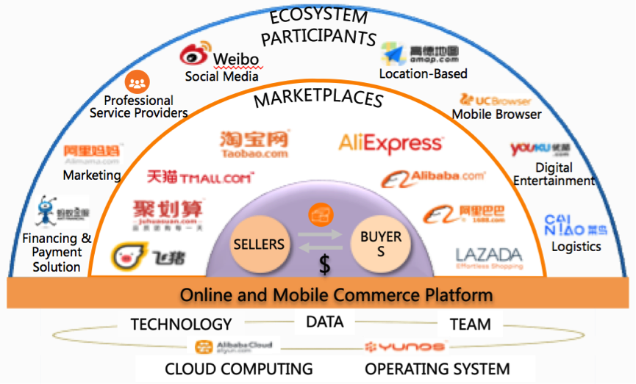
Learning from one of the largest profitable ecosystem in the world
“Customers first, Employees second, Shareholders third” – Jack Ma
Mission is to make it easy to do business anywhere
Inclusive - Customers, Merchants and Participants conduct e-commerce in its ecosystem
Technology, payment system, logistics and cloud are the “tools” supporting the ecosystem
Main objective is to satisfy customers

Slide 18
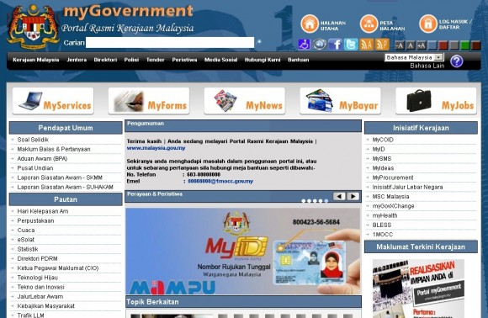
The portal myGovernment is our window to various online government services and information..

Slide 19
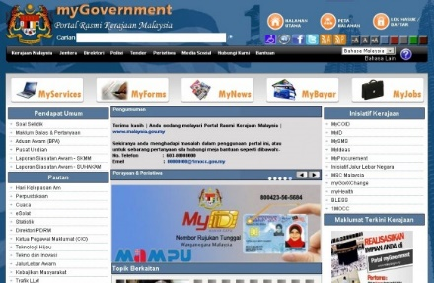
..which has started an e-government service ecosystem
Centralised vs decentralized
“No one size fits all” – Customer first
Project governance
Strong CIOs community
Private & public sector collaboration

Slide 20
Objectively, how do we fare against other digital governments..

Slide 21
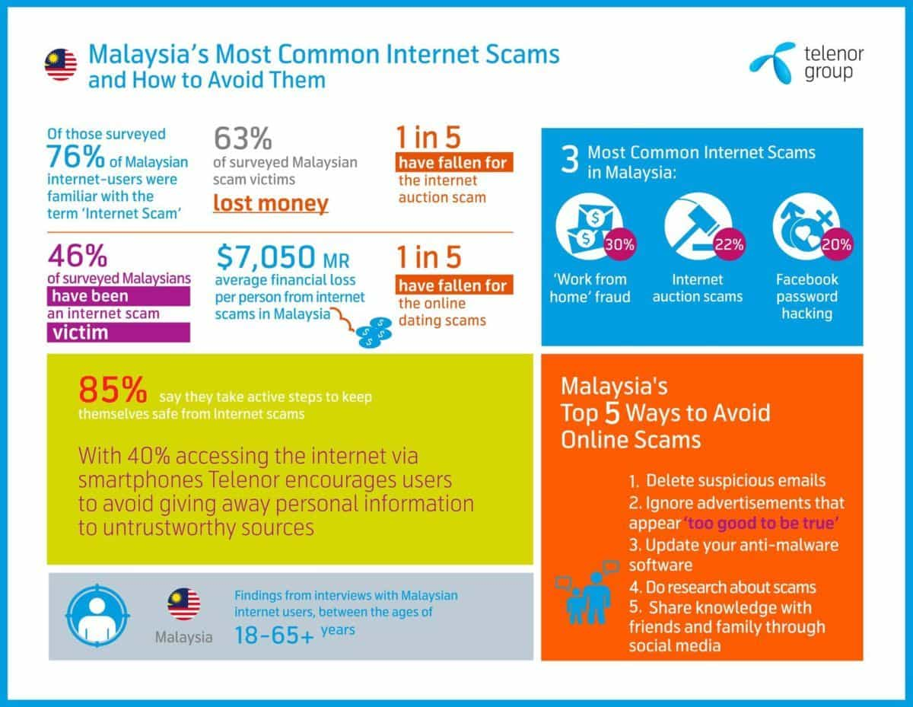
Studies reveal that Malaysians are very vulnerable to internet scams

Slide 22
Ultimately, customers need solutions they can trust..
Cyber security must come at the forefront of the digital initiatives, not as an “afterthought”
Balance between security vs privacy?
Security breach is inevitable. Embrace the risk and manage it – investments, governance, risk management, testing, security intelligence and inter-agency sharing
Human remains the weakest link - Educate on ethics and cyber security hygiene
Many initiatives have been taken by the government to protect and educate on cybersecurity

Slide 23
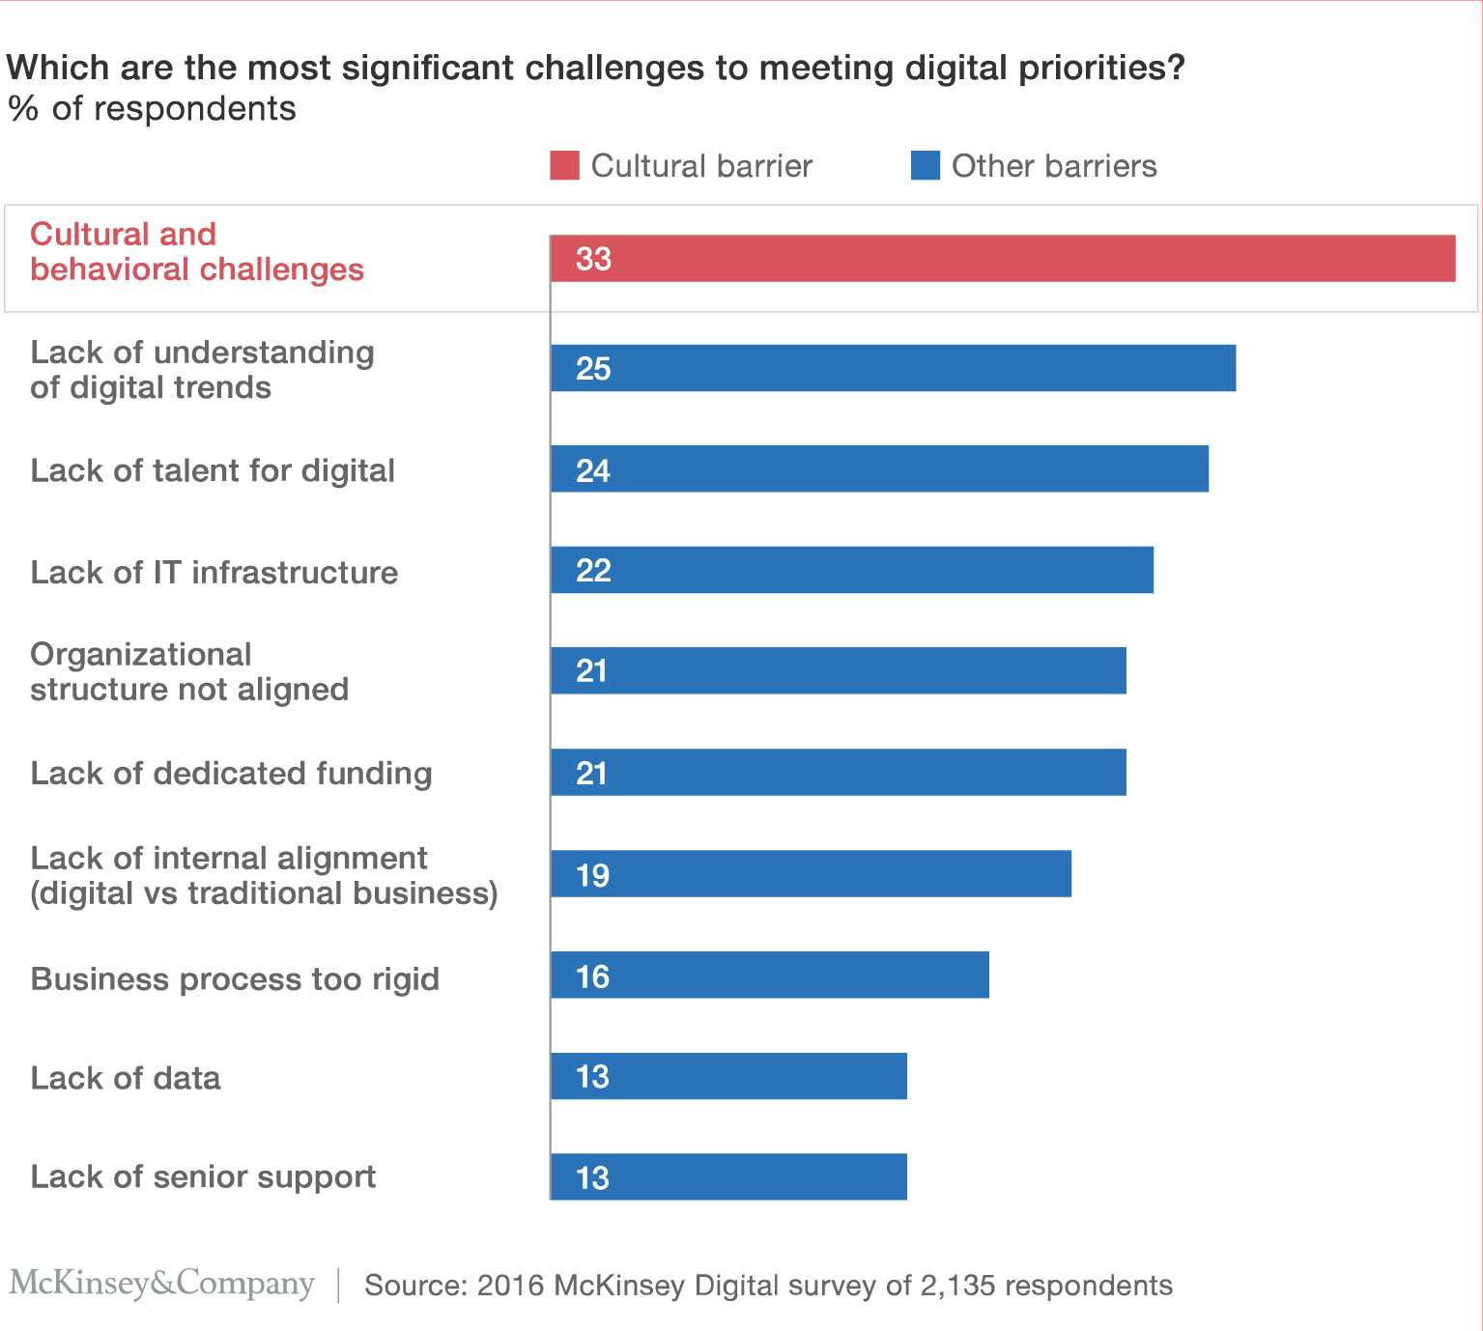
Digitalisation is also about culture change.. and human capabilities

Slide 24
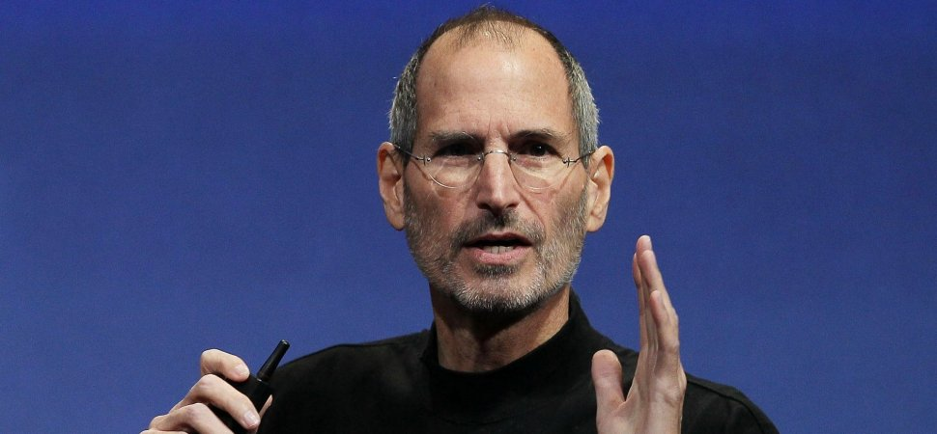
Digitalisation is also about culture change.. and human capabilities
“Technology is nothing. What's important is that you have faith in people, that they're basically good and smart, and if you give them tools, they'll do wonderful things with them.”
- Steve Jobs -

Slide 25
This has been proven many times in business history

Slide 26
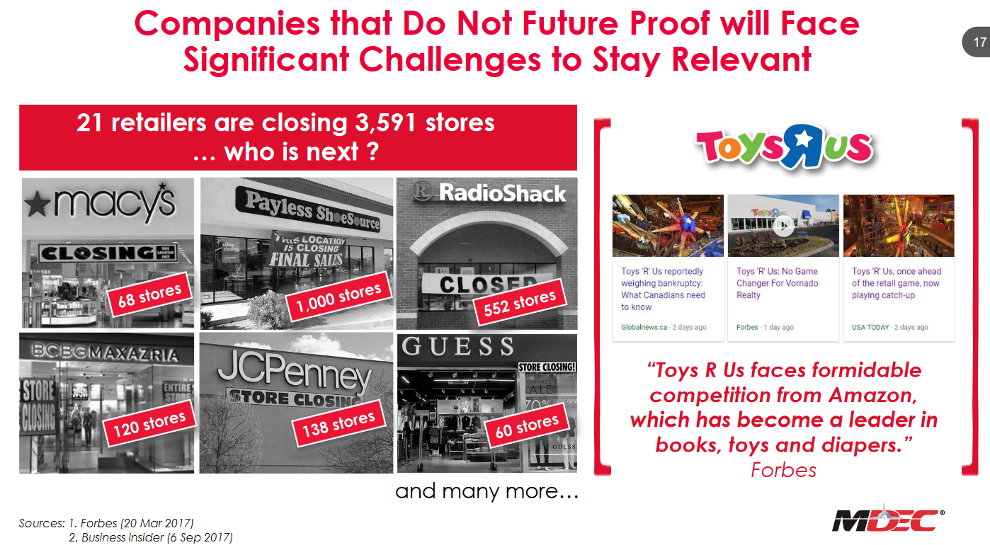
We must embrace technology and upskill ourselves to allow digitalisation to happen

Slide 27
The reality can be difficult for those who resist change
Culture and mindset shifts are critical not only for sustainability of our organisations but also personal careers
Embrace and promote change
Be consumer-oriented
Embrace “design thinking” – experiment, learn and improve
Encourage and reward innovation
Engage, communicate & collaborate
Upskill talent and digital capabilities
“The World Economic Forum estimates that about 75 million jobs may be displaced globally by a shift in the division of labour between humans and machines..
While 133 million new roles may emerge that are more adapted to the new division of labour between humans, machines and algorithms by 2022.”

Slide 28
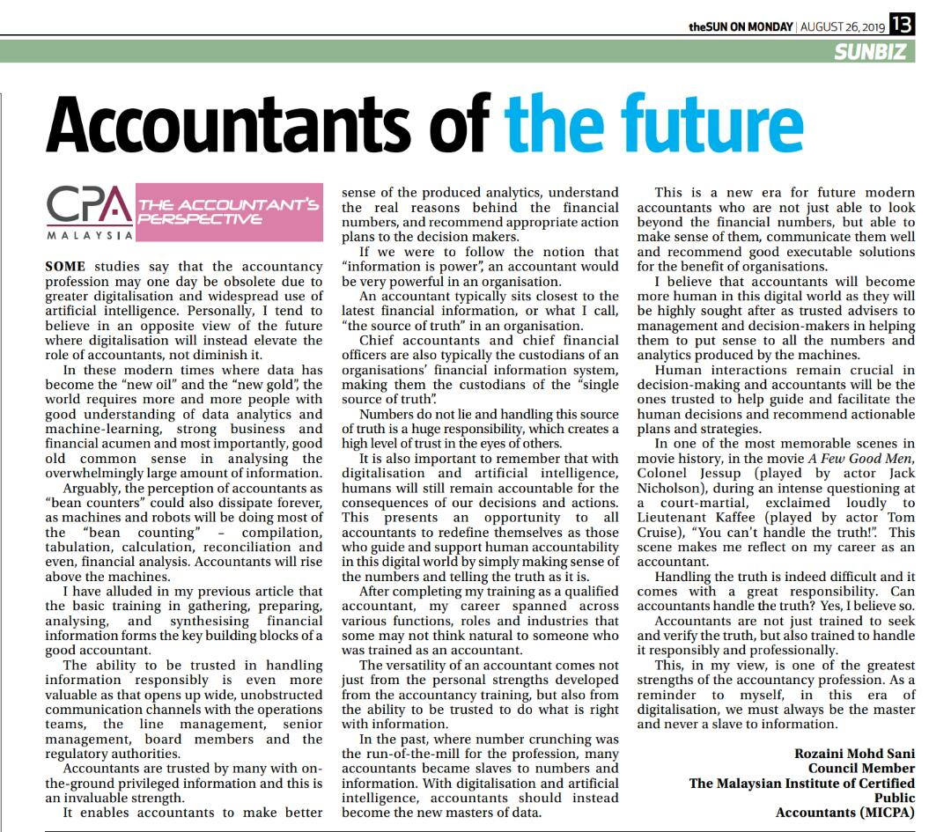
Accountants must rise up to stay relevant in the digital economy
Change agent in the transformation of mindsets
Collaborate with CIOs in governance and project selection
Measure success and value realisation – communicate lessons learnt
Engage others and be consumer-oriented in addressing issues - recommend digital solutions and collaborate in digital initiatives
Be a trustworthy custodian of financial data – the single source of truth. Accountants will be trusted advisors to facilitate human decision making

Slide 29
SUMMARY
Leveraging on Digital Economy requires us to
Approach digitalisation from a customer’s perspective
Develop digital solutions with an ecosystem in mind
Protect the trust of customers in our digital ecosystem and solutions
Be an agent of change. At the end, digitalisation is a culture.

Slide 30
Thank you
CONTACT US
Rozaini Mohd Sani
Council Member, MICPA
MICPA
No. 15, Jalan Medan Tuanku
50300 Kuala Lumpur.
Tel: 03-2698 9622
www.micpa.com.my
/theMICPA
/MICPAchannel

