Slide 1
Data Analytic In Industrial Revolution 4.0 Omar Osman ACMA (UK), FCCA (UK), CA(M)
Session: 6

Slide 2
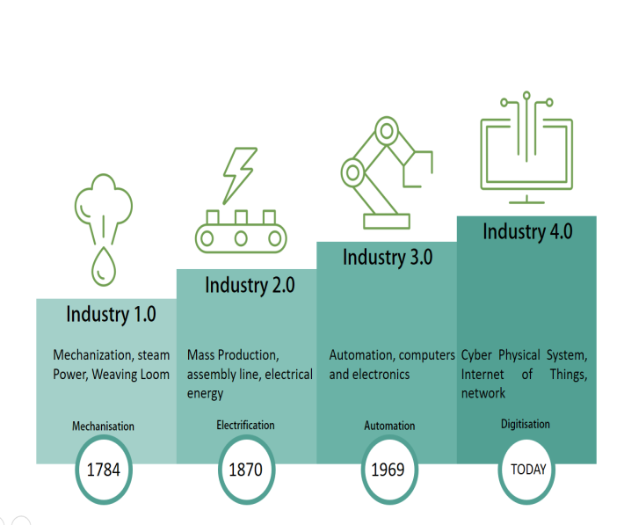
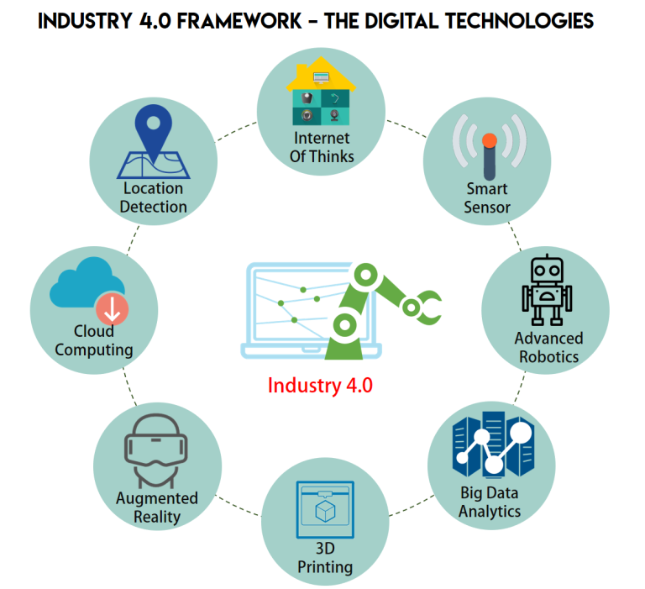
Industry 4.0
Machines
Manage themselves into production process.
integrated into the computer,
communicating with each other with intelligent connectivity that enables intelligent decision .
Creates rapid and disruptive changes
Improving customer experience,
Increasing speed to market and reducing costs.
New industries and technologies are emerging.
New business models and new value propositions.
Emerging terms

Slide 3
Building blocks of Industry 4.0
Industry 4.0
Autonomous Robots
Simulation
Horizontal and vertical system integration
Additive Mfg
Industrial Internet of Things
Augmented reality
Big data analytics
Cyber Security

Slide 4
Impacting all aspect of value chain

Slide 5
Digital Enterprise Entire value chain is digitized and integrated

Slide 6
Potential Implications
Robot Assisted production
Additive manufacturing of complex parts
Machines as a service
Big data drive quality control
Production line simulation
Predictive Maintenance
Smart supply network

Slide 7
Examples SIEMENS
German manufacturing giant Siemens, an industrial user, is implementing an Industry 4.0 solution in medical engineering. For years, artificial knee and hip joints were standardized products, with engineers needing several days to customize them for patients. Now, new software and steering solutions enable Siemens to produce an implant within 3 to 4 hours.

Slide 8
Examples TRUMPF
German toolmaker Trumpf, an Industry 4.0 supplier and worldwide market leader of laser systems, has put the first "social machines" to work. Each component is "smart" and knows what work has already been carried out on it. Because the production facility already knows its capacity utilization and communicates with other facilities, production options are automatically optimized.

Slide 9
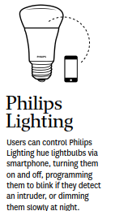
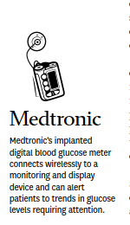
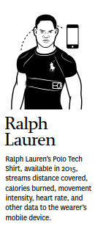
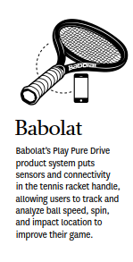
Examples of Product evolution: Connected and smart products

Slide 10
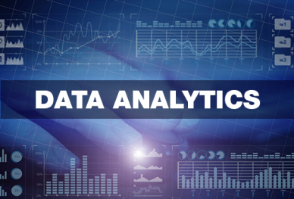
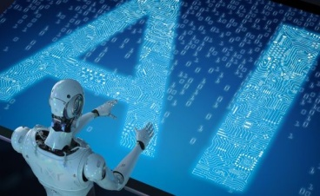
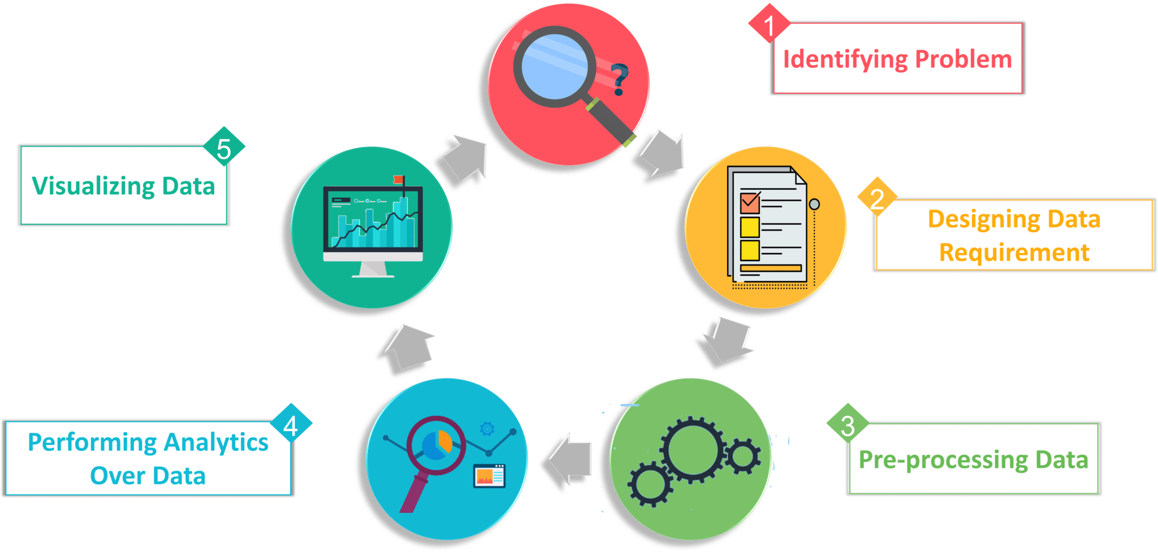
Artificial Intelligence (AI)
Artificial Intelligence (AI)
1
What is it? The use of data, information technology, statistical analysis, quantitative methods, and mathematical or computer-based models to help managers gain improved insight about their business operations and make better, fact-based decisions.
execute
Sort
Categorize
Analyze
Predict
Convert Data to info
learn
2
decide
predict
Descriptive analytics
- uses data to understand past and present
Predictive analytics
- analyzes past performance
Prescriptive analytics
- uses optimization techniques
Business Applications
Management of customer relationships
Financial and marketing activities
Supply chain management
Human resource planning
Pricing decisions
Sport team game strategies
3
4

Slide 11
AI Helps
Combat Dynamic Pricing e.g. E-commerce / Amazon change price every 10 minutes, hard for competitors to keep up.
(Not only comparing low price, but also take into consideration stock level, supply & best margin)
1
2
Tracks buying trends
Determine competitive product price
3
No more long hours to look for competitor pricing
- Can use AI algorithm to predict prices & take care of your customers
AI in E-commerce is a pro active approach in decision making
Predicts:-
What customer wants to buy next
What platform/device/ channel used by customer to purchase
What sort of price customer wants to pay
Time of purchase by customers
Location of purchase
Computing average spending per location/gender/age etc.
Customer spending behaviour
4
Combination of AI with Dynamic Pricing – ability to give significant impact on the bottom line of our organisation.

Slide 12
The reporting standard for Industry 4.0

Slide 13
“With one touch on a button, I know and can explain exactly and in real time, the production process, my profit and/or losses are created”
End User Requirement

Slide 14
Perspectives
Two different perspectives:
The present industrial / processing / banking landscape
The digital perspective of Industy 4.0

Slide 15
Perspective 1: The present industrial landscape
4 < t < 12
In weeks
t = 0
Cost Control: Monthly/quarterly Variance reporting Incidental / “out of bandwidth” P&L production order analyses
ERP/SAP
Information collection & process control
Usage:
Hours / materials / etc
Output: volumes etc
Installed base /Assets:
Machines / Equipment Buildings
Systems
Stocks / Supplies
People
Budgets
Production orders
Budgeting

Slide 16
Perspective 2: The digital perspective of Industry 4.0
0 < t < 3
In hours
t = 0
Real time reporting Assets management Dynamic Costcontrol / P&L Labourplanning
Financial Planning
Maintenance planning
Service planning
Procurement planning
Spareparts planning
Scenario/simulations
EPR/SAP
RTW platform 4.0
Dashboards
&
apps
Production / process control
Installed base/Assets:
Machines/equipment Buildings
Systemen
Stocks/supplies
People
Budgets
Production orders
Provider Platform 4.0 Data & System integration
Dynamic Budget

Slide 17
End User Requirements
“With one touch on a button, it is for the first time possible , that I can explain exactly and in real time, where in the production process, my profit and/or losses are created” Means for end users:
Assets Management
Dynamic Cost Control
Maintenance Planning
Service Planning
Stocks-/Supplies-/Spareparts Planning
Financial Planning
Scenarios / Simulations
Dynamic Budgeting

Slide 18
The roles of developer
Project Management & Change/transition management
Platform 4.0 software
Dedicated platform 4.0 real time reporting
Interface and synchronizing the interface connecting Platform 4.0 and ERP/SAP system
Input for Production and Process control / -Alarm and Feedback
Dashboards / Apps

Slide 19
Users Expectation Vs Developer Constraint
Complete Automation of task
Time / Urgency of the matters
Users Expectation
Transparency of the process
Budget / Funds/ Cost
Developer Constraints
High productivity ( high efficiency)
GAP
User acceptance
Accuracy
Security
e.g. AR – identify overdue customers - reminder letter, contacting customers for the payment via email/telephone, until the collection of debts .
Availability of the technology/machines

Slide 20
Will AI replace human
Yes, AI will replace "repetitive" jobs--those tasks that can be automated like robots are doing in factories. It will also potentially replace many "white-collar" tasks in the fields of accounting, healthcare, marketing, law, hospitality, and other areas.
1
AI is not going to take away jobs. It will displace some jobs, yes, but it will more likely change what human workers do. ... There are experts who believe AI will actually create a plethora of new jobs (many of which we don't even know what they'll be yet).
2
lot
Yes, robots will replace humans for many jobs, just as innovative farming equipment replaced humans and horses during the industrial revolution. However, in the wake of these changes, humans will be needed to create and deliver value in brand new ways for brand new business models.”
3

Slide 21
Will AI replace human
limits to AI's use in the enterprise that tech and business leaders tend to overlook.
Data. In order for AI to do its job, models need to be trained on data. ...
Lack of knowledge. Another limitation to AI is that machines often don't know what they don't know,
Bias.
AI Can’t Multitask
AI Can’t Always Explain Its Decisions
AI Can’t Make Moral Judgments
AI Can’t Feel Empathy, Sympathy, or Anything Else for That Matter
AI Can’t Be Creative (On Its Own, Anyway)
AI Can’t Fully Replace Human Workers

Slide 22
Will AI replace human
Other factors
Government policy and social obligations
Skills and knowledge of people
Regulations ( such as the tax required printed documents for 7 years )
Legal requirements
Etc

Slide 23
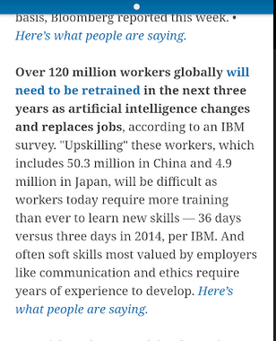
What Can/Cannot Replace
10 Jobs AI Can Replace
10 Jobs AI Can't Replace
Telemarketing
Bookkeeping Clerks
Compensation and Benefits Managers
Receptionists
Couriers
Proofreaders
Computer Support Specialists
Market Research Analysts
Advertising Salespeople
Retail Salespeople
Human Resource Managers
Sales Managers
Marketing Managers
Public Relations Managers
Chief Executives
Event Planners
Writers
Software Developers
Editors
Graphic Designers

Slide 24
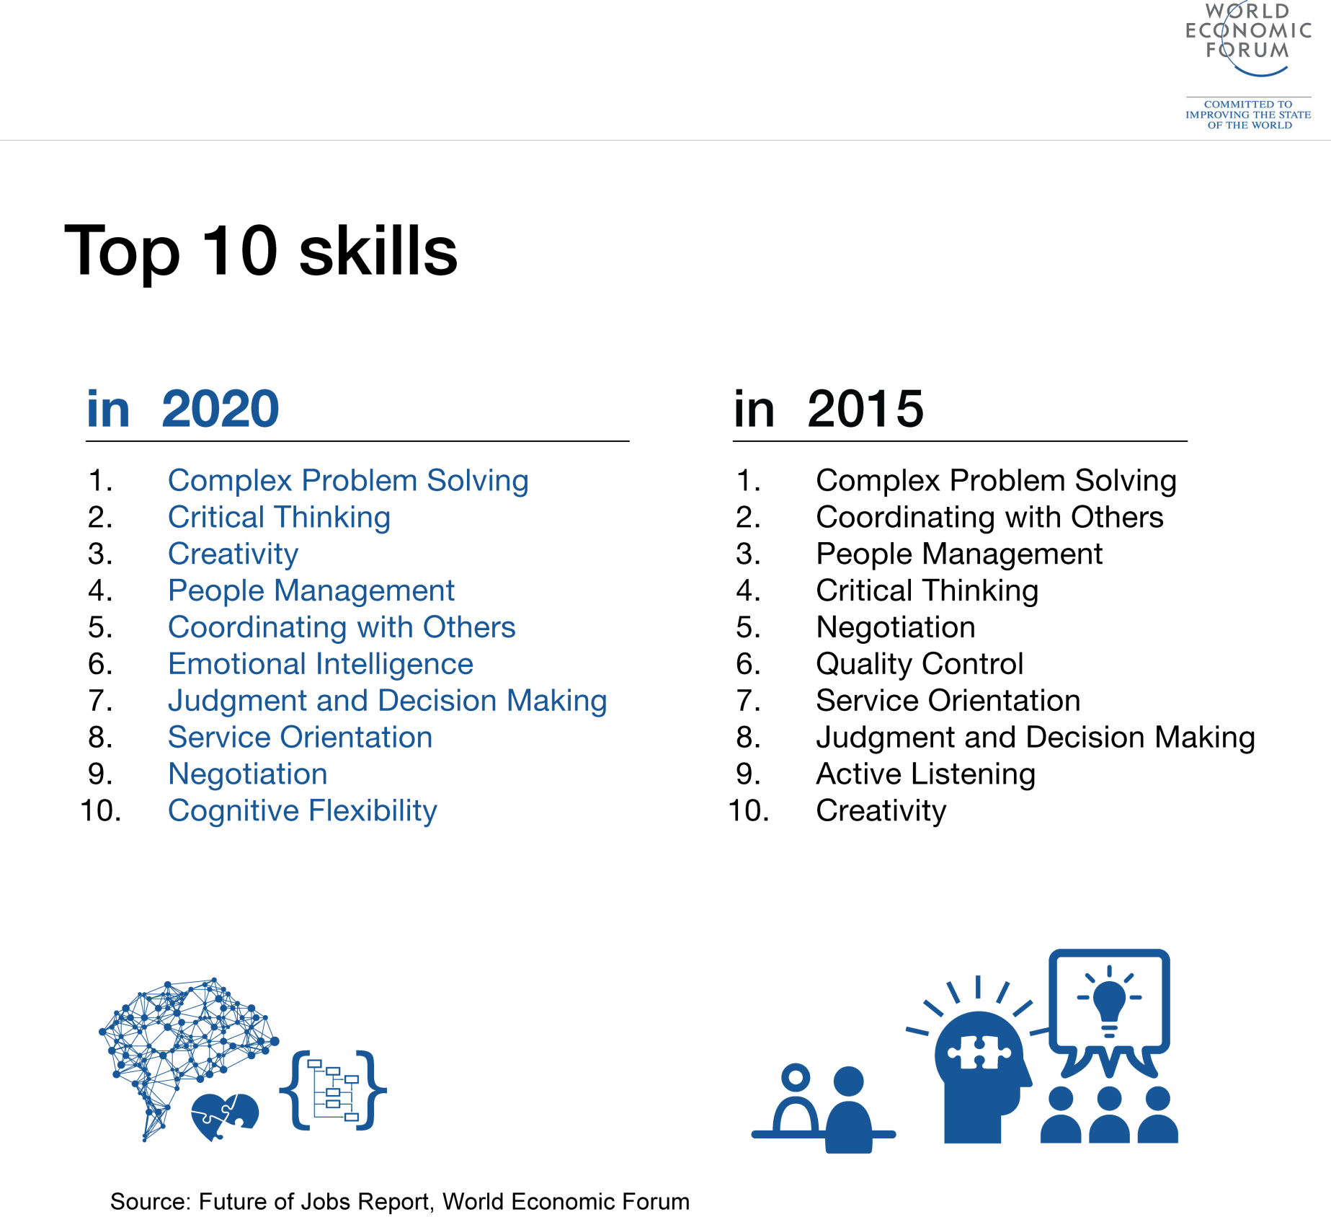
Top 10 Skills to be relevant in Industry 4.0
Is it still applicable now or it is far to go?

Slide 25
Thank You

