Slide 1


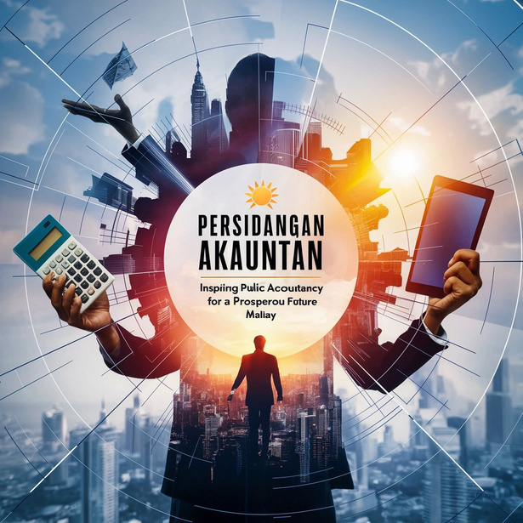
PERSIDANGAN AKAUNTAN SEKTOR AWAM KALI KE-31
(NATIONAL PUBLIC SECTOR ACCOUNTANTS CONFERENCE)
Integrity . Trustworthy . Sustainability
Strategi Pemerkasaan Digital : Transformasi Berterusan untuk Profesion Akauntan Yang Mampan & Kepimpinan Proaktif
Sesi 6 - 10.30am - 12.30pm
Navigating Public Accounting for Sustainable Future
Prof. Dr. David Asirvatham
Taylor’s University
MEMACU PERAKAUNAN AWAM UNTUK MASA HADAPAN YANG MAMPAN

Slide 2
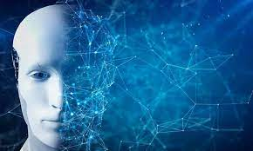
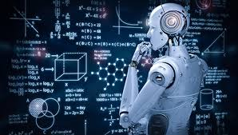
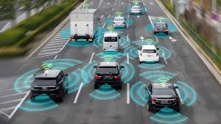
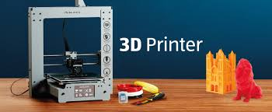
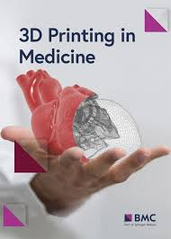
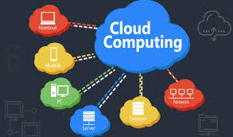
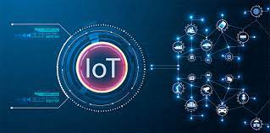
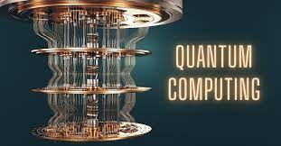
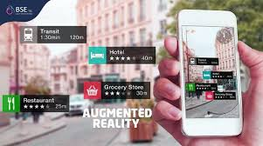
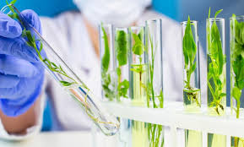
Technologies that will drive changes globally
Artificial Intelligence
Robotics
Autonomous Vehicles
Biotechnology

Slide 3
What are the key technologies that will impact Accounting?
Blockchain
Artificial Intelligence
Cloud Computing
Big Data
Cybersecurity
Robotic Process Automation

Slide 4
Why Artificial Intelligence is different from other technologies?
It can learn and adapt from data, allowing it to improve its performance over time.
Artificial intelligence aims to replicate and augment human cognitive abilities
They can make decisions

Slide 5
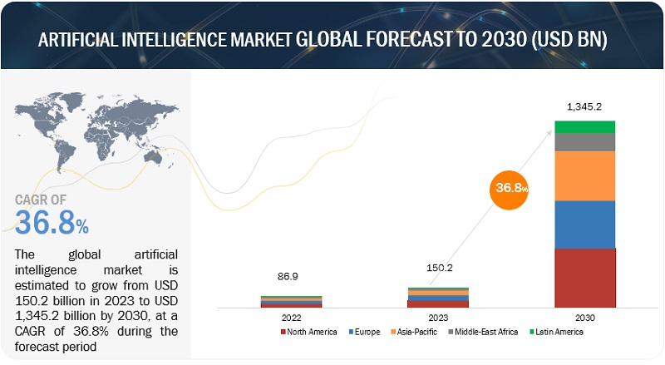
Artificial Intelligence Global Market

Slide 6
What is Artificial Intelligence?
What is AI?
A machine is said to have artificial intelligence if it can interpret data, potentially learn from data, and used that knowledge to adapt and achieve specific goals.

Slide 7
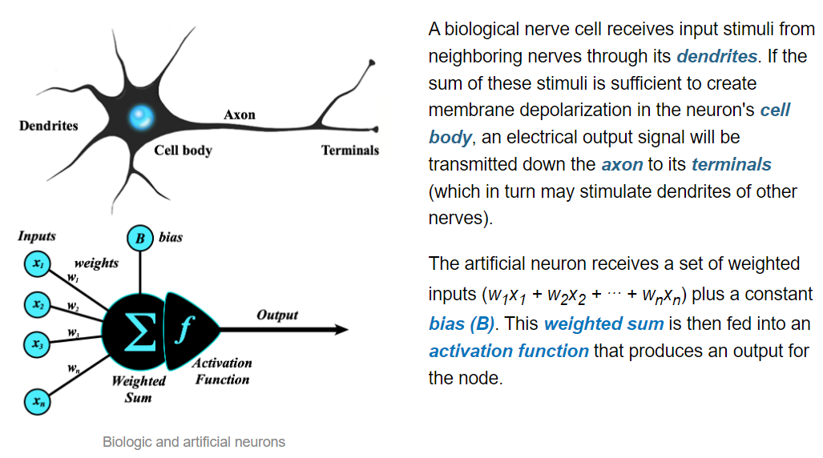
Biological vs Artificial Neuron

Slide 8
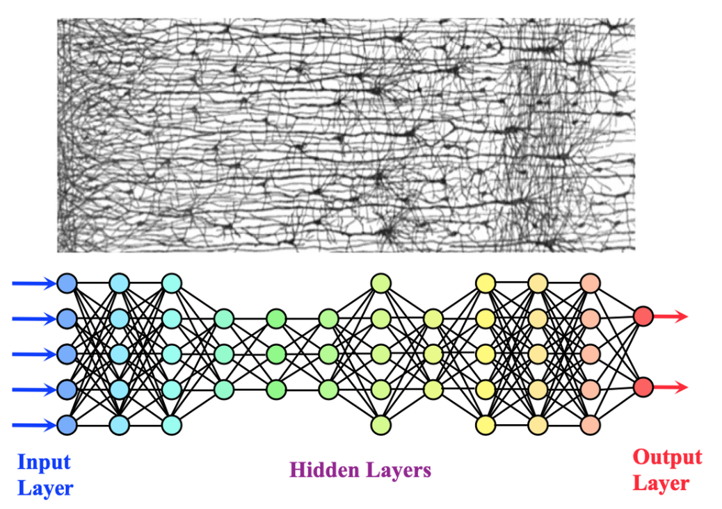
Human Neuron Vs Artificial Neuron

Slide 9
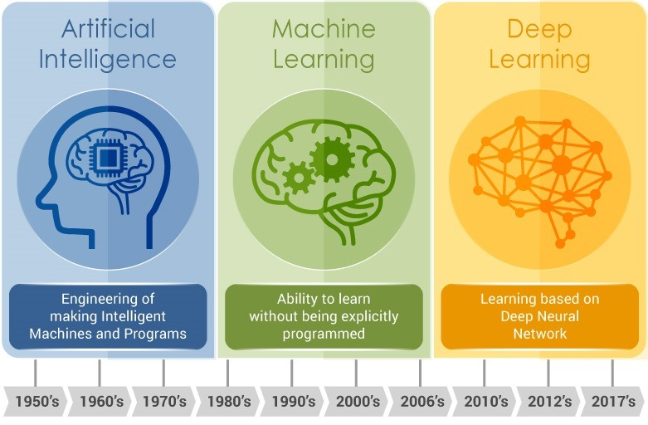
Machine Learning vs Deep Learning
Machine Learning
Deep Learning
Ability to learn based on patterns without explicit instructions
Ability to learn based on artificial neural network

Slide 10
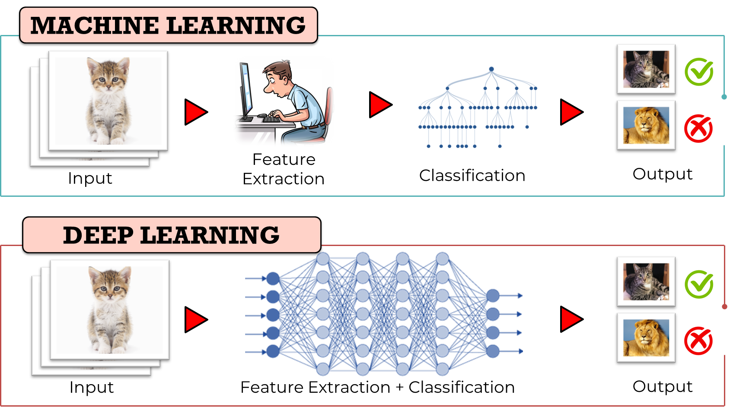
Machine Learning vs Deep Learning

Slide 11
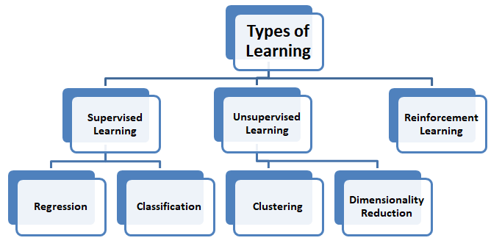
Types of MACHINE LEARNING
Notes:
A deep learning model is designed to continually analyze data with a logic structure similar to how a human would draw conclusions. To achieve this, deep learning applications use a layered structure of algorithms called an artificial neural network. The design of an artificial neural network is inspired by the biological neural network of the human brain, leading to a process of learning that’s far more capable than that of standard machine learning models. A major difference between the traditional machine learning algorithms and the one in deep learning is the feature extraction approach. Features are specific structures in an image, such as points, edges, or objects. While an expert would have to select the relevant features in a more traditional machine learning algorithm, the Deep Learning model is capable of extracting features automatically.

Slide 12
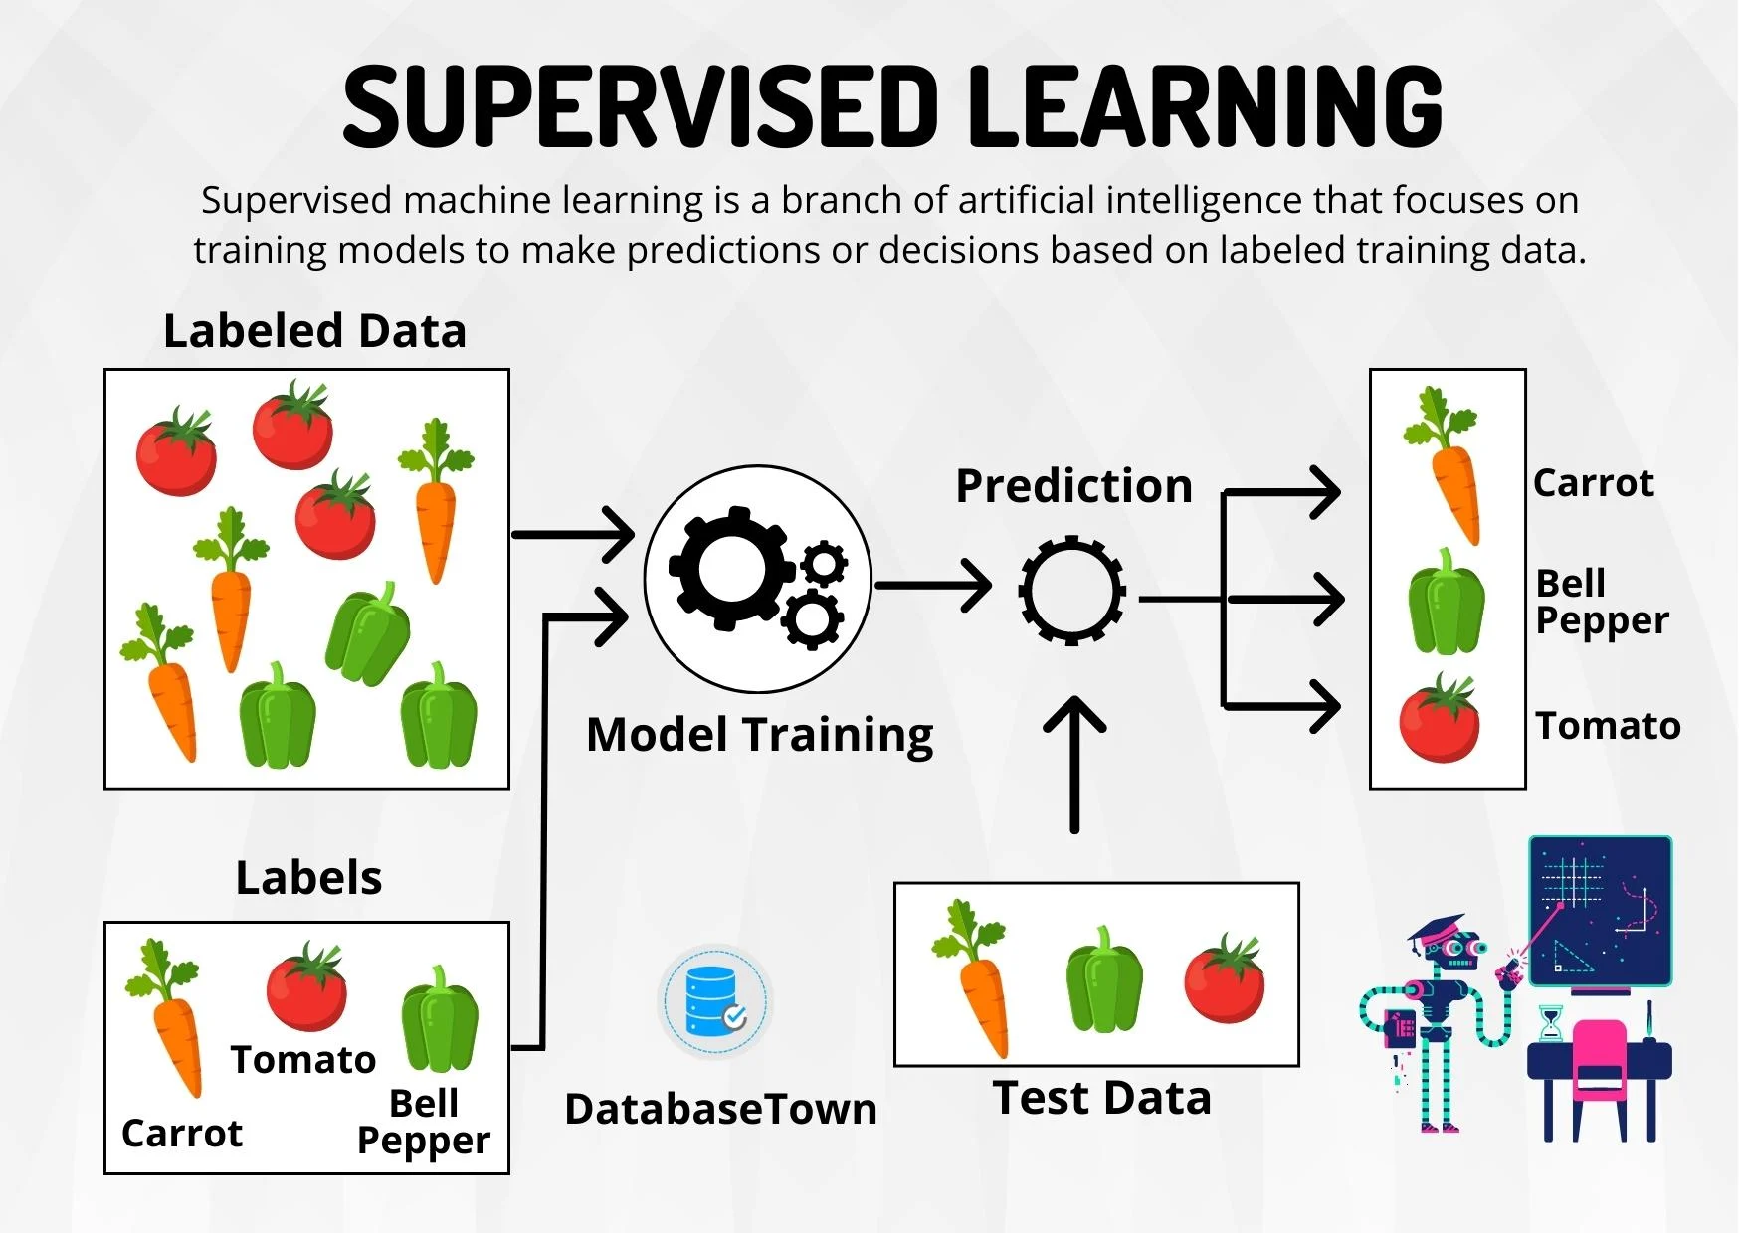
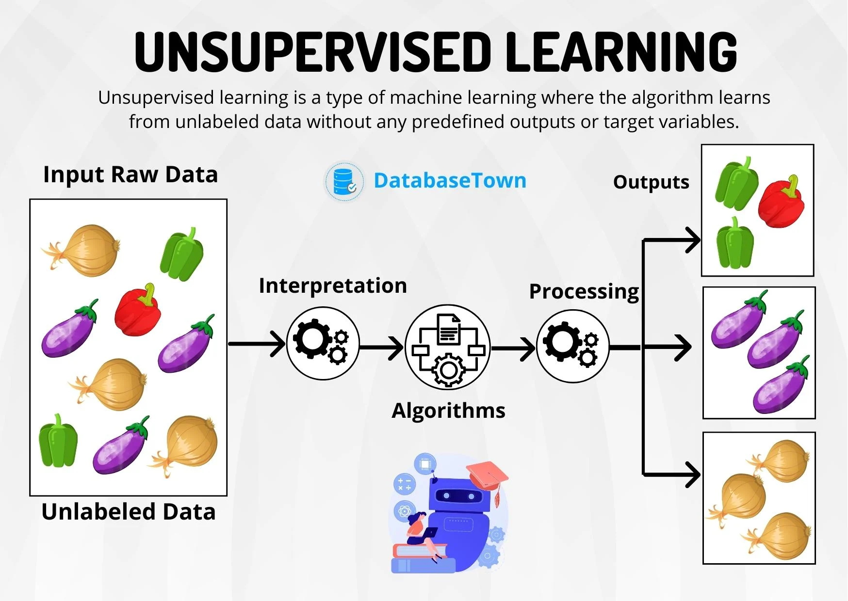
Supervised Learning vs Unsupervised Learning

Slide 13
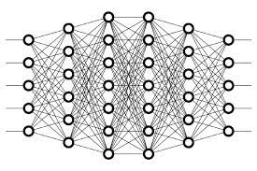
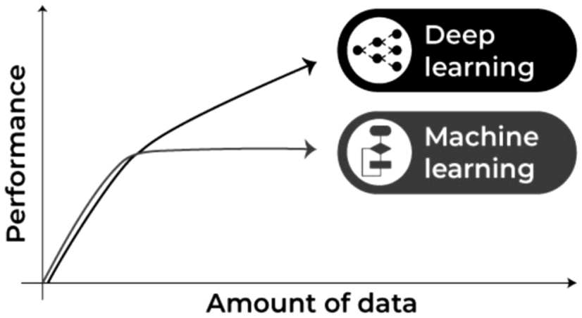
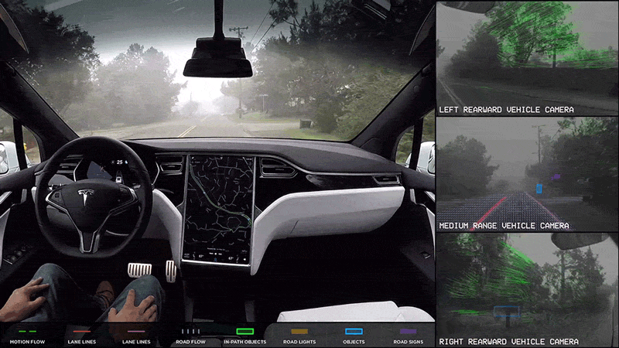
Deep Learning
DEEP LEARNING
With deep learning, the algorithms learn independently by analyzing large amounts of data.
Image source: Sarker, I.H. Machine Learning: Algorithms, Real-World Applications and Research Directions.
Example: A self-driving Tesla
Notes:
Deep Learning shows huge potential in the areas where access to a vast amount of data is available. It has been used to do a lot of amazing things such as: beating the world’s best Go Chess player, driving cars, and painting portraits.

Slide 14

How is AI going to change the World?

Slide 15
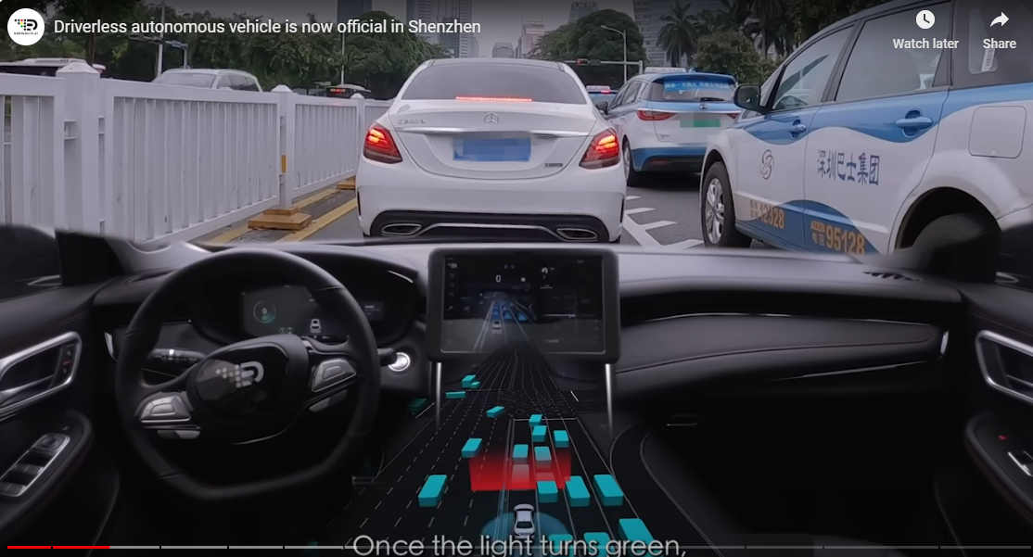
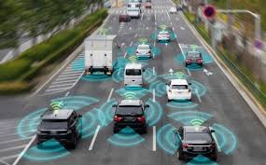

Impact of AI on Transportation
Autonomous Vehicles
No truck drivers or shipping crews?
Vehicles will be able to communicate with each other.

Slide 16
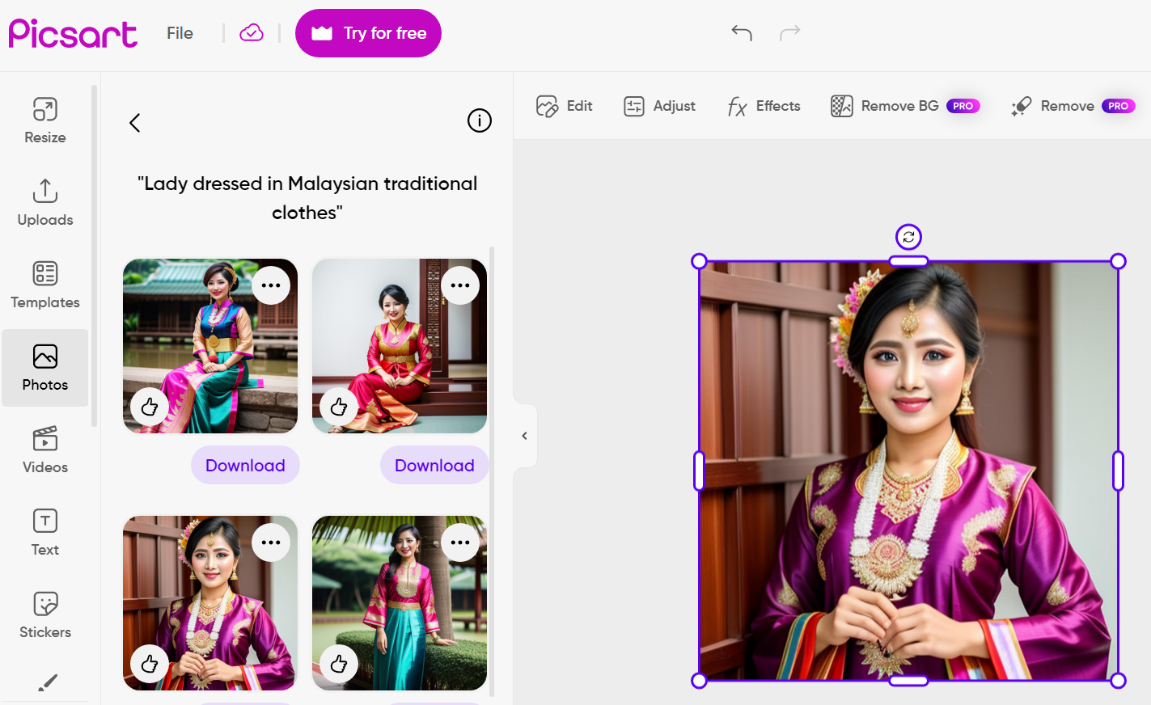
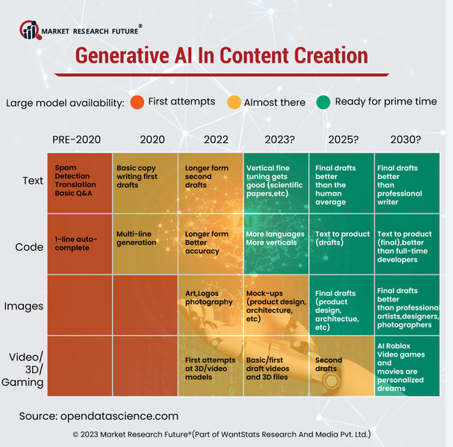
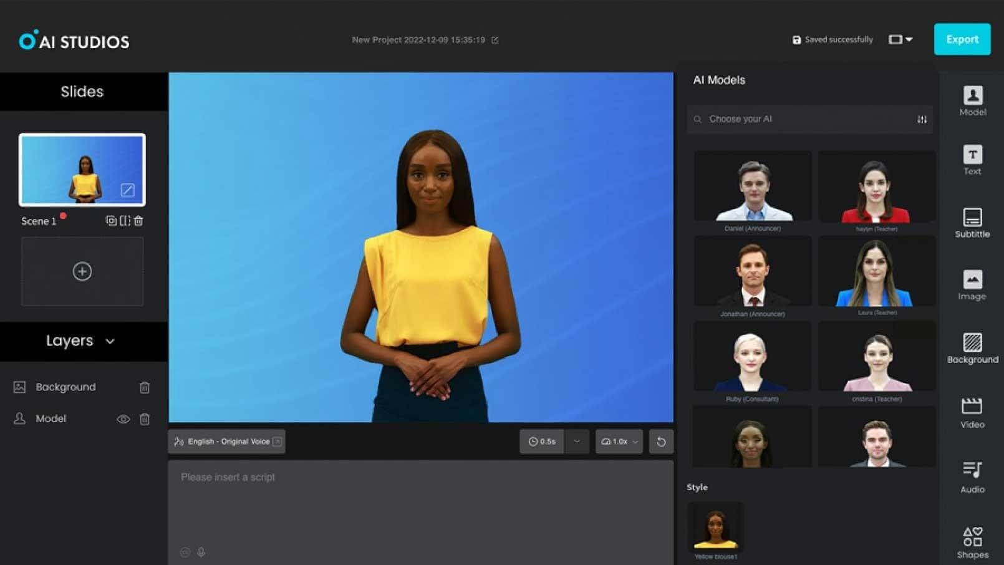
AI and Content Creation

Slide 17
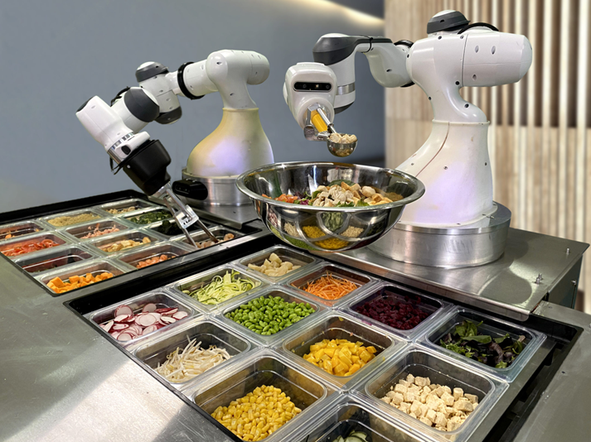
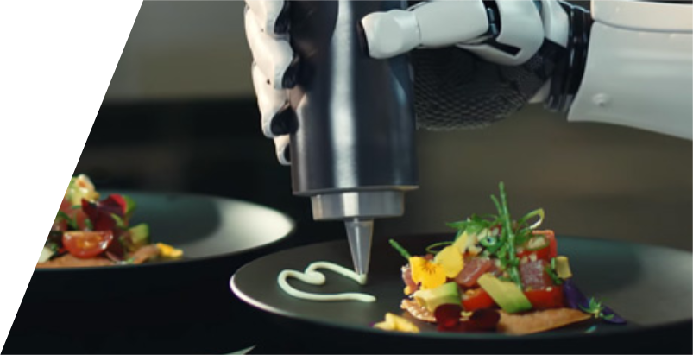
Hotel Industry
Chef Watson, it’s able to generate entirely new recipes from scratch using an astonishing knowledge of taste chemistry and flavor pairings.
Customize to the taste of individuals
robots like Miso Robotics’ burger-preparing Flippy are capable of preparing meals and serving them up at speeds that human chefs struggle to achieve
Add table delivery robots into the mix and you don’t even need human waiters to deliver the food to customers.

Slide 18
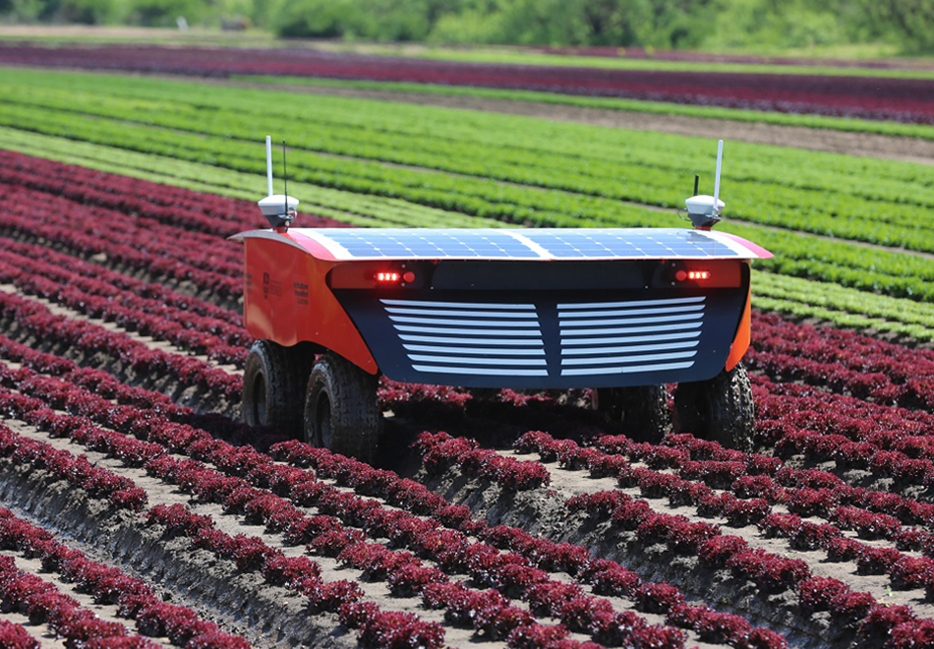
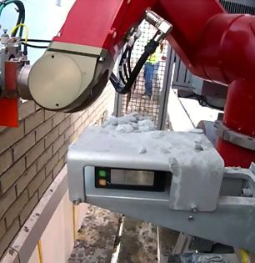
CONSTRUCTION WORKERS OR OTHER MANUAL LABOUR JOBS
bricklaying on construction sites, working in warehouses, or picking fruit and vegetables on a farm, there’s no doubt that a large number of manual labor jobs that once required humans can now be carried out by robots.
Ability to work nonstop without getting tired.

Slide 19
Impact of AI at Workplaces by 2030
Many jobs will be automated
85M jobs will be displaced; 97M new jobs will be created
40% of Core Skills will change
Seamless integration between humans and machines (AI)

Slide 20

What will be the impact of AI on the
Accounting Profession?

Slide 21
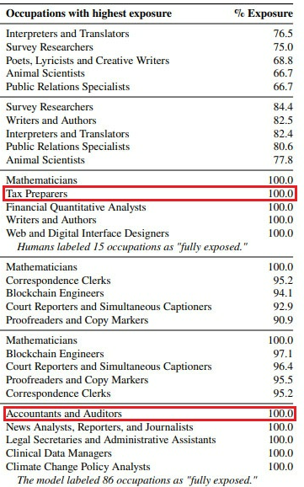
AI in the Accounting Profession
Can AI replace Accountants?
In a recent study by OpenAI, maker of ChatGPT, occupations like accountants and tax preparers are some of the most exposed to AI.
Emergence of a completely new business models

Slide 22
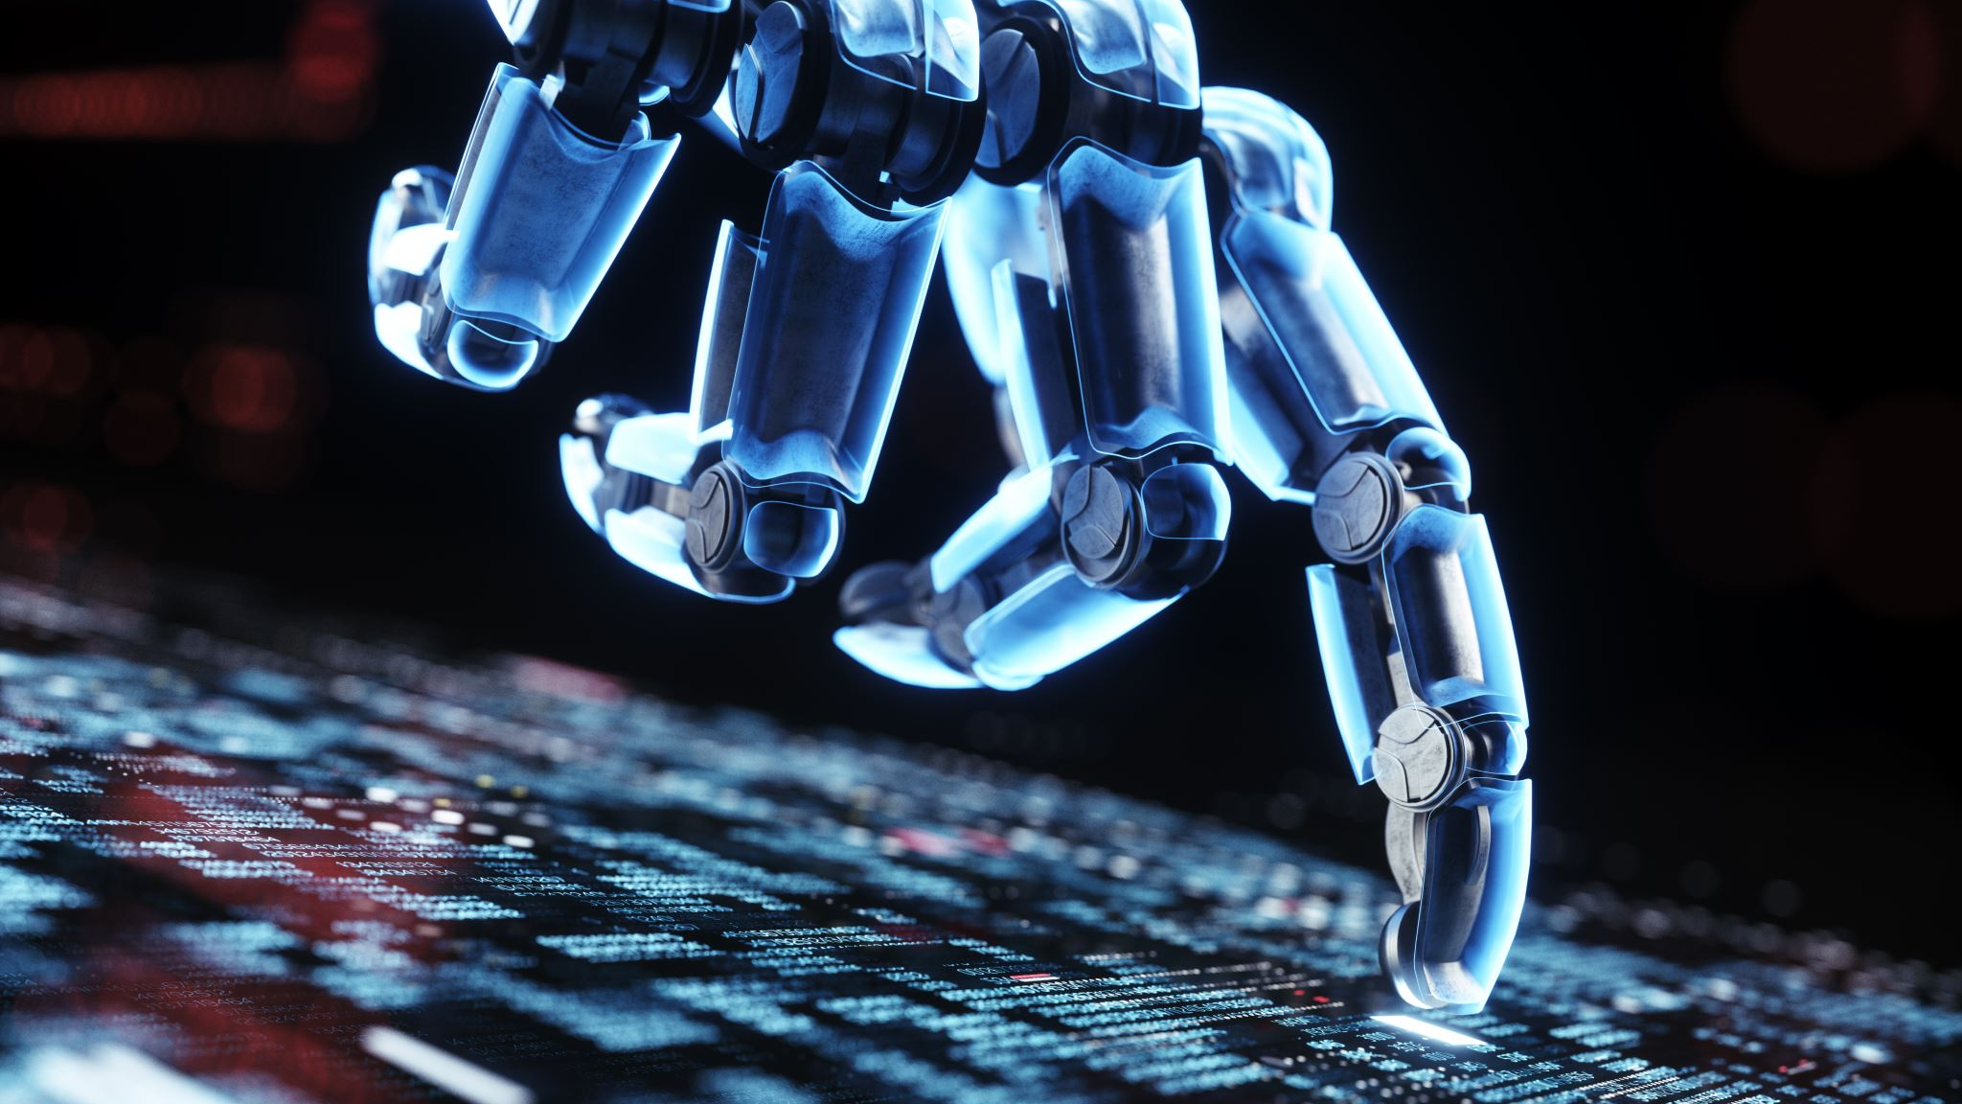
AI models in Accounting
Type of AI Models that can be applied in Accounting Profession:
  Machine learning (ML) / Deep Learning (DL) Models
  Natural Language Processing (NLP)
    Example: ChatGPT and other Large Language Models (LLM)
  Computer vision
    image detection, recognition, and classification
  Expert systems (ES) for decision-making
  Robotics Process Automation (RPA)

Slide 23


ChatCPA – AI model trained by CPAs

Slide 24
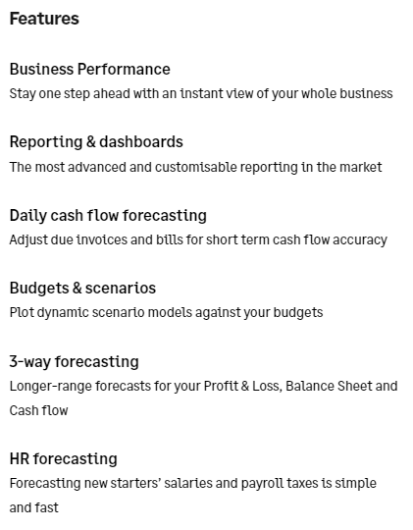
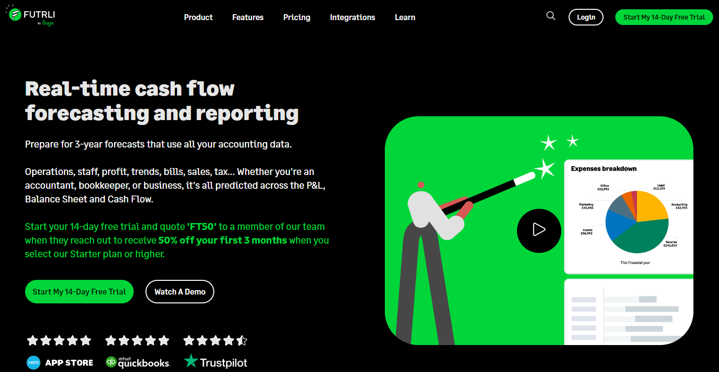
Futrli is a Predictive Financial Analysis Tool

Slide 25
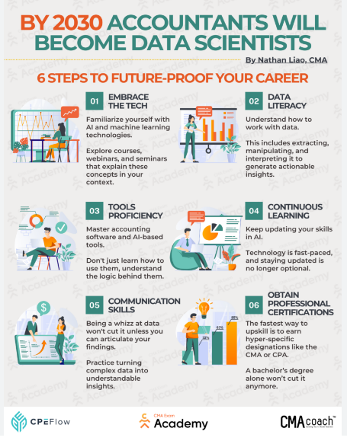
How will the role of the Accounting Profession Change?

Slide 26
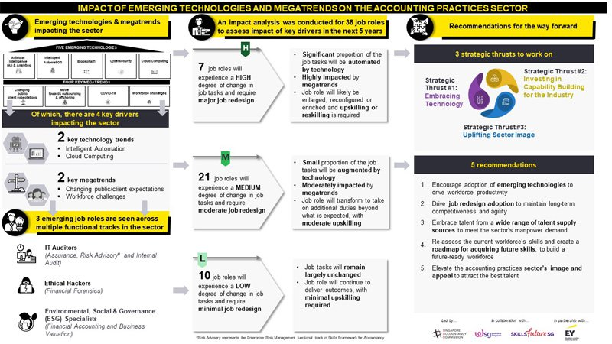

Slide 27

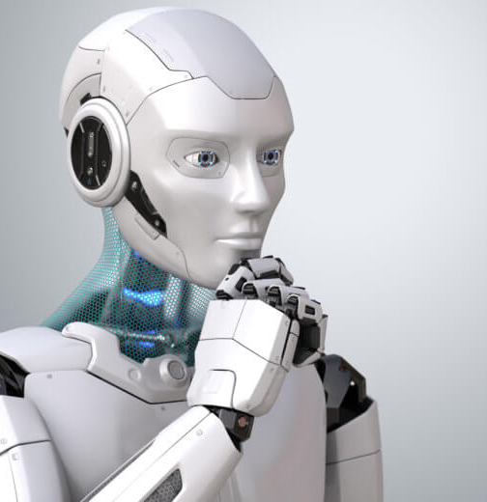
New Digital Divide:
Human vs Machine
Digital Divide
Machines (AI and ML) will challenge humans
Machines are becoming more “Intelligent”
Machines can make decisions – sometimes better decisions than humans
Don’t compete with Machines, work with Machines.

Slide 28

TERIMA KASIH

