Slide 3
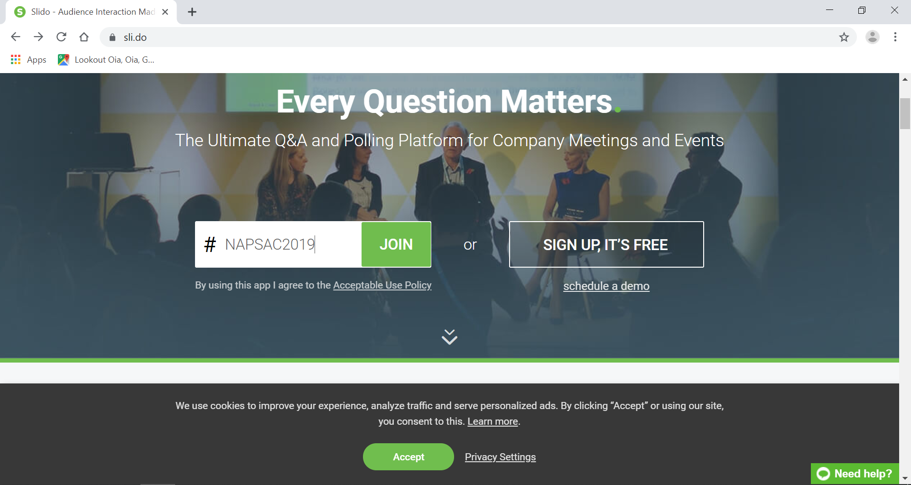
Slido

Slide 5
SECRETS OF SUSTAINABLE LEADERSHIP by DATO’ DR LUKMAN IBRAHIM
Session: 9am – 10.30am

Slide 6
TABLE OF CONTENTS
1.0 Managing
2.0 Leading
3.0 Sustaining

Slide 7
1.0: MANAGING
Another Works

Slide 8
Managing
Level 3
Competent Manager
Organizes people and resources toward the effective and efficient pursuit of predetermined objectives
Level 2
Contributing Team Member
Contributes individual capabilities to the achievement of group objectives and works effectively with others in a group setting
Level 1
Highly Capable Individual
Makes productive contributions through talent, knowledge, skills, and good work habits

Slide 9
4 Elements of Management
Planning – Determining causes of action
Organizing – Coordinating activities and resources
Leading – Managing, motivating and directing people
Controlling – Monitoring and evaluating activities

Slide 10
2.0: LEADING
Another Works

Slide 11
Leading
Definition of leadership
The ability to influence others towards achieving common goals

Slide 12
5 RULES TO LEADERSHIP

Slide 13
Rule 1 : Shape the future
To shape the future, be a strategist:
Stay curious and develop a point of view about your own future
Engage the organisation – no ‘one’ knows enough
Create strategic traction within the organisation

Slide 14
Rule 2: Make things happen
To make things happen, be an executor:
Make change happen
Follow a decision protocol
Ensure accountability
Build teams
Ensure technical proficiency

Slide 15
Rule 3: Engage Today’s Talent
To engage today’s talent, be a talent manager
Communicate, communicate, communicate
Create aligned direction; connect the individual to the organisation
Strengthen others; ensure people have competencies they need
Provide people with the resources to cope with demands
Create positive work environment- practice spiritual disciplines at work
Have fun at work

Slide 16
Rule 4: Build the Next Generation
To build the next generation, be a human capital developer
Map the workforce
Help people manage their careers
Find and develop next generation talent
Encourage networks and relationships

Slide 17
Rule 5: Invest in Yourself
To invest in yourself, be a personally proficient:
Practice clear thinking: rise above details
Know yourself
Tolerate stress
Demonstrate learning agility
Tend to your own character and agility
Take care of yourself
Have personal energy and passion

Slide 18
Leading
Human Capital Developer
Rule # 4:
Build the next generation
Strategist
Rule # 1:
Shape the future
Long term strategic
Personal Proficiency
Rule #5:
Invest in Yourself
Individual
Organisation
Talent Manager
Rule #3:
Engage today’s talent
Executor
Rule # 2:
Make things happen
Near term operational

Slide 19
Leading
Catalyzes commitment to and vigorous pursuit of a clear and compelling vision, simulating higher performance standards
Level 4 : Effective Leader

Slide 20
3.0: SUSTAINING
Another Works

Slide 21
Sustaining
“Emotional intelligence is your ability to recognize and understand emotions in yourself and others, and your ability to use this awareness to manage your behavior and relationships.”
Travis Bradberry and Jean Greaves
Emotional Intelligence 2.0

Slide 22
Sustaining: Emotional Intelligence Domains and Competencies
Self- Awareness | Self- Management | Social Awareness | Relationship Management
Emotional Self Awareness | Emotional Self Control | Empathy | Influence
 | Adaptability |  | Coach and mentor
 | Achievement Orientation | Organisational awareness | Conflict Management
 | Positive Outlook |  | Teamwork
 |  |  | Inspirational Leadership

Slide 23
Sustaining
Builds enduring greatness through a paradoxical blend of personal humility and professional will.
Level 5 : Level 5 Executive

Slide 24
Sustaining
Sustainable leadership = EI + Will + Humility

Slide 25
Thank you
for listening

