Slide 2
STRESS MANAGEMENT AT WORKPLACE
PROF. DR. RASHIDI AHMAD

Slide 3
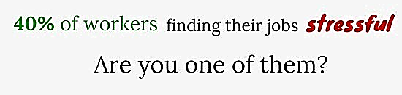

Slide 4
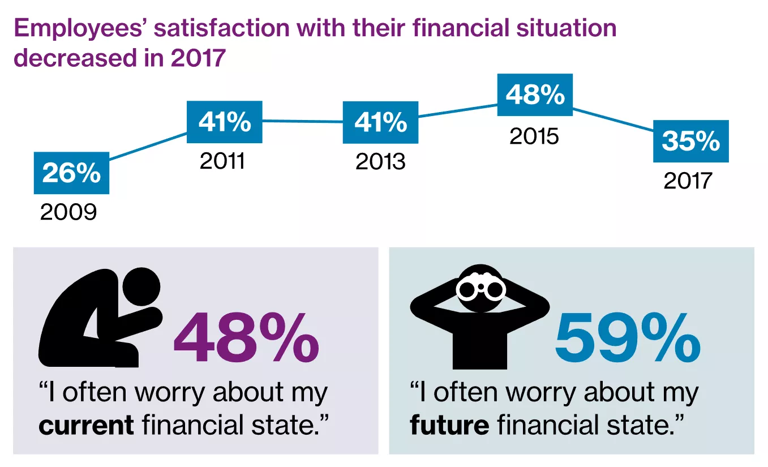

Slide 6
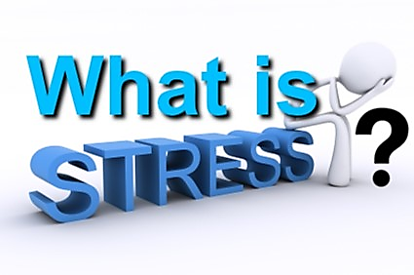

Slide 7
Stress = unexpected reality

Slide 8
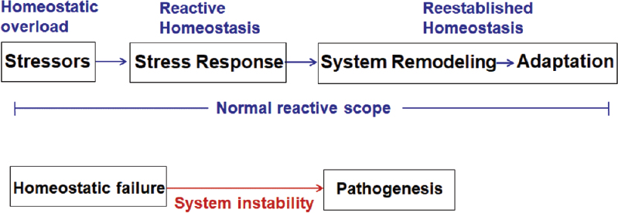

Slide 11
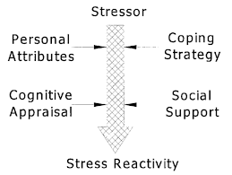

Slide 13
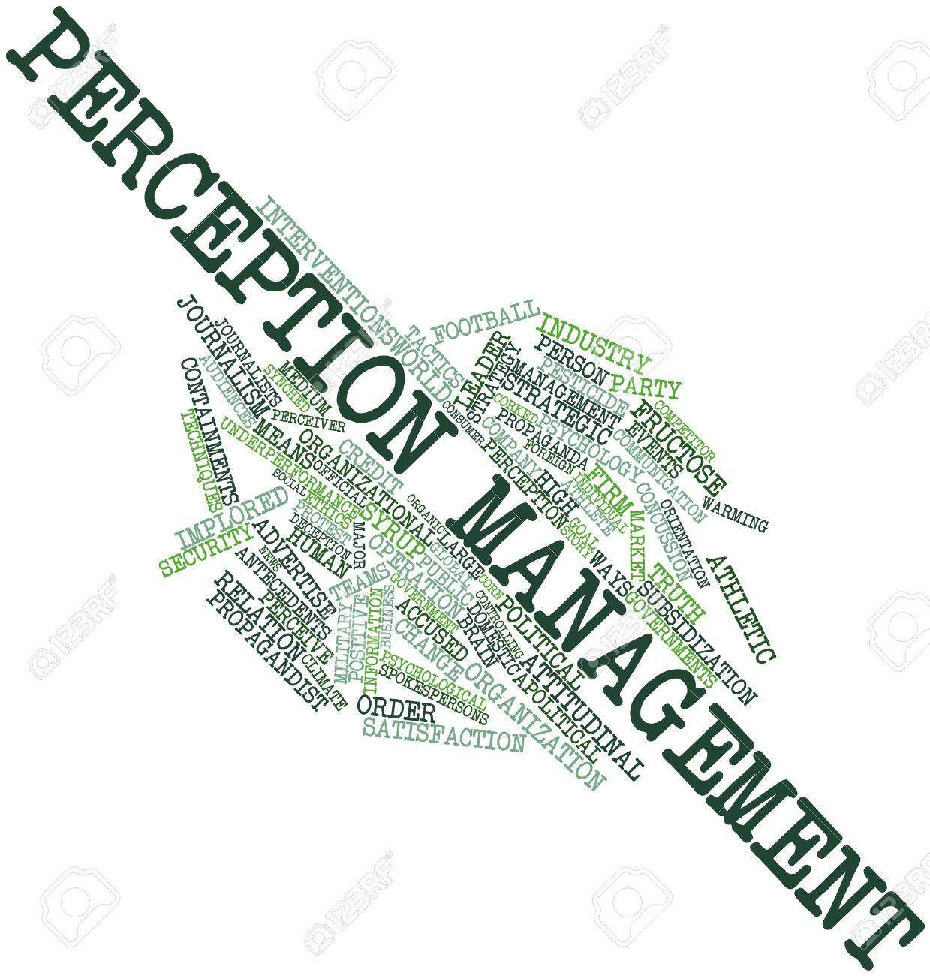
Stress management

Slide 14
Stressor + negative Perception = STRESS

Slide 15
Stressor is bad!

Slide 17
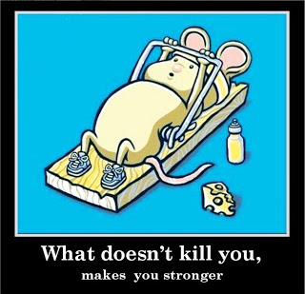

Slide 18
Stress is bad!

Slide 19
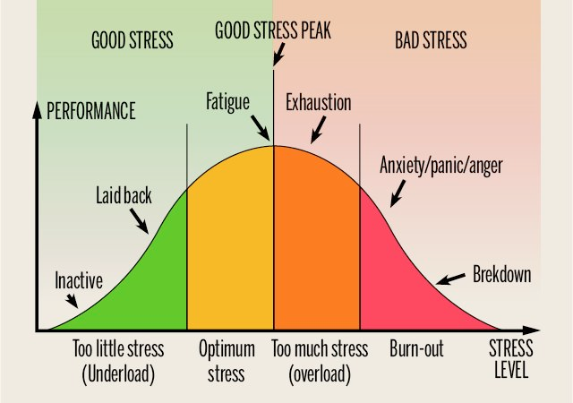

Slide 20
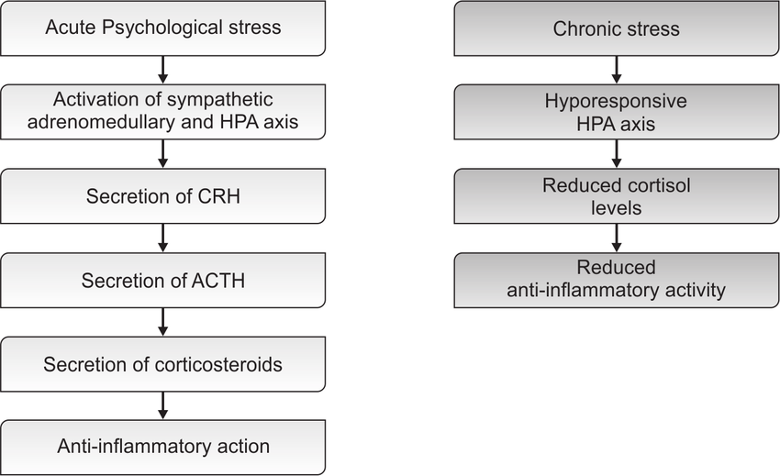

Slide 21
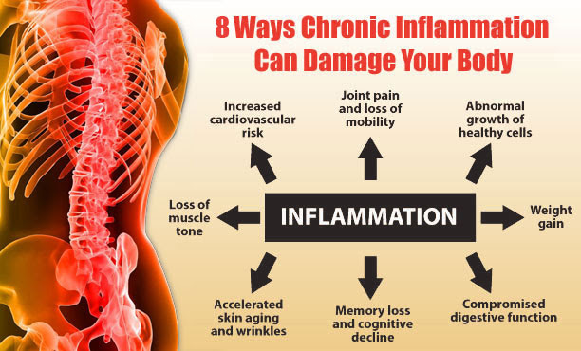

Slide 22
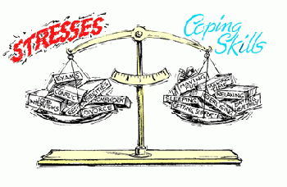

Slide 23
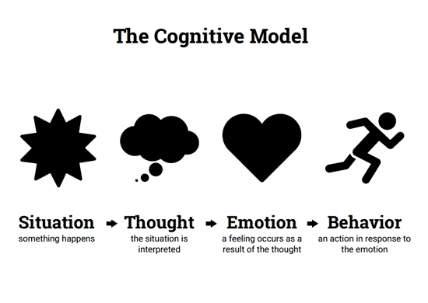

Slide 24
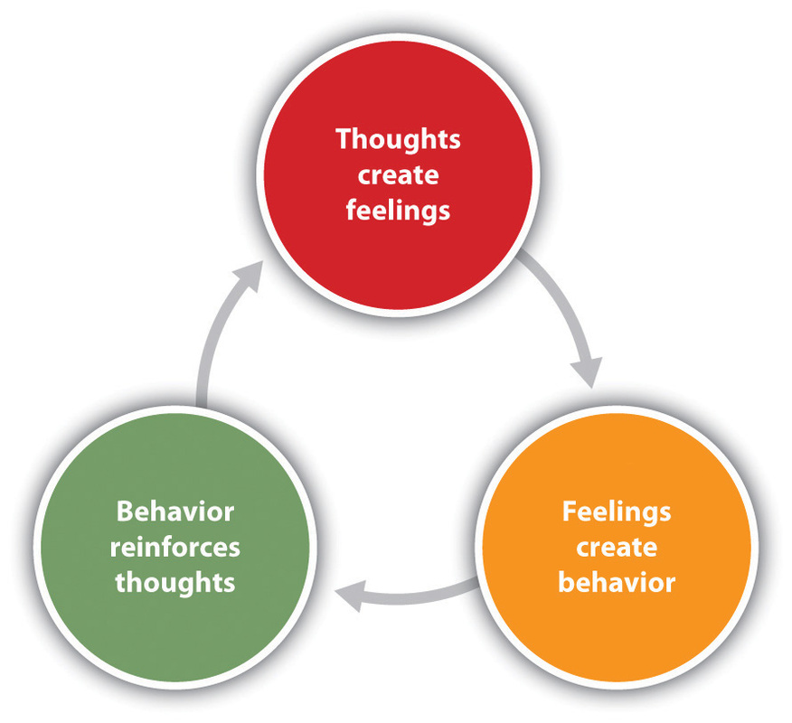

Slide 25
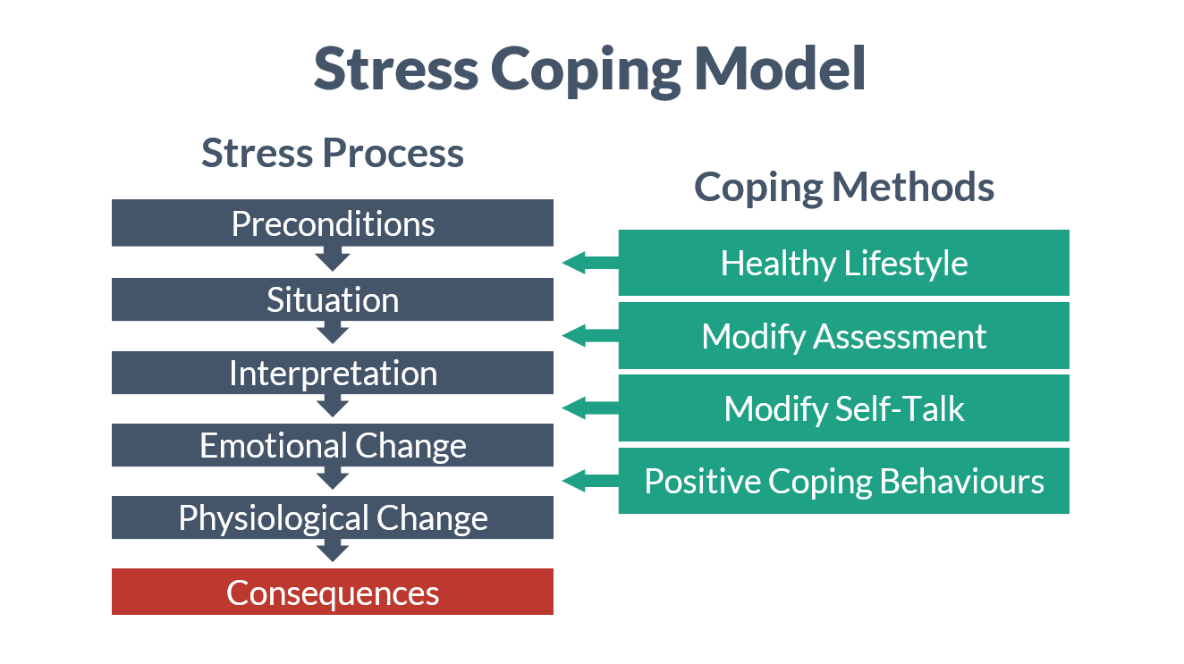

Slide 26
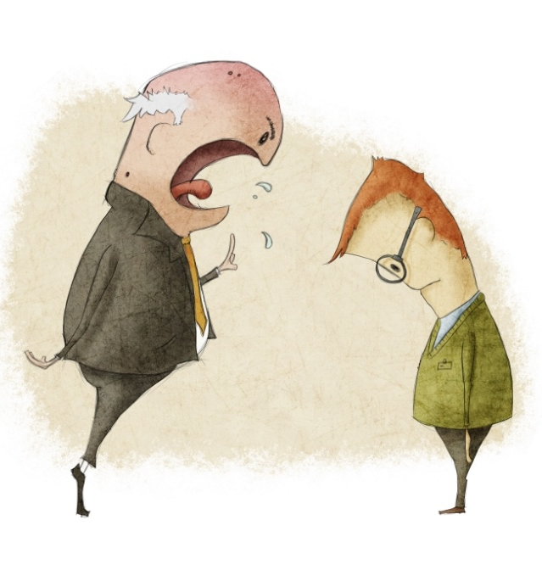

Slide 27
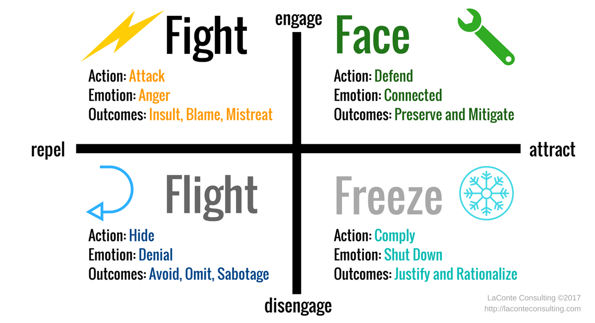

Slide 28
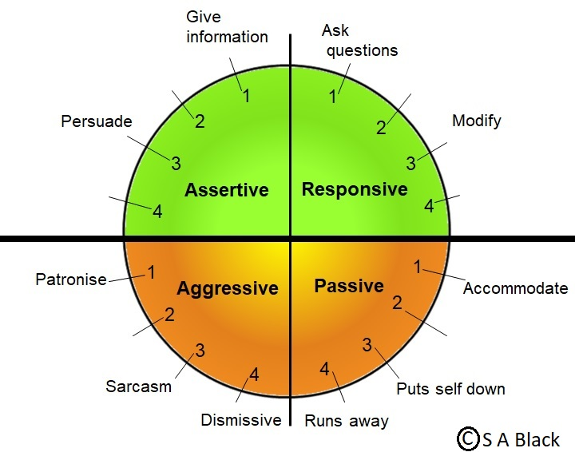

Slide 30
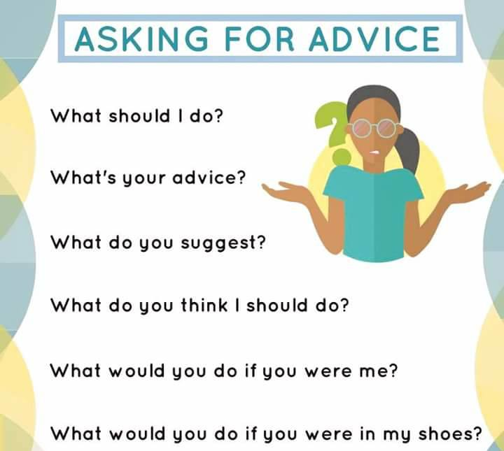

Slide 32
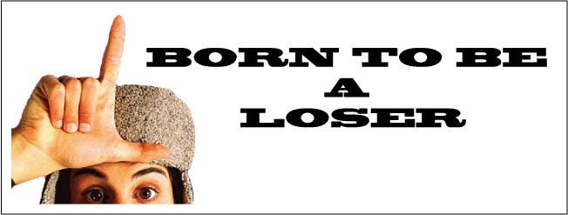
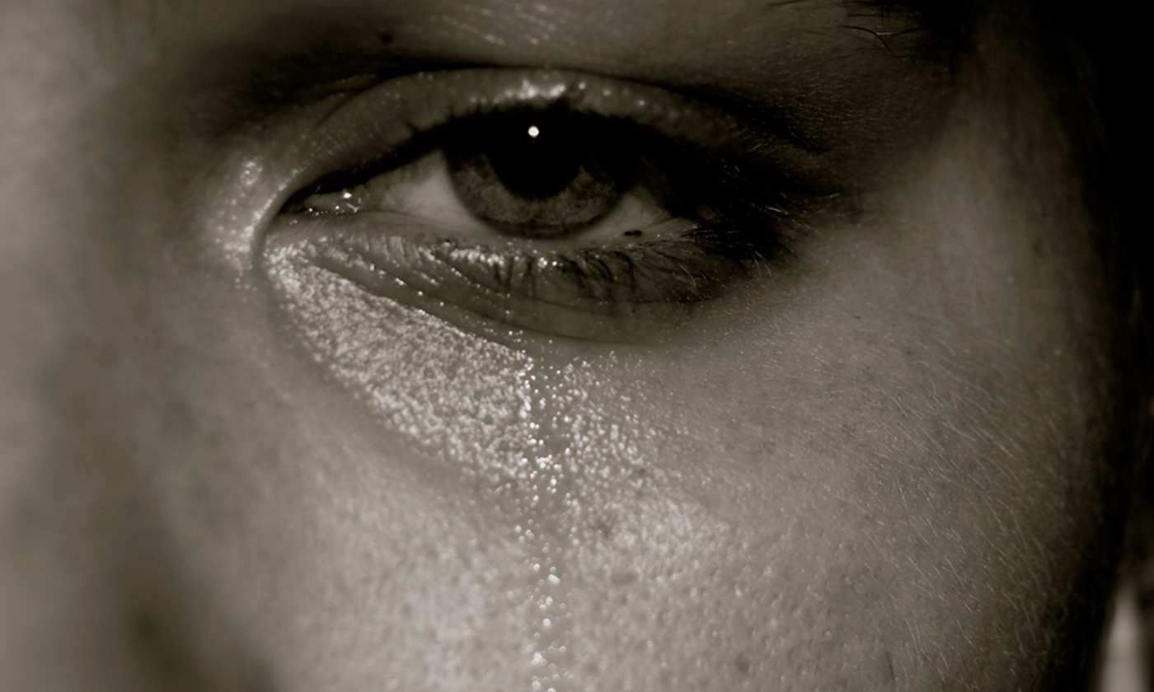
Self perception

Slide 33
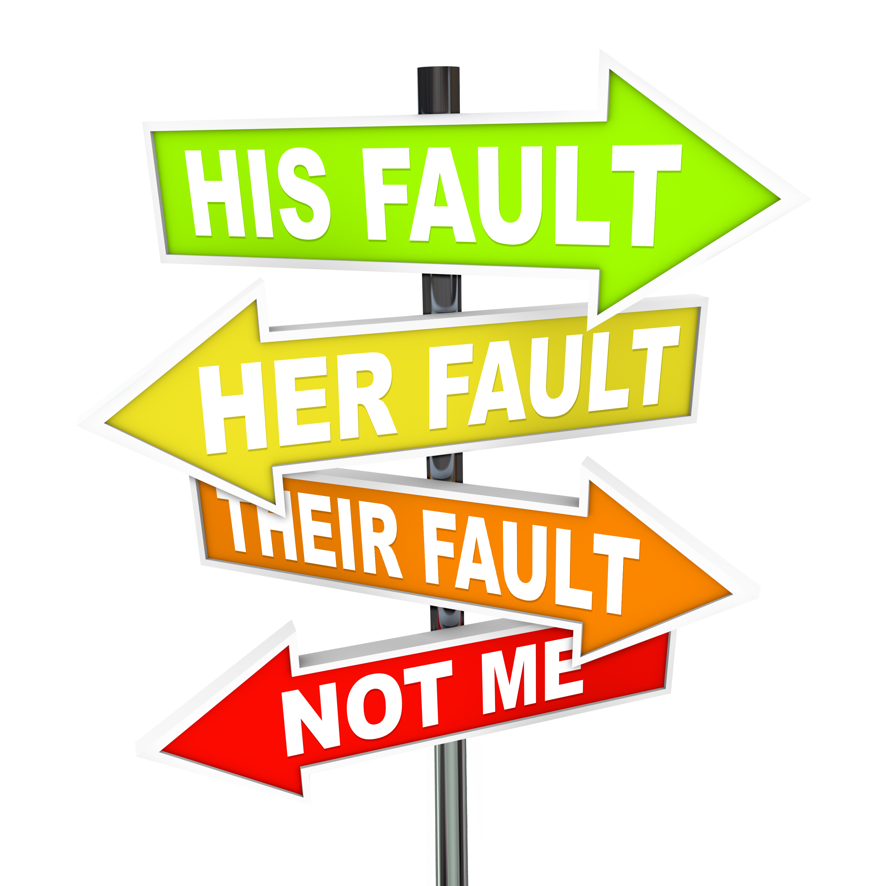

Slide 35
Perception of future life
If….
Will…
May…
What is going to happen…

Slide 38
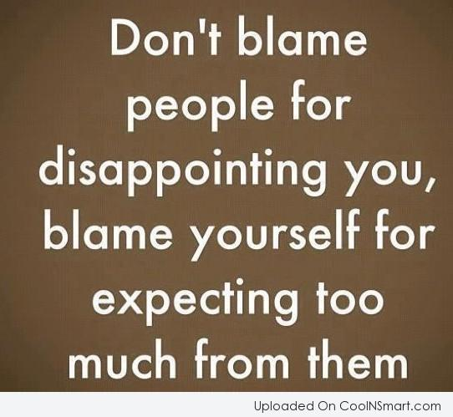

Slide 40
Cognitive restructuring

Slide 41
A | B | C
Stressor | Perception (belief, thoughts) | Feelings
 | Self Others/situation Future

Slide 42
Self perception score

Slide 44
What is the evidence?
Is it really matter?
Am I making errors of thinking?
What are the alternative views?

Slide 51
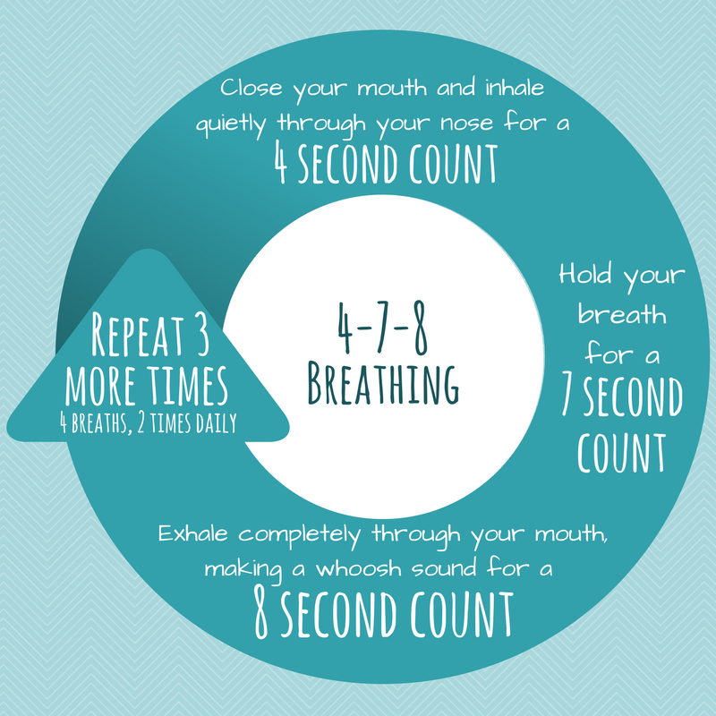
Dr. Weil's Breathing Exercises
Rest your tongue behind
front teeth

Slide 52
