Slide 1
Value Creation in Management Accounting: From Dissemination to Diffusion Dr. Ng Boon Beng PhD, FCCA, FCMA, CGMA, MBA,
Session: 6

Slide 2
Management Accounting
FOCUS
Unlike Financial Accounting, it serves a different purpose.
OBJECTIVE
STRATEGIC CONSIDERATION
EVOLVE WITH TIME
APPLICATION

Slide 3
Contextualizing Terms used
Value Creation
Dissemination
Diffusion
Big Words – have to be in specific context of Management Accounting

Slide 4
Value Creation
Business Drivers
Proactively focusing on measuring business/organization activities using pre-established measurements to evaluate potential monetary benefits, gain, operation efficiency and productivity; with the aim of shifting reactive spending to proactive planned activities so as to derive bigger monetary value from deployment of resources, and to identify effective drivers and measure effectiveness of policies and procedures.
Management accounting helps to establish fundamental measurements and apply technique of measurement on organization / business activities and to proactively determine value drivers for managing business/organization operation.
Process
ROI
Costs and Benefits
KPI
Operation Activities
Effectiveness of Policies and Procedure
Analytic and Reporting
Products and Services
Systems usage

Slide 5
Dissemination
Dissemination is about making defined results available to the management, policy makers and stakeholders.
Analyzed operating insights of the organization in whole or in segment are made available to targeted audiences or specialist group of people for them to take-up and use to confirm ideas, methodology or planned targets, measurements in focus areas.
SITUATIONAL
INTENTIONAL
CIRCUMSTANTIAL
GOALS AND OBJECTIVES DRIVEN

Slide 6
Diffusion
Diffusion often occurs after the disseminated results, ideas, products, methodology, processes, procedures and processes are accepted by the target audiences leading to widespread general acceptance and implementation, which proliferated through specific community or social system in usage.
METHODOLOGY
PROCEDURES
GUIDELINES
PROCESS
SYSTEMS
POLICY

Slide 7
Dissemination vs Diffusion
Dissemination is about exerting conscious effort to spread new knowledge, policies, and practices to target audiences or to the public at large.
Diffusion is the natural spread of ideas.

Slide 8
Sharpening the Management Edge
Management Accounting is essential to support
Policies and regulation implementation
Project Management
Strategy Formulation
Cross Analytics of Qualitative and Quantitative Data
Digital Business Activities
Business Segment Analysis
TQM
Strategic and tactical implementation
Balance Scorecard
KPI
Lean Manufacturing

Slide 9
Profit Centre Management
Implemented 1989 – Computer Company
Objective:
Accountability at Department and Unit level
Driving Revenue target and costs management
Pricing of Computer unit, projects and spares
Re-organised all departments into Profit Centre
New Accounting System and Chart of Accounts

Slide 10
Turnaround Failed Company
Implemented 1996/7 - Consumer Research company
Objective to save the company from bankruptcy
Adding revenue without increasing fixed costs (Activity Based Costing)
Syndicated selling of research info on volume of consumer products sold
Offering free consumers market information (cost/market impact analysis)
KPI implementation: (1) Revenue (2) Profit (3) Employees Satisfaction Score (3) Personal Objectives
Policies, procedures and process change
New systems implementation and revision to chart of accounts
Revenue and Profit Center management (driving ownership mindset)
Revenue doubled, Cash at Bank +RM22m (from -RM12m)

Slide 11
Solved A Management Problem
Situation and problem of a local pastry making co.
Daily contracted orders in fixed quantity are already in planned production schedule.
Ad-hoc orders are the main cause to fluctuation in production activities, which account for 50% total volume.
Initial plan was to increase production capacity by purchasing more machineries.
Implement new inventory module to manage raw materials in store to ensure availability.

Slide 12
Solved A Management Problem
Production lines are running at 70% capacity on a single shift.
Customers orders came via Fax or secured by sales representatives
Takes about 3 days for a confirmed order to reach their production floor. Cos, order will not be processed until payment is received.
Unpredictable timing and fluctuating ad-hoc orders quantity necessitate more than sufficient raw materials are in stores.
Materials suppliers agree to supply materials in smaller quantity, at the same discount, if ordered is placed one to two days in advance.
Intense market competition as products are not unique.
Reputation of timely delivery and best products quality will retain customers

Slide 13
Solved A Management Problem
Confirmed:
More machinery to beef-up production capacity and a new inventory module will not help to solve the problem.
Internal operating environment is delaying production and delivery.
Order were recorded manually and customers; order will not be committed to production until full payment is collected.
Their standalone financial systems could not generate timely financial report for management use.
They are not taking advantage of discount and delivery promises offered by their suppliers.

Slide 14
Solved A Management Problem
Final evaluated solution: An integrated operating environment is needed.
An ERP system linking to an interactive web portal hosting online catalogue and allow online order taking.
The website feed the confirmed orders directly to ERP.
At the point of order confirmation, amount payable is computed and payment is requested.
Invoice is generated online at the point of order confirmation for printing.
Production schedule is automatically updated and ready for products to be made and delivered.
End Result: current production facilities is maintained, and volume of production and deliveries doubled without the need of more machineries.

Slide 15
KPI Implementation
KPI implementation – sustaining school revenue, teachers productivity, improving school results
Introducing Management Philosophy (performance driven)
Key focus areas identified (drivers)
Reward for beyond targets performance (recognition)
Activities Based mindset (ownership)
New systems to support KPI implementation
New policies, process and procedures (enforce acceptance)

Slide 16
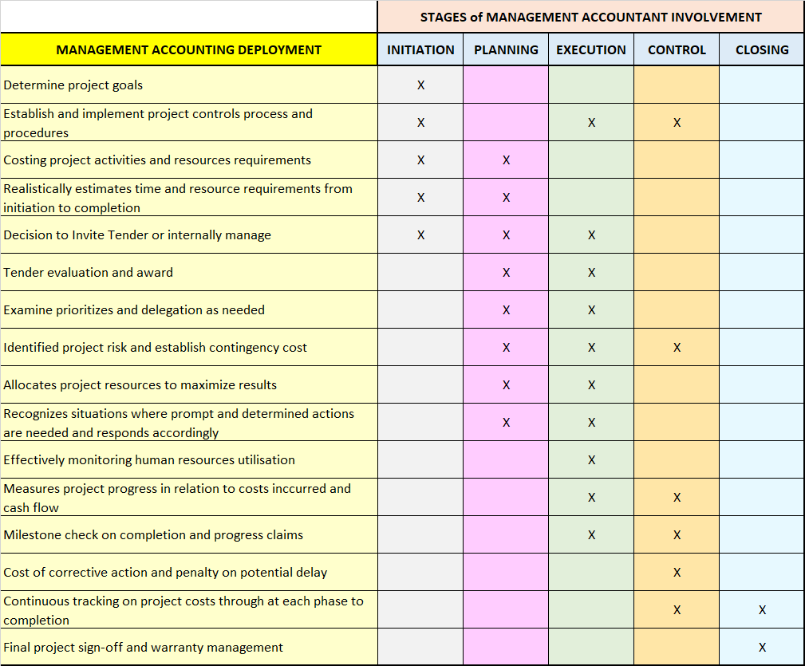
Accounting for Project Implementation

Slide 17
Sharpened the Management Edge
Evaluate efficiency of policy, procedures and internal processes
Capital and Resources allocation in complex operating environment
Coordinating diverse business activities, directing strategy.
Budgetary planning and controls to manage organisation activities of divisions, departments and units were congruent to overall goals.
Measure return on investment and ascertain success of operation.
Devised effective systems of transfer pricing as fair basis to account for profits between divisions.
Creatively manage project success, new product launch, etc.

Slide 18
SUMMARY
In order for Management Accounting to create value and serve the organization purpose of dissemination and ultimate diffusion, the organization need to have:-
Clarity of goals and objectives
Fair and operable policies, procedures, and guidelines
Efficient systems; capturing data at source, providing single truth with analytics capabilities
Management Accountants with digital mindset

Slide 19
Evolution of Management Accounting
Prior to 1950, focus on cost determination and financial control, through the use of budgeting and cost accounting technologies.
By 1965, shifted to provision of information for management planning and control.
By 1985, attention was on reduction of waste in resources used in business processes, through the use of process analysis and cost management technologies.
By 1995, shifted to generation or creation of value through the effective use of resources, through the use of technologies, which examine the drivers of customer value, shareholder value and organizational innovation.

Slide 20
Progressing with Time (1)
Year 2000 and beyond, fundamental shift in economic activity leading to a new wave of innovation in management accounting.
Information and Knowledge as a source of competitive advantage.
New skills and capabilities demanded on professional management accountant
Year 2005, technology is driving knowledge economy as key pillars of rapid change.
Global reach of Internet and its universal adoption is creating new businesses and transforming traditional sectors.

Slide 21
Progressing with Time (2)
Year 2010, Globalization, free flow of money and information has shrunk the world.
Global marketing to homogenize consumer behaviour.
Outsourcing and centralized information processing enable information to be disseminated cheaply across the globe quickly.
Sprouting competition and blurring of traditional industry boundaries with the emergence of new business sectors.
Insights as the key driver of competitive advantage.

Slide 22
Progressing with Time (3)
Year 2013, Data, information and knowledge as strategic digital competitive tools.
Big data, unstructured qualitative information
Correlate financial and non-financial data for reporting
Use of analytics to effectively guide management decisions.
Evaluate existing capabilities to identify strategic differentiators via usage of analytic tools and management accounting techniques.

Slide 23
Progressing with Time (4)
Year 2016, acceleration of digital revolution and extensive usage of cloud-computing, digitalization, block chain, Fintech, etc., among others have reformed business transactions.
Bridging between digital business activities and firm value is knowledge management.
All sectors (public and private) are stimulated by the new digital mechanisms that are driving digital transformation.

