Slide 1



From Zero to Billions of Views
My Social Media Journey
Pinn Yang
Co-Founder and CEO
Foodie Media

Slide 2

Started in 2016

Slide 3
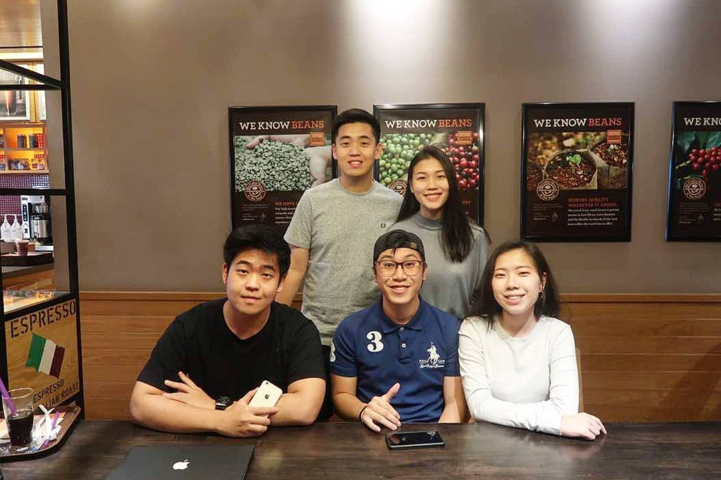
3 Co-Founders and 2 Interns

Slide 4


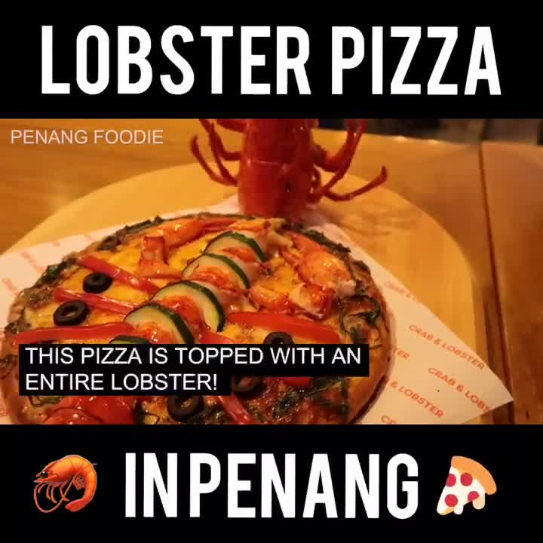

Evolution of Videos

Slide 5
From 1 Page
To

Slide 6





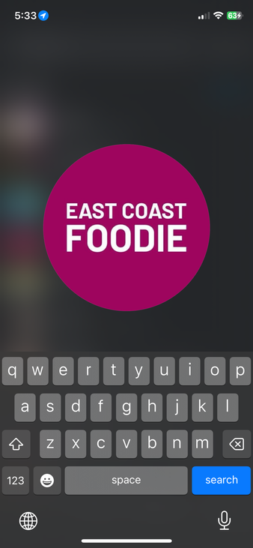










From 1 Page
To
15+ Cities Across SEA

Slide 7
Food Was Just the Beginning

Slide 8














Food
Property
Travel & Discovery
Car
Tech
Sports
Editorial
Lifestyle
Shopping

Slide 9






































Our Numbers
801 Million+
Woow !
33 Million+
Monthly video views across all our social media
290 Million+
Followers across all our social media
139 Thousand+
17.8 Million +
Monthly reach across all our social media
7.7 Million +
6.8Million +
Monthly article reads across our website
446K +
85 K +

Slide 10
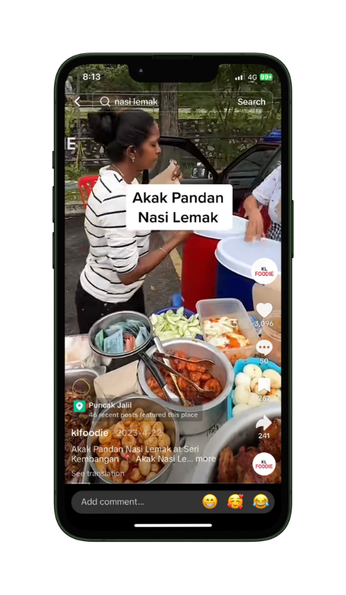

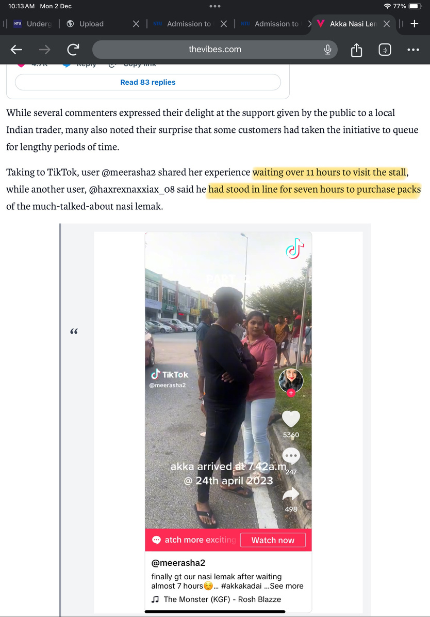

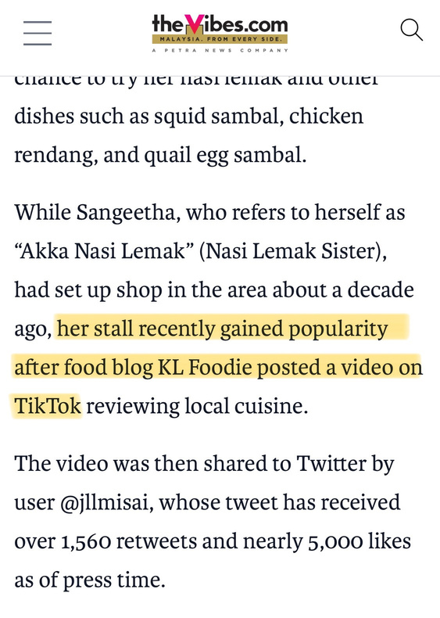
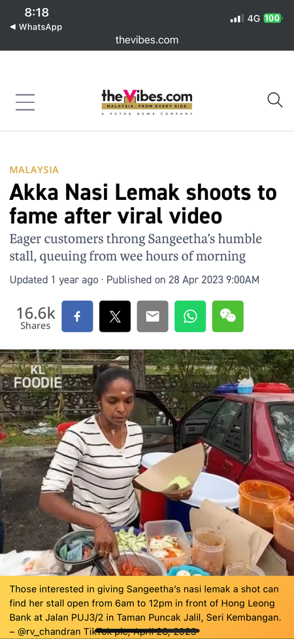

Case Study
The Shop That Went Viral Overnight
5.4m
193k
Views
Likes

Slide 11
We didn't stop at Content

Slide 12
4C's
Content . Commerce . Creator .Community

Slide 13


Slide 14
Personal Brand

Slide 15

Started in 2023

Slide 16
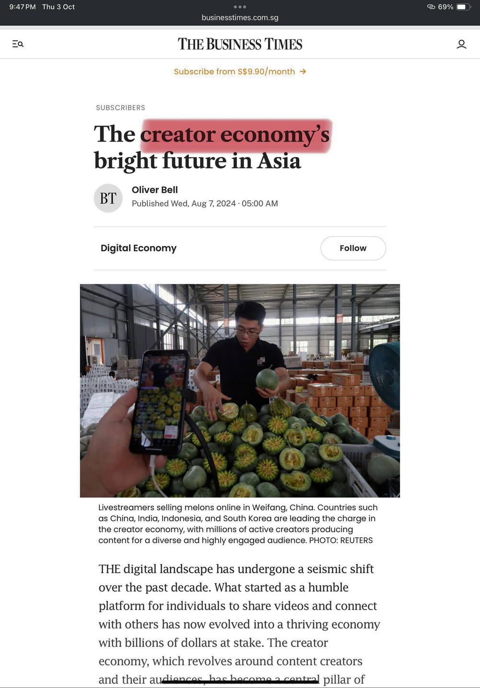
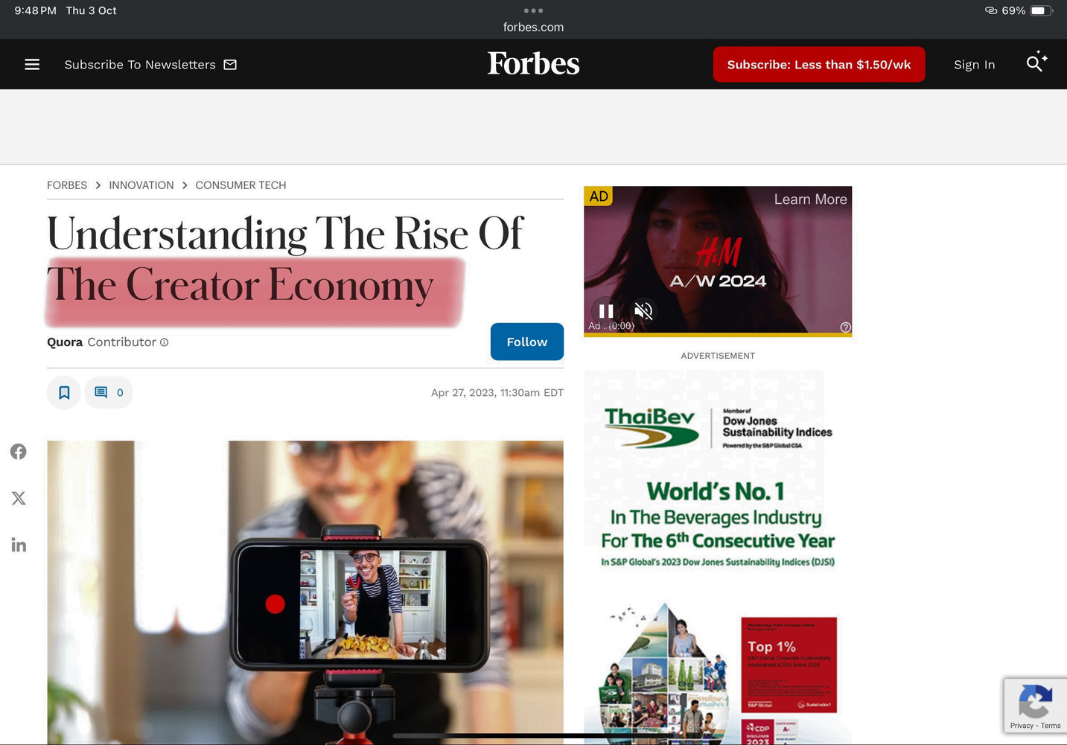
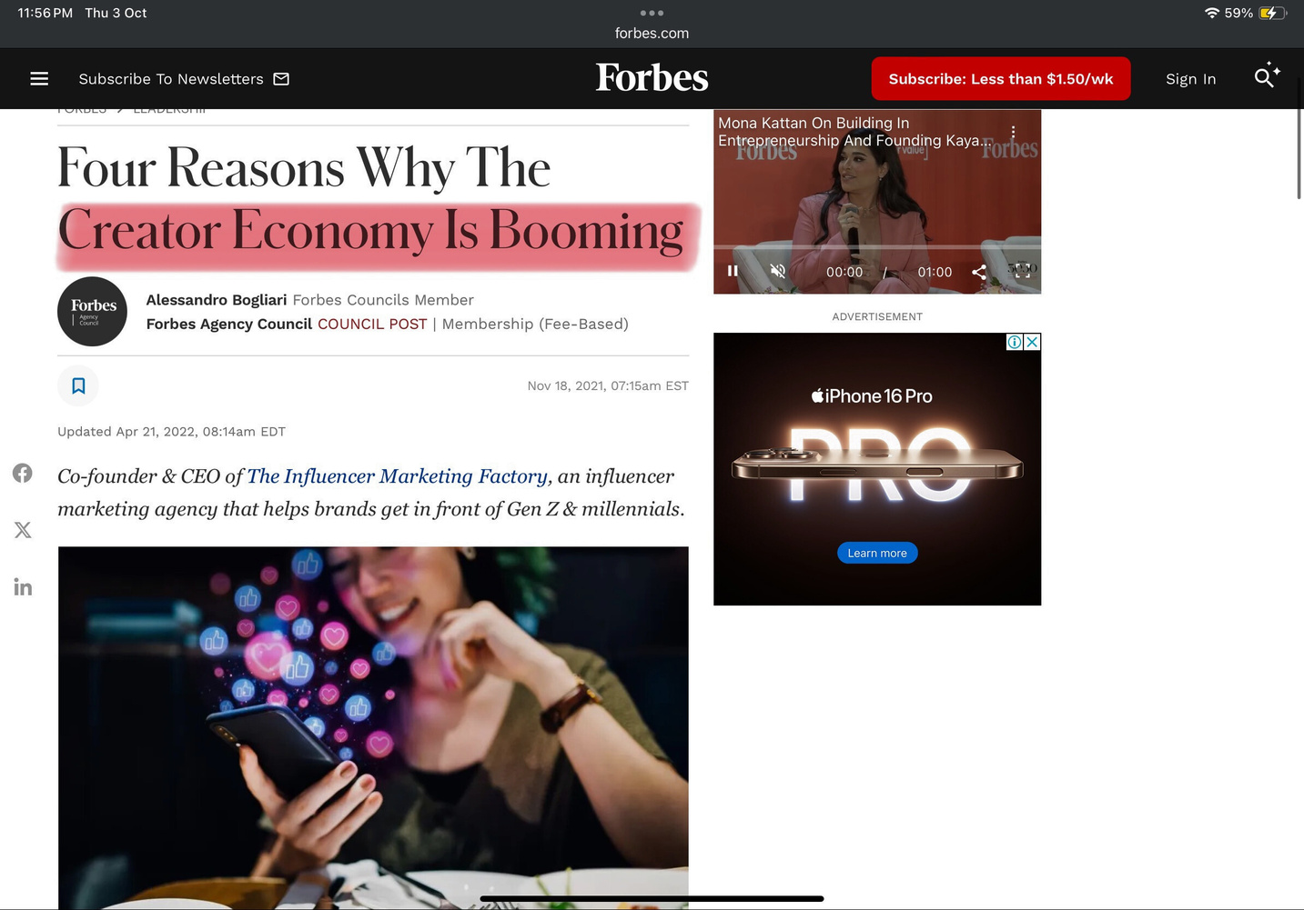
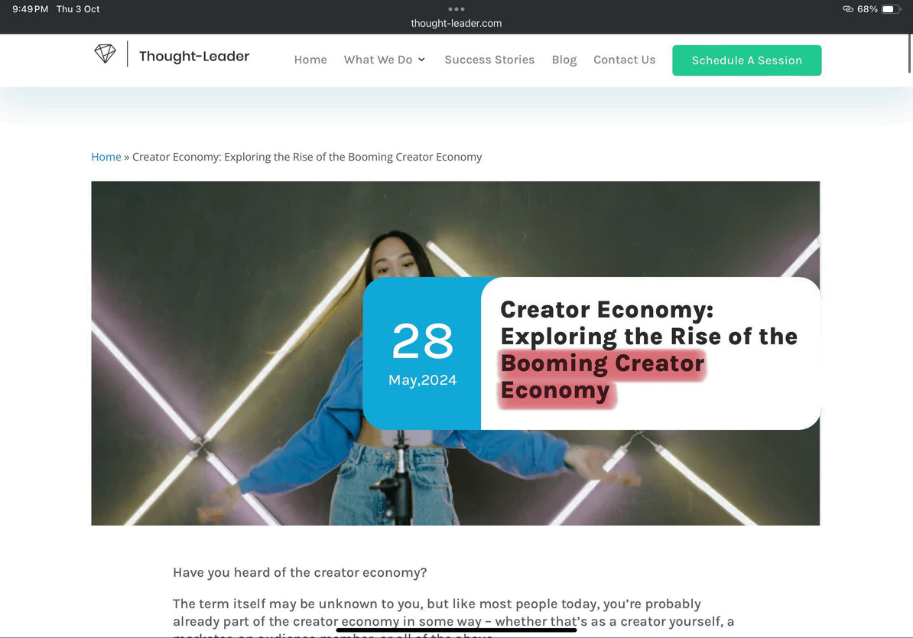
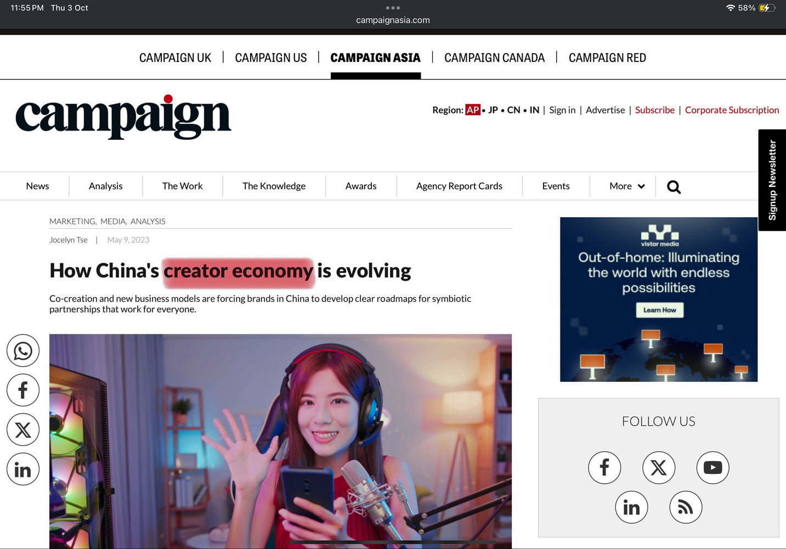
The Rise of Creator Economy

Slide 17
Creator Economy
250 Billion USD
500 Billion USD
2024 Market Size
2027 Expected Market Size
*A study by Goldman Sachs

Slide 18
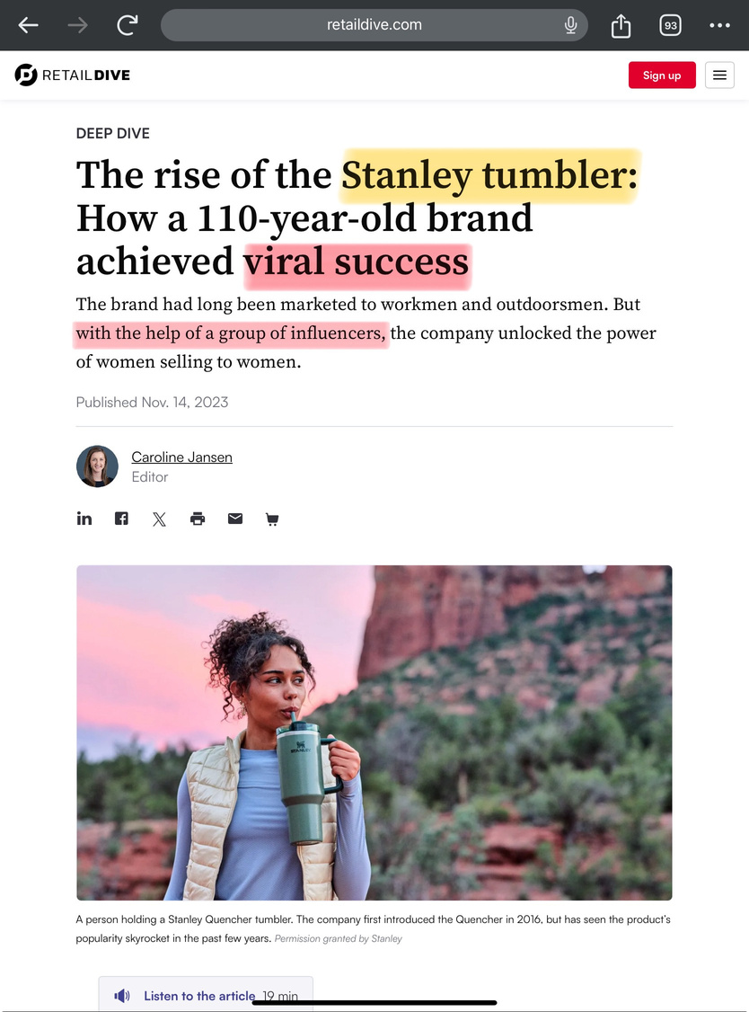
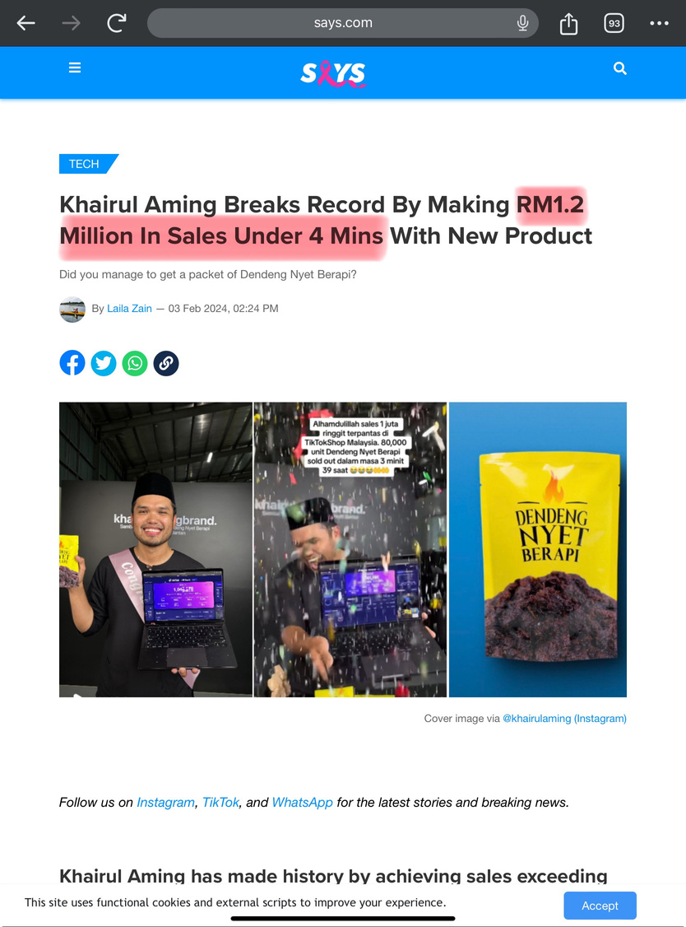
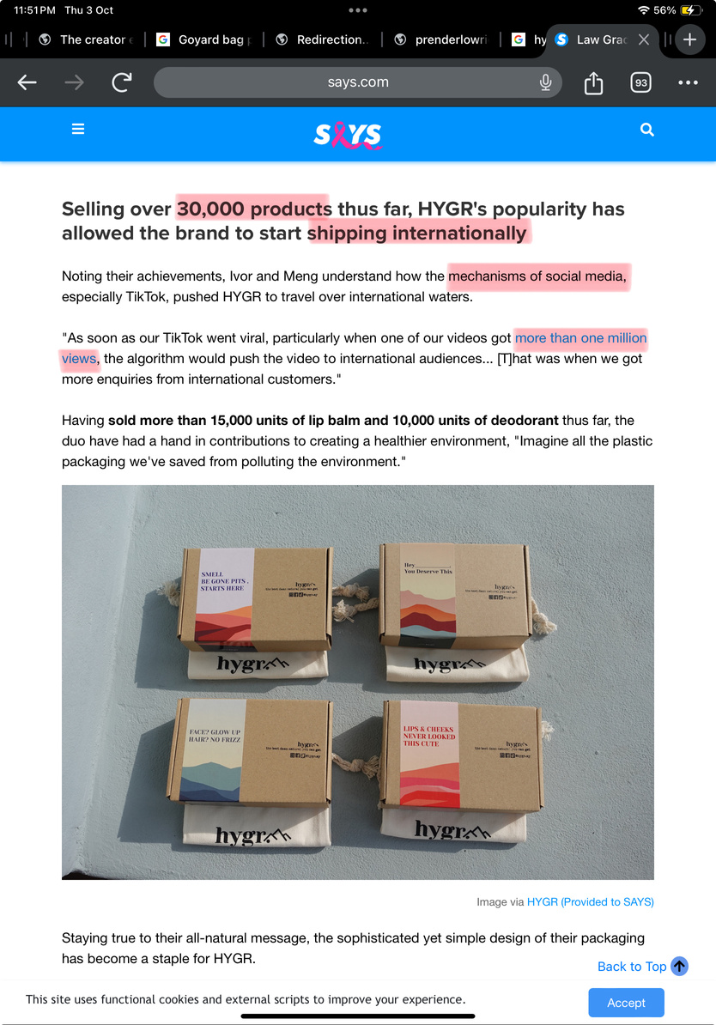
Brands thriving through Creators
Khairul Aming Dendeng Nyet Berapi
HYGR Lip Balm & Deodorant
Stanley Tumbler

Slide 19
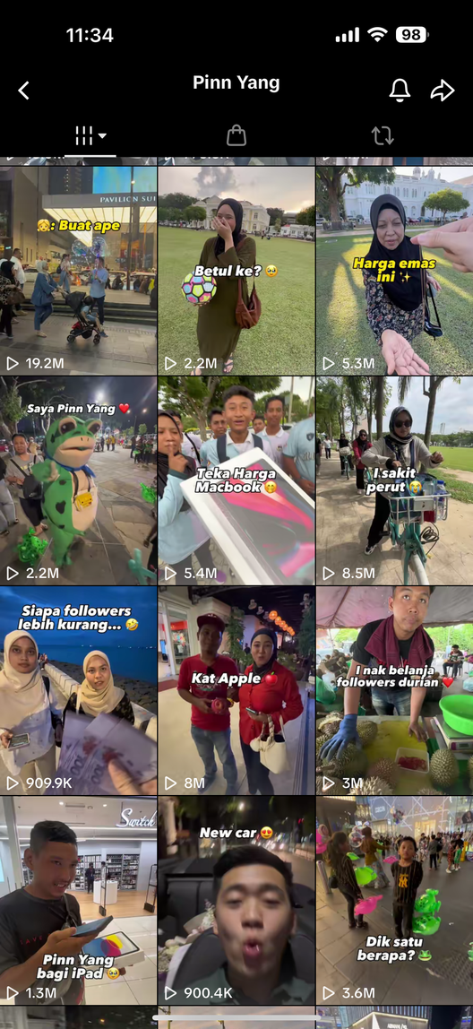
Consistency
Everyday 1 Content

Slide 20
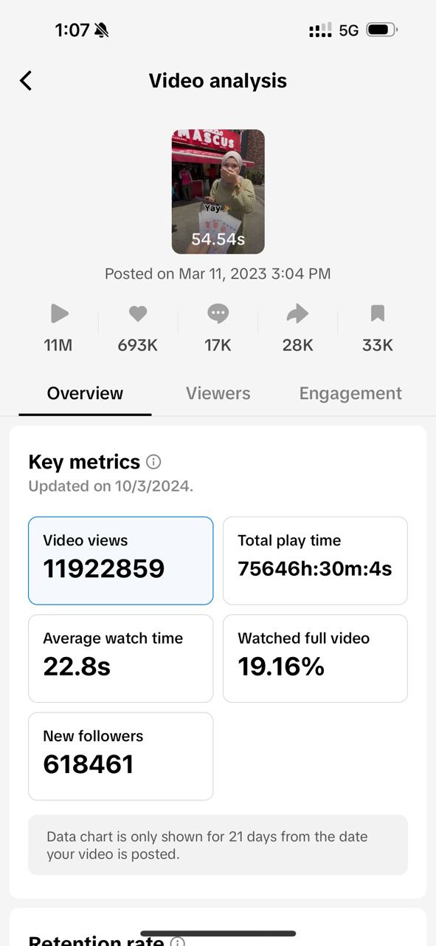

618 Thousand
New Followers

Slide 21
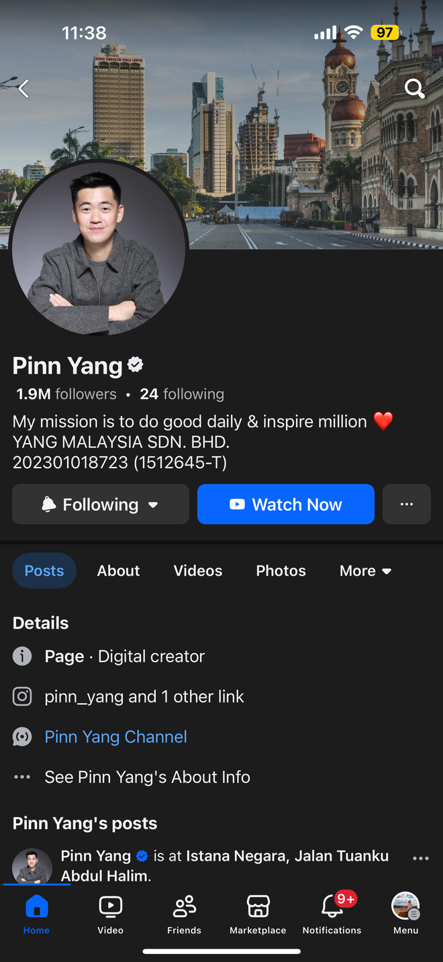
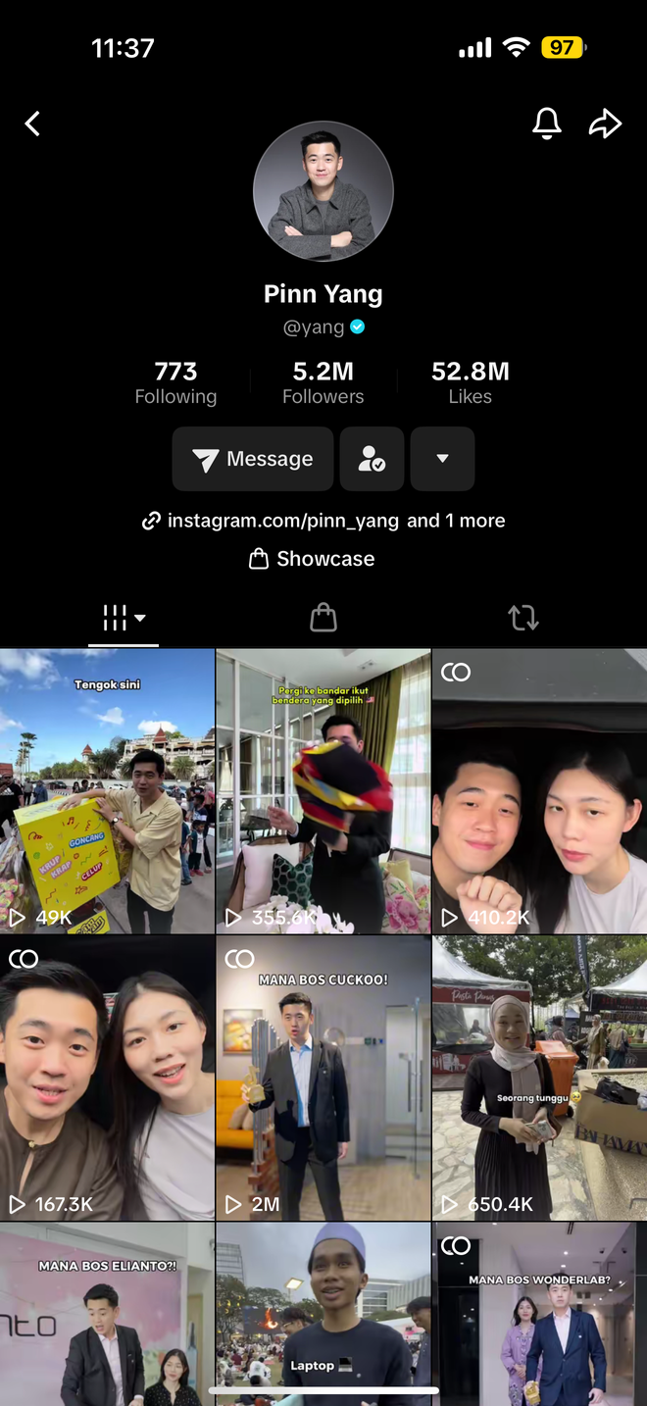

Pinn Yang
8 million followers

Slide 22
Thank you!

